Slide 1
Unit 6: Application of Probability
Vocabulary Builder

Slide 2
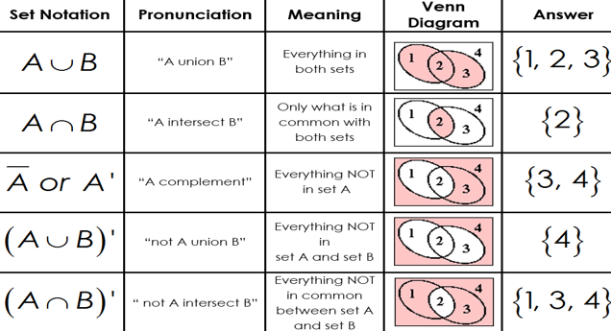

Slide 3
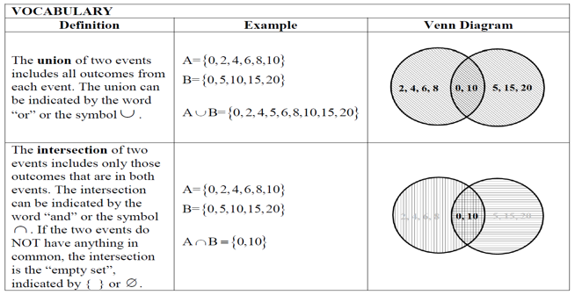

Slide 4
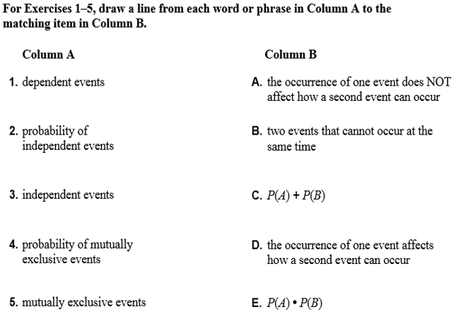

Slide 5
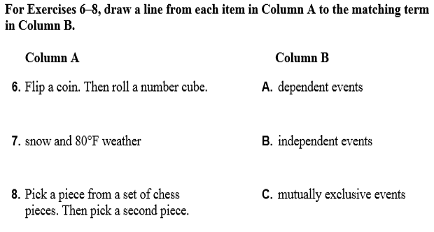

Slide 6
Unit 6: Application of Probability
6.1 Theoretical vs. Experimental
Probability and Venn Diagrams

Slide 7
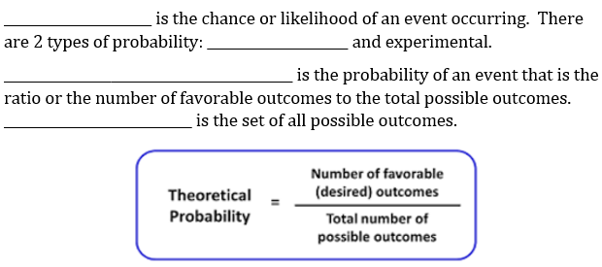
6.1 – Theoretical vs. Experimental Probability and Venn Diagrams
Probability
theoretical
Theoretical Probability
Sample space

Slide 8
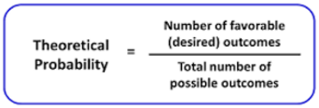
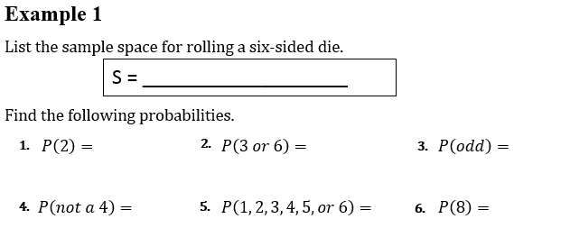
6.1 – Theoretical vs. Experimental Probability and Venn Diagrams
{1, 2, 3, 4, 5, 6}
$$\frac{1}{6}$$
$$\frac{2}{6}=\frac{1}{3}$$
$$\frac{3}{6}=\frac{1}{2}$$
$$\frac{5}{6}$$
$$\frac{6}{6}=1$$
$$\frac{0}{6}=0$$

Slide 9
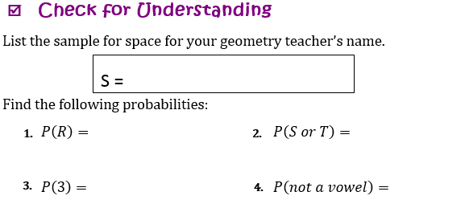
{M, R, S, S, A, I, L, O, R}
$$\frac{2}{9}$$
$$\frac{2}{9}$$
$$\frac{0}{9}=0$$
$$\frac{6}{9}=\frac{2}{3}$$

Slide 10
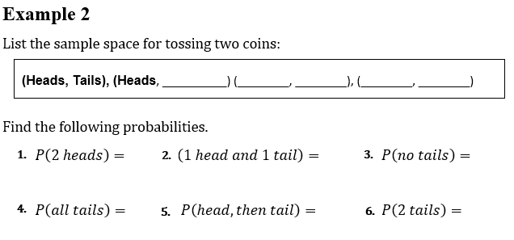
6.1 – Theoretical vs. Experimental Probability and Venn Diagrams
Heads
Tails
Tails
Tails
Heads
$$\frac{1}{4}$$
$$\frac{2}{4}=\frac{1}{2}$$
$$\frac{1}{4}$$
$$\frac{1}{4}$$
$$\frac{1}{4}$$
$$\frac{1}{4}$$

Slide 11
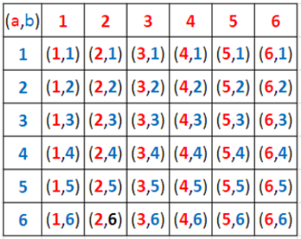
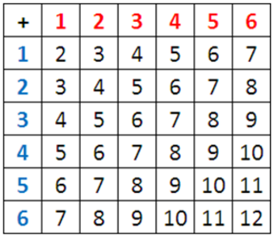
$$\frac{2}{36}=\frac{1}{18}$$
$$\frac{1}{36}$$
$$\frac{5}{36}$$
$$\frac{1}{36}$$
$$\frac{6}{36}=\frac{1}{6}$$
$$\frac{0}{36}=0$$

Slide 12
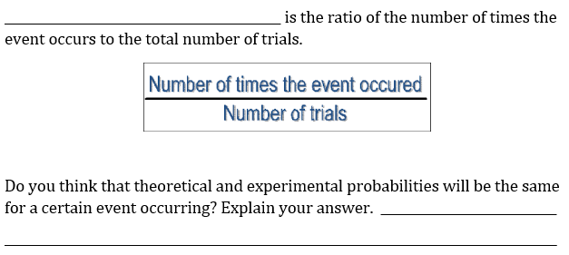
6.1 – Theoretical vs. Experimental Probability and Venn Diagrams
Experimental Probability
Yes. The more trials you
do, the closer your experimental probability will be to your theoretical probability.

Slide 13
6.1 – Theoretical vs. Experimental Probability and Venn Diagrams

Slide 15
6.1 – Theoretical vs. Experimental Probability and Venn Diagrams
$$\frac{9}{30}=\frac{3}{10}=0.3$$
$$\frac{13}{52}=\frac{1}{4}=0.25$$
$$\frac{18}{30}=\frac{3}{5}=0.6$$
$$\frac{26}{52}=\frac{1}{2}=0.5$$

Slide 16
Unit 6: Application of Probability
6.2 Set Notation and Venn diagrams

Slide 17
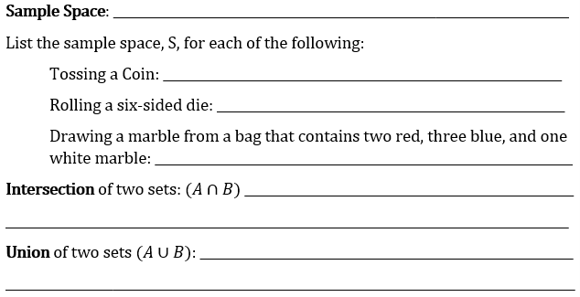
6.1 – Theoretical vs. Experimental Probability and Venn Diagrams
LIST OF ALL POSSIBLE OUTCOMES
{HEAD, TAIL}
{1, 2, 3, 4, 5, 6}
{RED, RED, BLUE, BLUE, BLUE, WHITE}
THE OVERLAPPING OF ELEMENTS FROM
2 SETS; “THE COMMON ELEMENTS”
COMBINING THE ELEMENTS TO CREATE
ONE SET

Slide 18
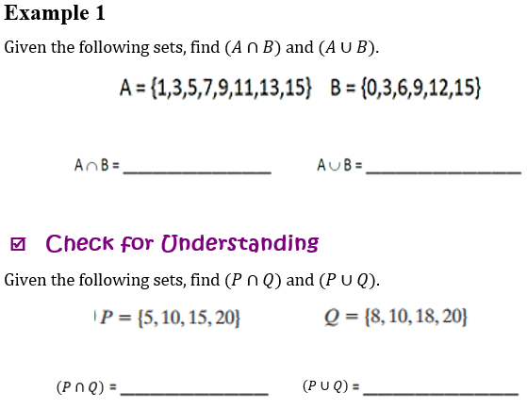
6.1 – Theoretical vs. Experimental Probability and Venn Diagrams
4
{3, 9, 15}
{0,1, 3, 5, 6, 7, 9, 11, 12, 13, 15}
{10, 20}
{5, 8, 10, 15, 18, 20}

Slide 19
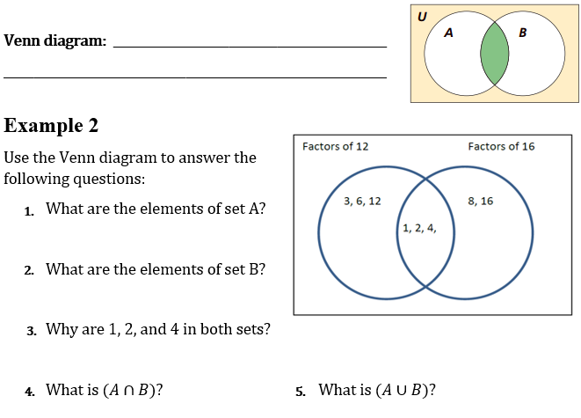
6.1 – Theoretical vs. Experimental Probability and Venn Diagrams
A VISUAL REPRESENTATION OF THE
RELATIONSHIP BETWEEN TWO OR MORE SETS
5
{1, 2, 3, 4, 6, 12}
{1, 2, 4, 8, 16}
They are factors of both 12 and 16
{1, 2, 4}
{1, 2, 3, 4, 6, 8, 12, 16}

Slide 20
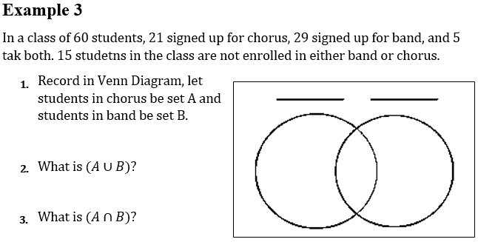
6.1 – Theoretical vs. Experimental Probability and Venn Diagrams
6
Chorus
Band
16
5
24
45
15
5

Slide 21
6.1 – Theoretical vs. Experimental Probability and Venn Diagrams
Example 7
Factors of 64
Factors of 24
{1, 2, 4, 8, 16, 32, 64}
3, 6, 12, 24
16, 32, 64
1,2, 4 8
{1, 2, 3, 4, 6, 8, 12, 24}
3
6
13
2
48
24

Slide 22
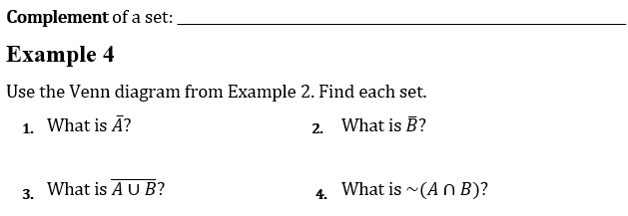
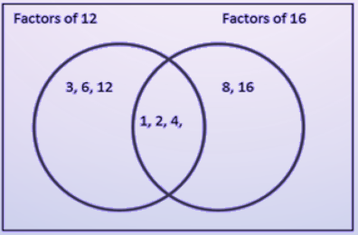
6.1 – Theoretical vs. Experimental Probability and Venn Diagrams
All outcomes in the sample space that are not part of the subset.
7
Example 8
{8, 16}
{3, 6, 12}
{$∅$}
{3, 6, 8, 12, 16}

Slide 23
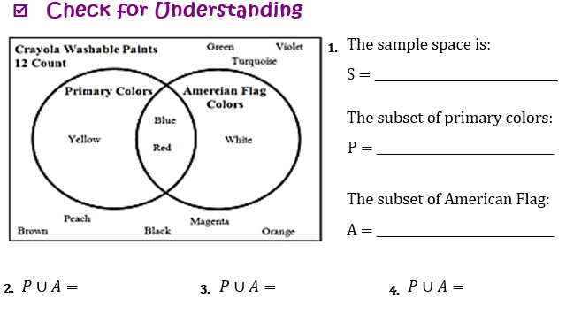
6.1 – Theoretical vs. Experimental Probability and Venn Diagrams
Example 9
{Y,B,R,W,G,T,V,B,P,B,M,O}
{Y,B,R}
{B,R,W}
{Y,B,R,W}
{B,R}
{G,V,T,B,P,B,M,O}

Slide 24
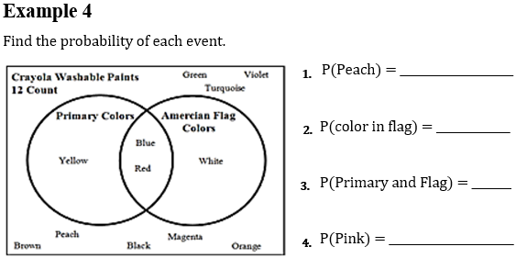
6.1 – Theoretical vs. Experimental Probability and Venn Diagrams
Example 9
$$\frac{1}{12}$$
$$\frac{3}{12}$$
$$=\frac{1}{4}$$
$$\frac{2}{12}$$
$$=\frac{1}{6}$$
$$\frac{0}{12}=0$$

Slide 26
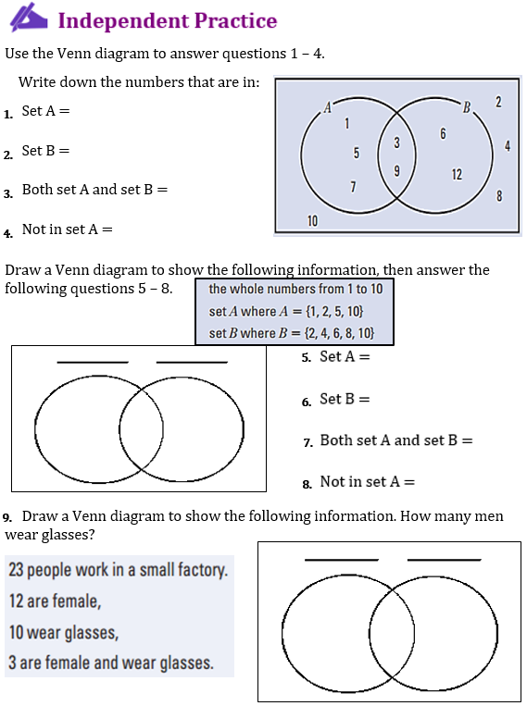

Slide 27
Unit 6: Application of Probability
6.2 Mutually Inclusive & Mutually Exclusive Events

Slide 28
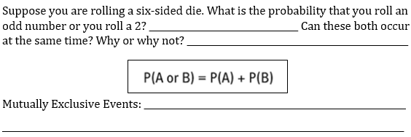
6.2 – Mutually Inclusive & Mutually Exclusive Events
ODD = {1, 3,5} ROLL 2 = {2}
NO, THERE IS NO OVERLAP
TWO EVENTS THAT CANNOT OCCUR
AT THE SAME TIME

Slide 29
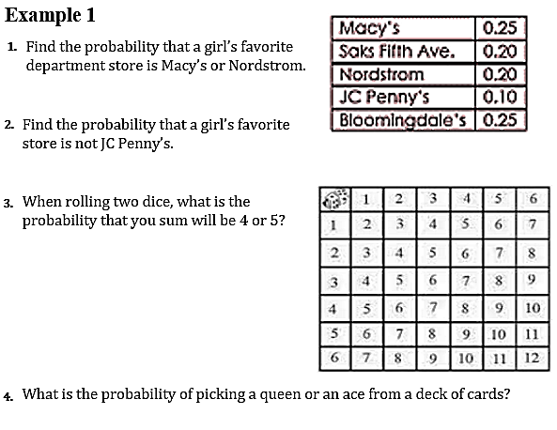
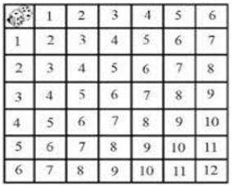
6.2 – Mutually Inclusive & Mutually Exclusive Events
0.25 + 0.20
= 0.45
0.25 + 0.20 + 0.20 + 0.25
= 0.90
1 – 0.10
= 0.90
$$\frac{3}{36}+\frac{4}{36}$$
$$=\frac{7}{36}$$
$$\frac{4}{52}+\frac{4}{52}$$
$$=\frac{8}{52}=\frac{2}{13}$$

Slide 30
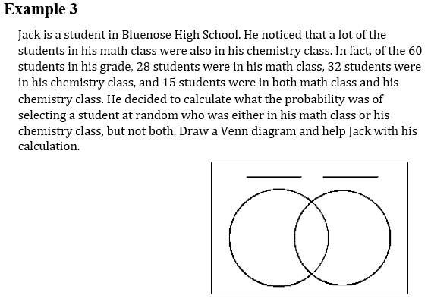
6.2 – Mutually Inclusive & Mutually Exclusive Events
Example 2
Math
Chemistry
$$\frac{13}{60}+\frac{17}{60}$$
$$=\frac{30}{60}=\frac{1}{2}$$
13
15
17
15

Slide 31
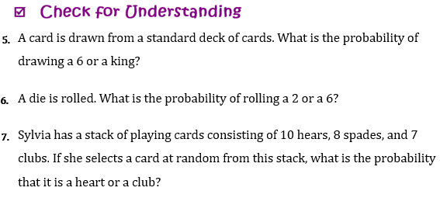
$$\frac{4}{52}+\frac{4}{52}$$
$$=\frac{8}{52}=\frac{2}{13}$$
$$\frac{1}{6}+\frac{1}{6}$$
$$=\frac{2}{6}=\frac{1}{3}$$
$$\frac{10}{25}+\frac{7}{25}$$
$$=\frac{17}{25}$$

Slide 32
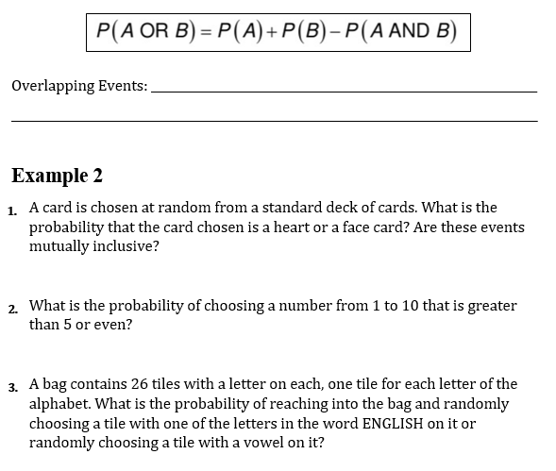
6.2 – Mutually Inclusive & Mutually Exclusive Events
THE PROBABILITY THAT EITHER OF THE EVENTS
OCCUR IS THE SUM OF THE PROBABILITIES OF THE EVENTS MINUS THE PROBABILITY THAT BOTH EVENTS OCCUR
Example 3
$$\frac{13}{52}+\frac{12}{52}−\frac{3}{52}$$
$$=\frac{22}{52}=\frac{11}{26}$$
$$\frac{5}{10}+\frac{5}{10}−\frac{3}{10}$$
$$=\frac{7}{10}$$
$$\frac{7}{26}+\frac{5}{26}−\frac{2}{26}$$
$$=\frac{10}{26}=\frac{5}{13}$$

Slide 33
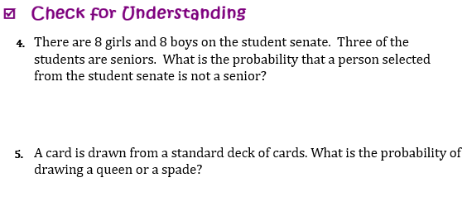
$$\frac{8}{16}+\frac{8}{16}−\frac{3}{16}$$
$$=\frac{13}{16}$$
$$\frac{4}{52}+\frac{13}{52}−\frac{1}{52}$$
$$=\frac{16}{52}=\frac{4}{13}$$

Slide 34
6.2 – Mutually Inclusive & Mutually Exclusive Events
Example 4
$$\frac{32}{71}+\frac{25}{71}−\frac{4}{71}$$
$$=\frac{53}{71}$$
$$\frac{71}{71}−\frac{53}{71}$$
$$=\frac{18}{71}$$

Slide 36
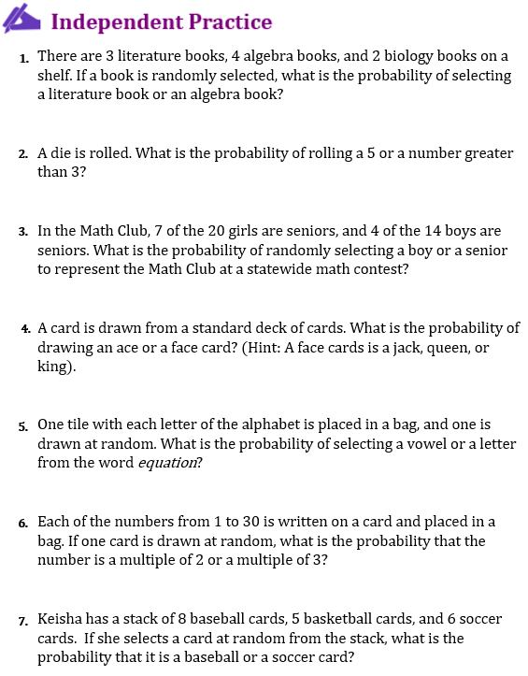

Slide 37
Unit 6: Application of Probability
6.3 Independent and Dependent events

Slide 38
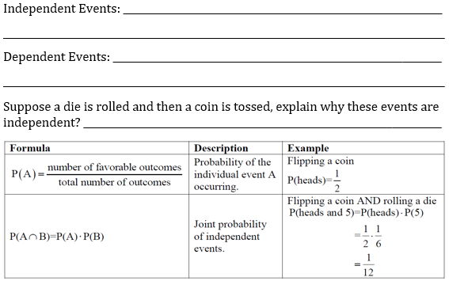
THE OCCURRENCE OF ONE EVENT DOES NOT AFFECT
HOW A SECOND EVENT CAN OCCUR
THE OCCURRENCE OF ONE EVENT AFFECTS
HOW A SECOND EVENT CAN OCCUR
COIN TOSS DOES NOT DEPEND ON THE DIE ROLL

Slide 39
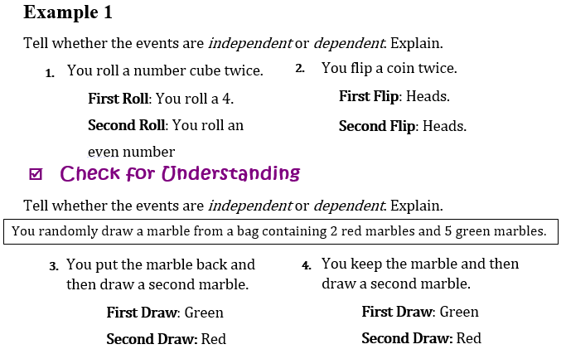
INDEPENDENT
INDEPENDENT
INDEPENDENT
DEPENDENT

Slide 41
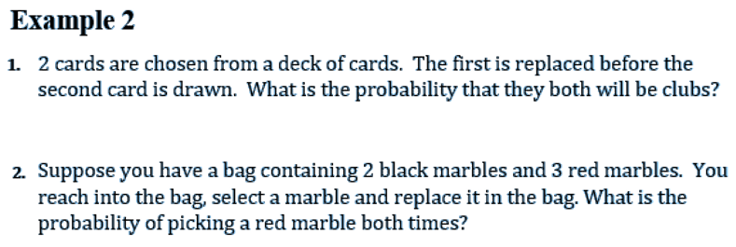
$$\frac{13}{52}∙\frac{13}{52}$$
$$=\frac{1}{16}$$
$$\frac{3}{5}∙\frac{3}{5}$$
$$=\frac{9}{25}$$

Slide 42
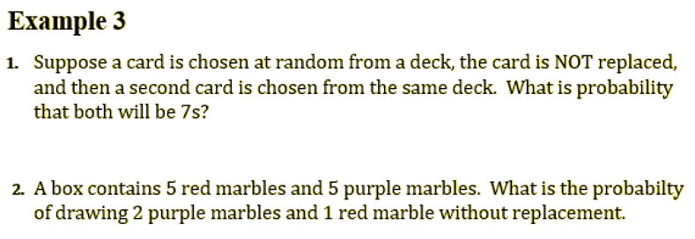
$$\frac{4}{52}∙\frac{3}{51}$$
$$=\frac{1}{221}$$
$$\frac{5}{10}∙\frac{4}{9}∙\frac{5}{8}$$
$$=\frac{5}{36}$$

Slide 43
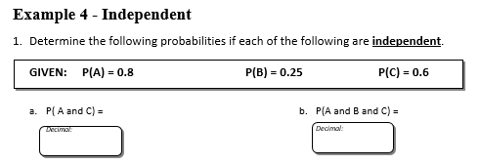
0.48
0.12
P(A) x P(C) =
(0.8)(0.6)
P(A) x P(B) x P(C) =
(0.8)(0.25)(0.6)

Slide 44
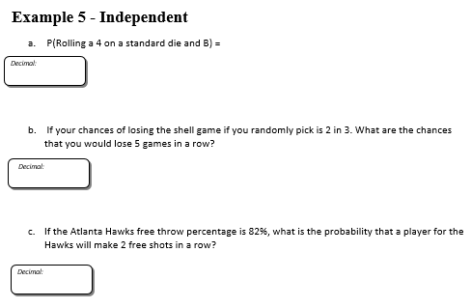
0.041$\overline{6}$
$$\frac{1}{6}∙(0.25)$$
0.1317
$\frac{2}{3}∙\frac{2}{3}∙\frac{2}{3}∙\frac{2}{3}∙\frac{2}{3}$
0.6724
$$(0.82)(0.82)$$

Slide 45
$$\frac{11}{18}$$
$$∙\frac{10}{17}$$
$$∙\frac{9}{16}$$
$$= \frac{55}{272}$$
$$=0.2022$$
$$=20.22\%$$

Slide 46
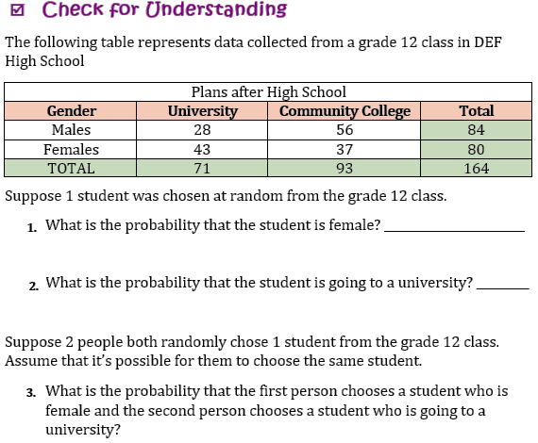
$$\frac{80}{164}=\frac{20}{41}$$
$$\frac{71}{164}$$
$$\frac{80}{164}∙\frac{71}{164}$$
$$=\frac{2840}{13448}$$

Slide 47
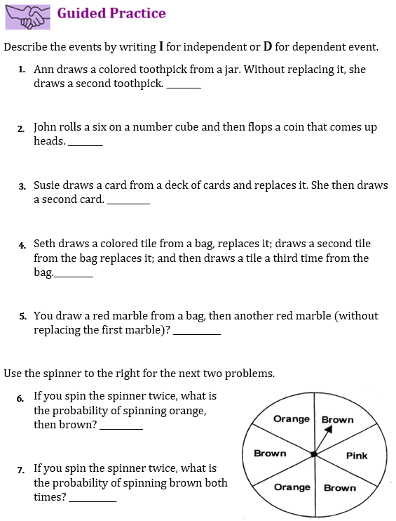

Slide 48
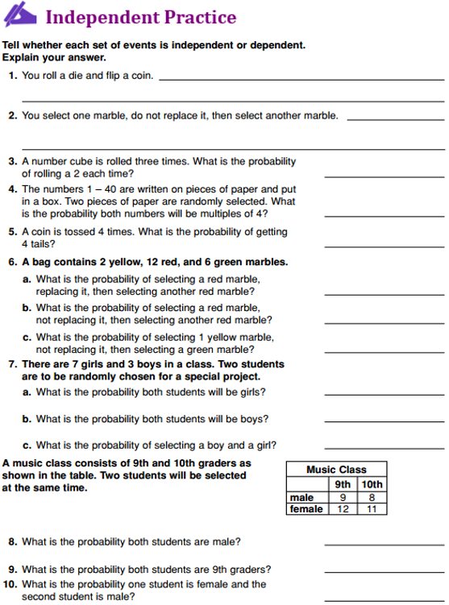

Slide 49
Unit 6: Application of Probability
6.4 Conditional Events and Frequency Tables

Slide 50
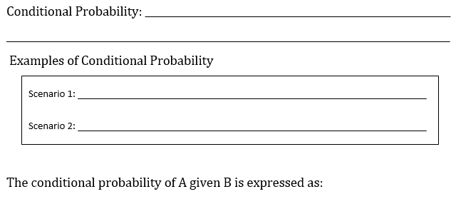
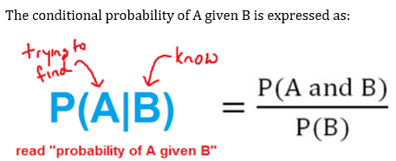
6.4 – Conditional Events and Frequency Tables
THE CHANCE OF A SECOND EVENT OCCURRING
IF THE FIRST EVENT HAS ALREADY HAPPENED
IF EVENT A, THEN EVENT B
EVENT B, GIVEN EVENT A

Slide 51
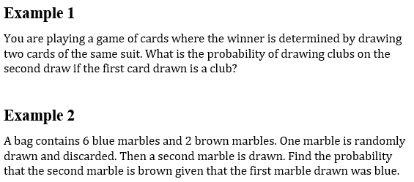
6.4 – Conditional Events and Frequency Tables
$$\frac{12}{51}$$
$$\frac{2}{7}$$

Slide 52
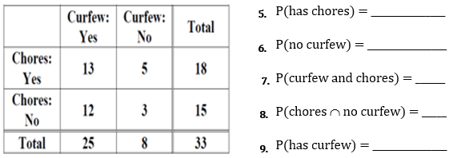
6.4 – Conditional Events and Frequency Tables
Example 3
$$P\left(A|B\right)=\frac{intersection}{last total}$$
$$\frac{18}{33}$$
1.
$$\frac{8}{33}$$
$$\frac{13}{33}$$
1.
$$\frac{5}{33}$$
1.
$$\frac{25}{33}$$
1.

Slide 53
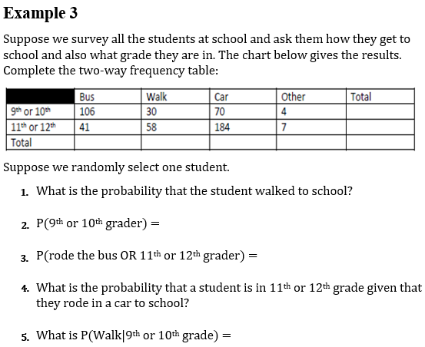
complex
6.4 – Conditional Events and Frequency Tables
$$P\left(A|B\right)=\frac{intersection}{last total}$$
Example 4
210
290
147
88
254
11
500
$$\frac{88}{500}$$
$$=\frac{22}{125}$$
$$\frac{210}{500}$$
$$=\frac{21}{50}$$
$$\frac{147}{500}+\frac{290}{500}−\frac{41}{500}$$
$$=\frac{99}{125}$$
$$\frac{184}{254}$$
$$=\frac{92}{127}$$
$$\frac{30}{210}$$
$$=\frac{1}{7}$$

Slide 54
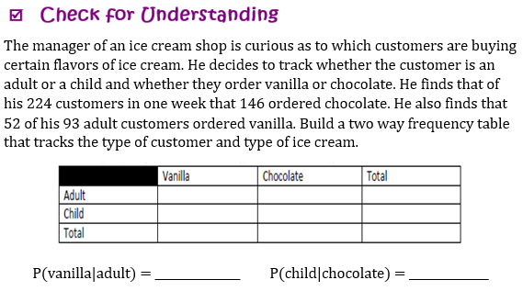
6.4 – Conditional Events and Frequency Tables
Example 5
52
41
93
26
105
131
78
146
224
$$\frac{52}{93}$$
$$\frac{105}{146}$$

Slide 55
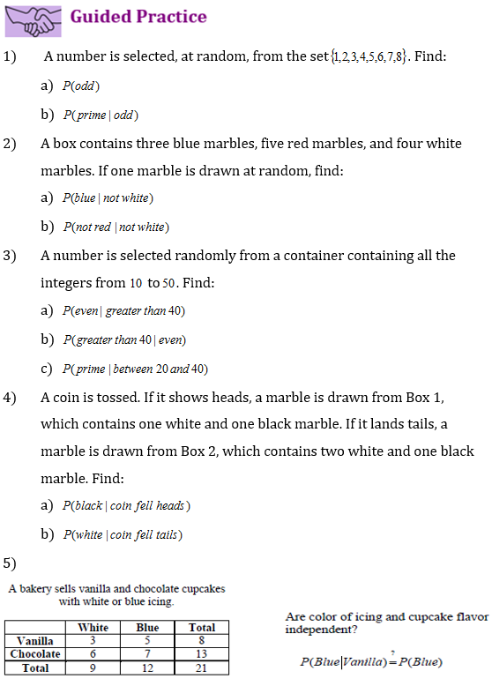

Slide 56
