Slide 1
Unit 5: Geometric and Algebraic Connections
Vocabulary Builder

Slide 3
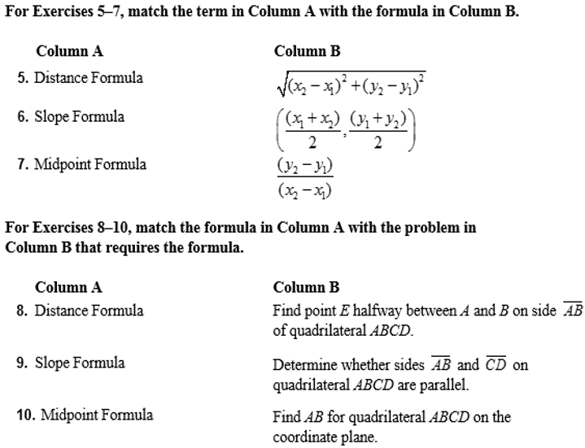

Slide 4
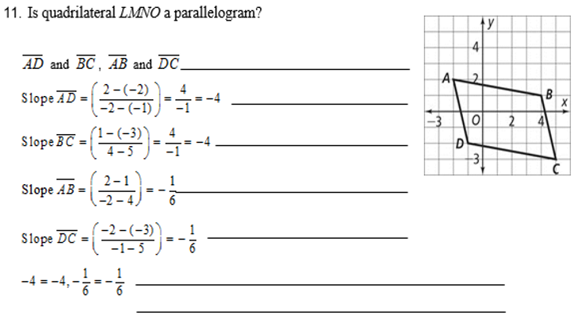
Identify opposite sides
Find the slope of $\overline{AD}.$
Find the slope of $\overline{BC}.$
Find the slope of $\overline{AB}.$
Find the slope of $\overline{DC}.$
Compare slopes, opposite sides have the
Same slope, then they are parallel.
LMNO is a parallelogram

Slide 5
3
1
1
2
2
3

Slide 6
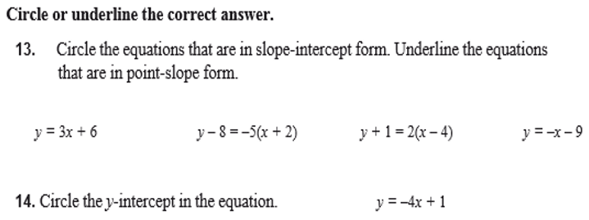

Slide 7
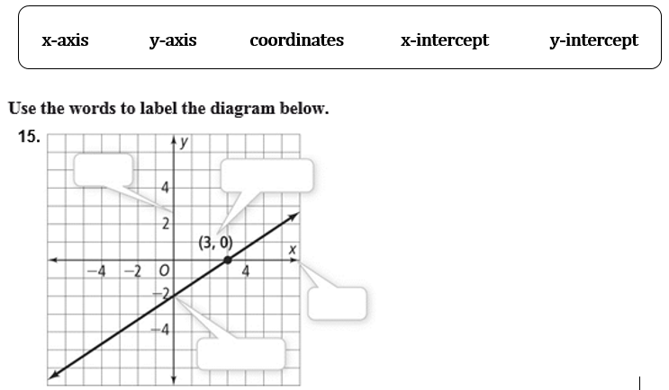
y-axis
coordinates
x-axis
y-intercept

Slide 8
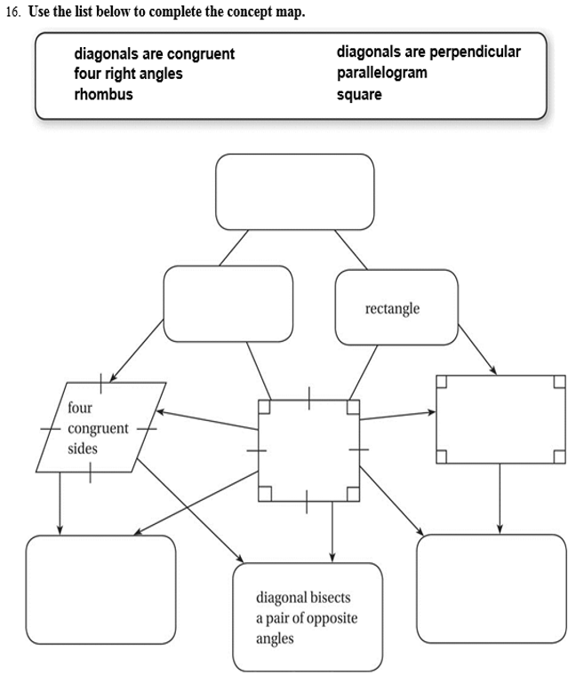
Parallelogram
Rhombus
Four right angles
Square
Diagonals are Perpendicular
Diagonals are Congruent

Slide 9
Unit 5: Geometric and Algebraic Connections
5.1 Slope and Equations of Lines

Slide 10
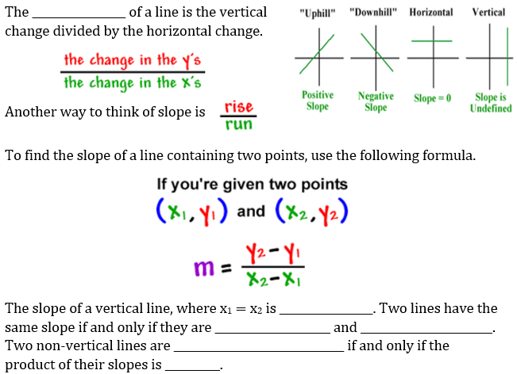
Slope
Undefined
Parallel
Congruent
Perpendicular
-1

Slide 11
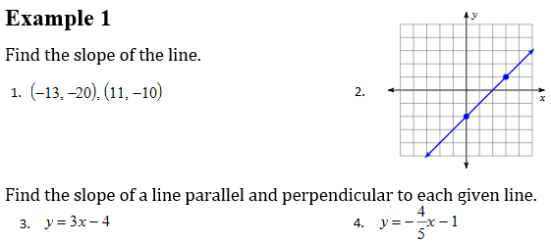
$$(3, 1)$$
$$\frac{−10 −(−20)}{11−(−13)}$$
$$\frac{1 −(−2)}{3−0}$$
$$=\frac{3}{3}=1$$
$$(0,−2)$$
$$=\frac{10}{24}$$
$$=\frac{5}{12}$$
Slope: 3
Slope: $−\frac{4}{5}$
Parallel Slope: 3
Parallel Slope: $−\frac{4}{5}$
Perpendicular Slope: $−\frac{1}{3}$
Perpendicular Slope: $\frac{5}{4}$

Slide 12
$$(−3, 3)$$
$$\frac{−3 −3}{1−(−3)}$$
$$\frac{15 −8}{−11−(−20)}$$
$$=−\frac{6}{4}=−\frac{3}{2}$$
$$(1,−3)$$
$$=\frac{7}{9}$$
Slope: $\frac{2}{5}$
Slope: $−1$
Parallel Slope: $\frac{2}{5}$
Parallel Slope: $−1$
Perpendicular Slope: $−\frac{5}{2}$
Perpendicular Slope: $1$

Slide 13
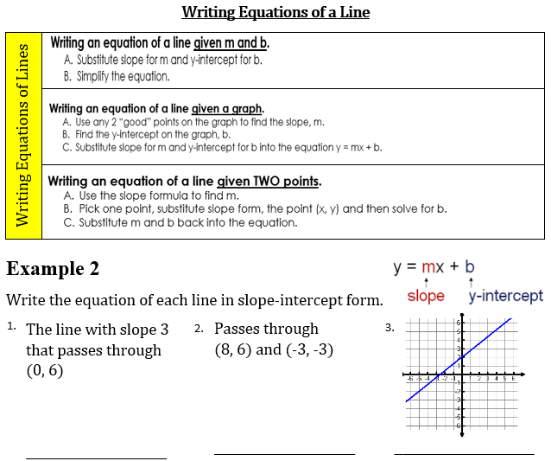
$$y=\frac{9}{11}x−\frac{6}{11}$$
$$y=\frac{4}{5}x+2$$
$$y=3x+6$$

Slide 14
$$y=−\frac{6}{7}x+\frac{40}{7}$$
$$y=−2x$$
$$y=−3x+2$$

Slide 15
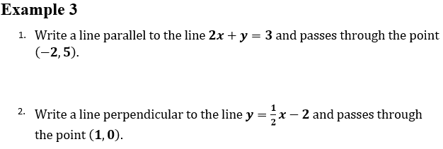
$$y=−2x+1$$
$$y=−2x+2$$

Slide 16
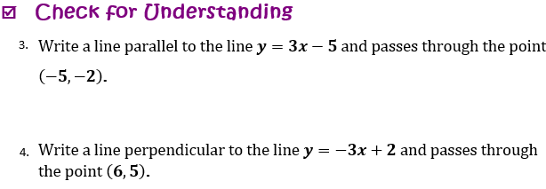
$$y=3x+13$$
$$y=\frac{1}{3}x+3$$

Slide 18
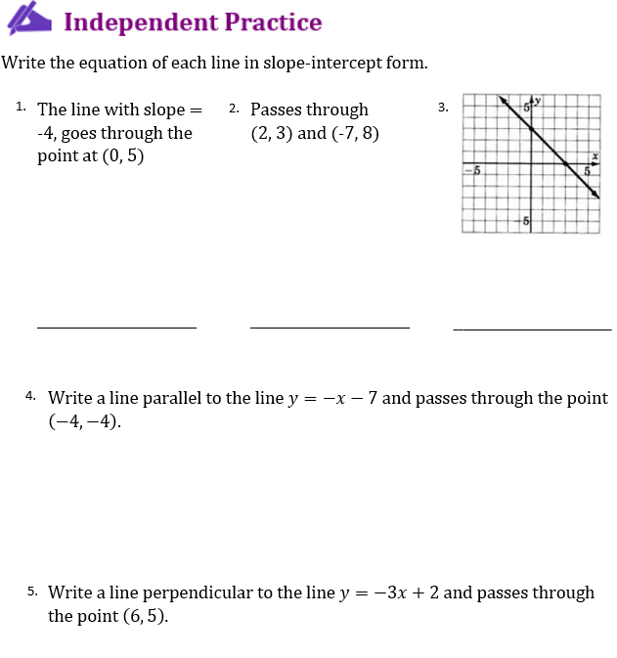

Slide 19
Unit 5: Geometric and Algebraic Connections
5.2 Coordinate Proofs

Slide 20
Pythagorean Theorem
hypotenuse
Distance Formula
Square root
difference
difference

Slide 21
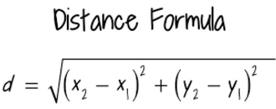
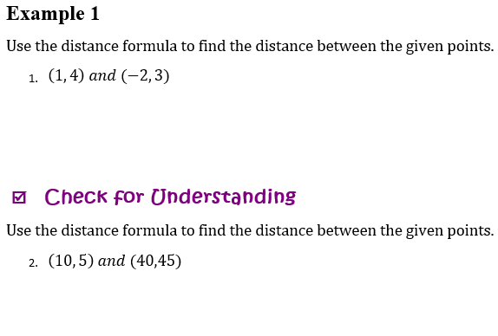
$$\sqrt{({−2−1)}^{2}+({3−4)}^{2}}$$
$$=\sqrt{({−3)}^{2}+(−1)^{2}}$$
$$=\sqrt{9+1}$$
$$=\sqrt{10}$$
$$\sqrt{({40−10)}^{2}+(45−5)^{2}}$$
$$=\sqrt{({30)}^{2}+(40)^{2}}$$
$$=\sqrt{900+1600}$$
$$=50$$

Slide 23
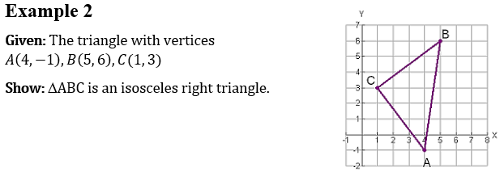
Use Distance Formula to prove congruent length
$$\overline{BC}=\sqrt{(5−1)^{2}+(6−{3)}^{2}}$$
$$=\sqrt{({3)}^{2}+(4)^{2}}$$
$$=5$$
$$\overline{AC}=\sqrt{({1−4)}^{2}+({3−(−1))}^{2}}$$
$$=\sqrt{({−3)}^{2}+(4)^{2}}$$
$$=5$$
Use Slope Formula to prove a right triangle
$$\overline{BC}=\frac{6−3}{5−1}$$
$$=\frac{3}{4}$$
$$\overline{AC}=\frac{−1−3}{5−1}$$
$$=−\frac{4}{3}$$

Slide 24
Use Slope Formula to prove a right triangle
$$\overline{BC}=\frac{−1−3}{2−2}$$
$$=\frac{−4}{0}$$
$$\overline{AC}=\frac{−1−(−1)}{2−(−3)}$$
$$=\frac{0}{5}$$
Undefined
0

Slide 25
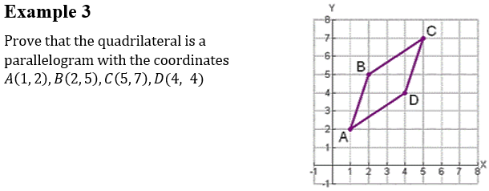
Use Distance Formula to prove congruent length
$$\overline{AB}=\sqrt{(2−1)^{2}+(5−{2)}^{2}}$$
$$=\sqrt{10}$$
$$\overline{CD}=\sqrt{({4−5)}^{2}+(4−7)^{2}}$$
$$=\sqrt{10}$$
$$\overline{BC}=\sqrt{(5−2)^{2}+(7−5)^{2}}$$
$$=\sqrt{13}$$
$$\overline{AD}=\sqrt{({4−1)}^{2}+({4−2)}^{2}}$$
$$=\sqrt{13}$$

Slide 26
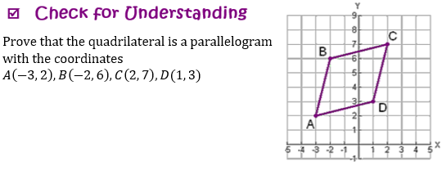
$$\overline{AB}=\sqrt{(−2−(−3))^{2}+(6−{2)}^{2}}$$
$$=\sqrt{17}$$
$$\overline{CD}=\sqrt{({1−2)}^{2}+(3−7)^{2}}$$
$$=\sqrt{17}$$
$$\overline{BC}=\sqrt{(2−(−2))^{2}+(7−6)^{2}}$$
$$=\sqrt{17}$$
$$\overline{AD}=\sqrt{({1−(−3))}^{2}+({3−2)}^{2}}$$
$$=\sqrt{17}$$

Slide 27
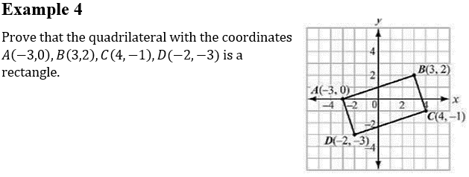
Use Slope Formula to prove a right triangle
$$\overline{AB}=\frac{2−0}{3−(−3)}$$
$$=\frac{1}{3}$$
$$\overline{AD}=\frac{−3−0}{−2−(−3)}$$
$$=−3$$
Use Distance Formula to prove congruent length
$$\overline{AB}=\sqrt{(3−(−3))^{2}+(2−0)^{2}}$$
$$=\sqrt{({6)}^{2}+(2)^{2}}$$
$$=\sqrt{40}$$
$$\overline{CD}=\sqrt{(−2−4)^{2}+(−3−(−1))^{2}}$$
$$=\sqrt{({−6)}^{2}+(−2)^{2}}$$
$$=\sqrt{40}$$

Slide 28
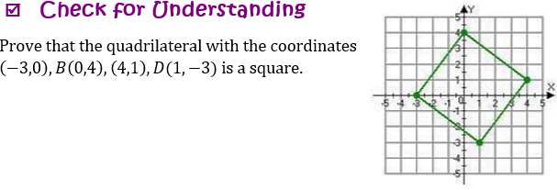
Use Slope Formula to prove a right triangle
$$\overline{AB}=\frac{4−0}{0−(−3)}$$
$$=\frac{4}{3}$$
$$\overline{AD}=\frac{−3−0}{−1−(−3)}$$
$$=−\frac{3}{4}$$
Use Distance Formula to prove congruent length
$$\overline{AB}=\sqrt{(0−(−3))^{2}+(4−0)^{2}}$$
$$=\sqrt{({3)}^{2}+(4)^{2}}$$
$$=5$$
$$\overline{BC}=\sqrt{(4−0)^{2}+(1−4)^{2}}$$
$$=\sqrt{({4)}^{2}+(−3)^{2}}$$
$$=5$$

Slide 29
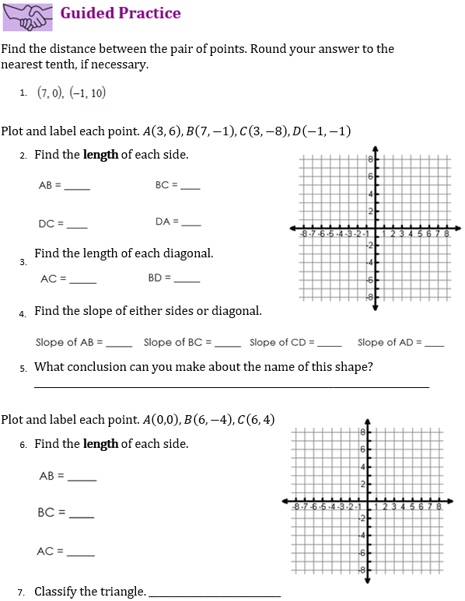

Slide 30
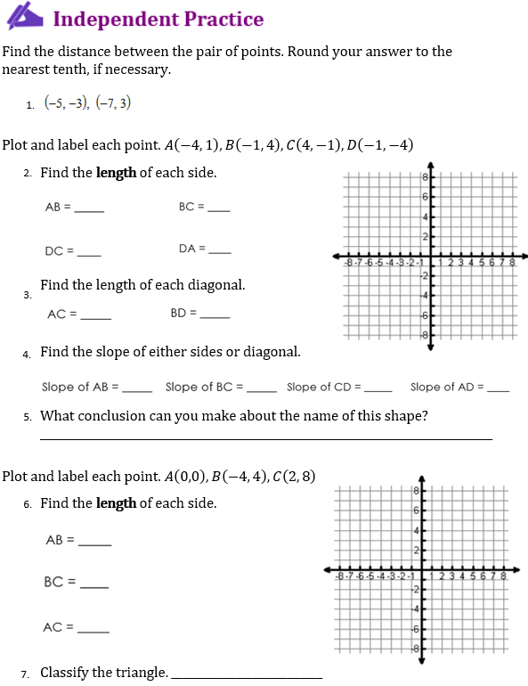

Slide 31
Unit 5: Geometric and Algebraic Connections
5.3 Perimeter and Area of Polygons

Slide 32
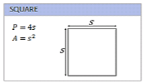
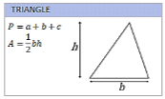
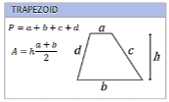
sides
angles
Pythagorean Theorem
Distance Formula

Slide 33
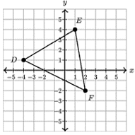
$$(1, 4)$$
$$(−4, 1)$$
$$(2, −2)$$
$$\overline{DE}=\sqrt{(1−(−4))^{2}+(4−1)^{2}}$$
$$=\sqrt{({5)}^{2}+(3)^{2}}$$
$$=\sqrt{34}$$
$$\overline{EF}=\sqrt{(2−1)^{2}+(−2−4)^{2}}$$
$$=\sqrt{({1)}^{2}+(−6)^{2}}$$
$$=\sqrt{37}$$
$$\overline{DF}=\sqrt{(2−(−4))^{2}+(−2−1)^{2}}$$
$$=\sqrt{({6)}^{2}+(−3)^{2}}$$
$$=\sqrt{45}$$
P = $\sqrt{34}+\sqrt{37}+\sqrt{45}=$
$$18.7$$

Slide 34
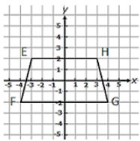
$$(−3, 2)$$
$$(3, 2)$$
P = $8+6+\sqrt{17}+\sqrt{17}=$
= 14 $+2\sqrt{17}$
$$(−4, −2)$$
$$(4, −2)$$
$$=22.24$$
$$\overline{EH}=\sqrt{(3−(−3))^{2}+(2−2)^{2}}$$
$$=\sqrt{({6)}^{2}+(0)^{2}}$$
$$=6$$
$$\overline{HG}=\sqrt{(4−3)^{2}+(−2−2)^{2}}$$
$$=\sqrt{({1)}^{2}+(−4)^{2}}$$
$$=\sqrt{17}$$
$$\overline{FG}=\sqrt{(4 −(−4))^{2}+(−2−(−2))^{2}}$$
$$=\sqrt{({8)}^{2}+(0)^{2}}$$
$$=8$$
$$\overline{EF}=\sqrt{(4−(−3))^{2}+(−2−2)^{2}}$$
$$=\sqrt{(−1)^{2}+(−4)^{2}}$$
$$=\sqrt{17}$$

Slide 35
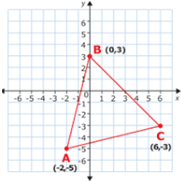
$$A=\frac{1}{2}bh$$
$$=\frac{1}{2}\left(\sqrt{53}\right)\left(\sqrt{65}\right)$$
$$D(2, −4)$$
$$=29.35$$
$$\overline{BD}=\sqrt{(2−0)^{2}+(−4−3)^{2}}$$
$$=\sqrt{({2)}^{2}+(−7)^{2}}$$
$$=\sqrt{53}$$
$$\overline{AC}=\sqrt{(6−(−2))^{2}+(−3−(−2))^{2}}$$
$$=\sqrt{({8)}^{2}+(−1)^{2}}$$
$$=\sqrt{65}$$

Slide 36
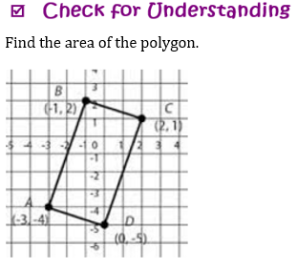
$$\overline{AB}=\sqrt{(−3−(−1))^{2}+(−4−3)^{2}}$$
$$=\sqrt{({−2)}^{2}+(−6)^{2}}$$
$$=\sqrt{40}$$
$$\overline{AC}=\sqrt{(0−(−3))^{2}+(−5−(−4))^{2}}$$
$$=\sqrt{({3)}^{2}+(−1)^{2}}$$
$$=\sqrt{10}$$
$$A=\frac{1}{2}bh$$
$$=20$$
$$=\left(\sqrt{40}\right)\left(\sqrt{10}\right)$$

Slide 37
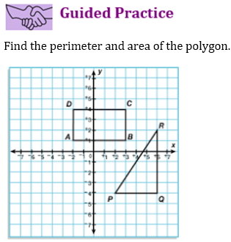

Slide 38
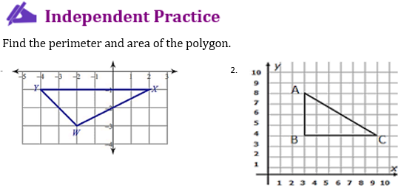

Slide 39
Unit 5: Geometric and Algebraic Connections
5.4 Midpoint and Direct Line Segments

Slide 40
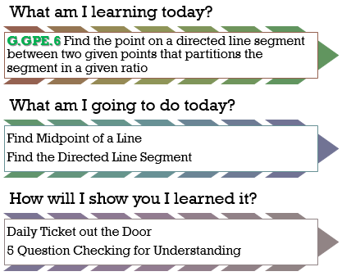
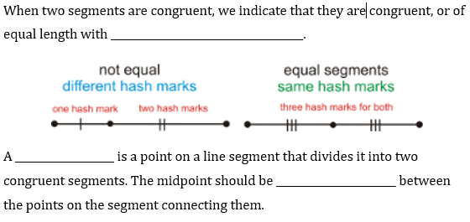
Congruent marks
Midpoint
halfway

Slide 41
$$=\left(\frac{3+(−2)}{2}, \frac{7+4}{2}\right)$$
$$=\left(\frac{1}{2}, \frac{11}{2}\right)$$
$$=\left(\frac{5+6}{2}, \frac{−2+14}{2}\right)$$
$$=\left(\frac{11}{2}, 6\right)$$

Slide 42
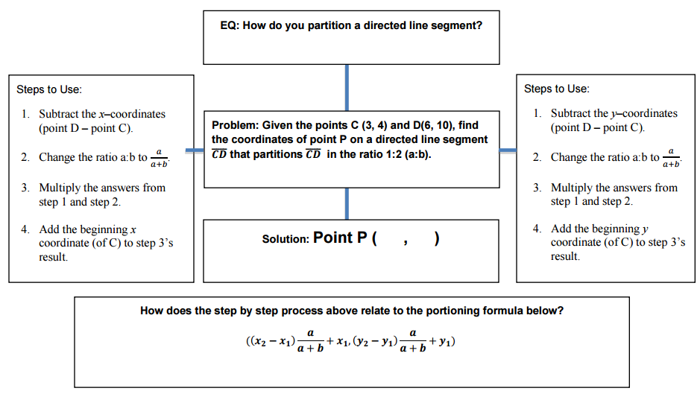

Slide 43
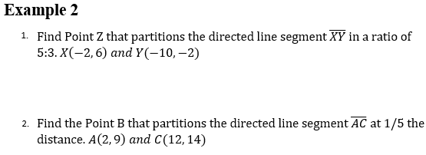
OR
$$Z(−7, 1)$$
$$B(4, 10)$$

Slide 44
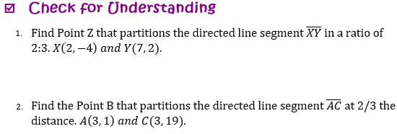
OR
$$Z(−7, −\frac{8}{5})$$
$$B(3, 13)$$

Slide 45
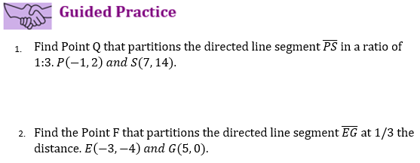
OR

Slide 46
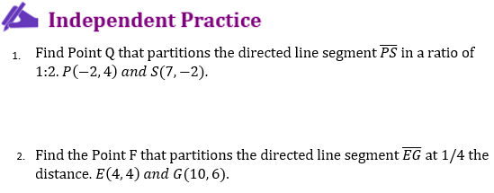
OR

Slide 47
Unit 5: Geometric and Algebraic Connections
5.5 Equations of Circles

Slide 48
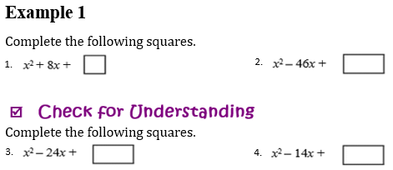
Completing the Square
Trinomial
To complete the square: Take half, then square it!
16
529
144
49

Slide 49
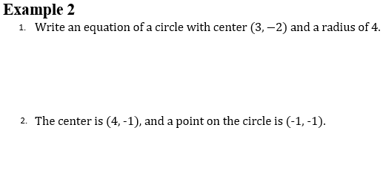
$${(x−3)}^{2}+({y−(−2))}^{2}=4^{2}$$
$${(x−3)}^{2}+({y+2)}^{2}=16$$
Radius:
$$=\sqrt{(1−4)^{2}+(−1−\left(−1\right))^{2}}$$
$$=\sqrt{({−5)}^{2}+(0)^{2}}$$
$$=5$$
$${(x−4)}^{2}+({y−(−1))}^{2}=5^{2}$$
$${(x−4)}^{2}+({y+1)}^{2}=25$$

Slide 50
$${(x−2)}^{2}+({y−(−9))}^{2}={\sqrt{11}}^{2}$$
$${(x−2)}^{2}+({y+9)}^{2}=11$$
Radius:
$$=\sqrt{(−3−2)^{2}+(16−4)^{2}}$$
$$=\sqrt{({−5)}^{2}+(12)^{2}}$$
$$=13$$
$${(x−2)}^{2}+({y−4)}^{2}={13}^{2}$$
$${(x−2)}^{2}+({y−4)}^{2}=169$$

Slide 51
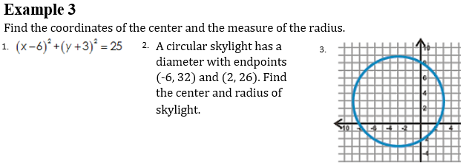
$$(6, −3)$$
Center:
Radius:
$$5$$
Center:
$$=\left(\frac{−6+2}{2}, \frac{32+26}{2}\right)$$
$$=\left(−2, 29\right)$$
Center:
$$(−3, 3)$$
Radius:
$$=\sqrt{(−2 −2)^{2}+(29−26)^{2}}$$
Radius:
$$6$$
$$=\sqrt{({−4)}^{2}+(3)^{2}}$$
$$=5$$

Slide 52
$$(4, −3)$$
Center:
Radius:
$$6$$
Center:
$$=\left(\frac{2+12}{2}, \frac{8+24}{2}\right)$$
$$=\left(7, 16\right)$$
Radius:
Center:
$$(5, 5)$$
$$=\sqrt{(7 −2)^{2}+(16−8)^{2}}$$
$$=\sqrt{({5)}^{2}+(8)^{2}}$$
Radius:
$$=\sqrt{89}$$
$$4$$

Slide 53
$$(4, 0)$$
Center:
$$(4, −1)$$
Center:
Radius:
$$3$$
Radius:
$$\sqrt{7}$$

Slide 54
$$(−2, 3)$$
Center:
$$(2, 3)$$
Center:
Radius:
$$4$$
Radius:
$$\sqrt{5}$$

Slide 55
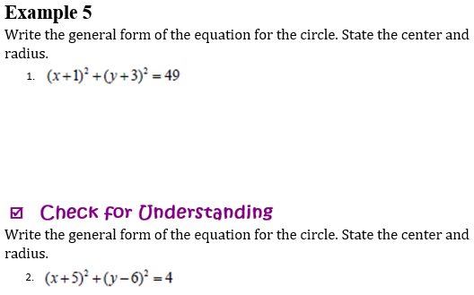
$$(−1, −3)$$
Radius:
Center:
$$7$$
$$x^{2}+y^{2}+2x+6y−39=0$$
$$(−5, 6)$$
Radius:
Center:
$$2$$
$$x^{2}+y^{2}+10x−12y−57=0$$

Slide 56
yes
yes

Slide 57
no
no

