Slide 1
Unit 4: Circles and Volume
4.5 Congruent Chords and Arcs

Slide 2
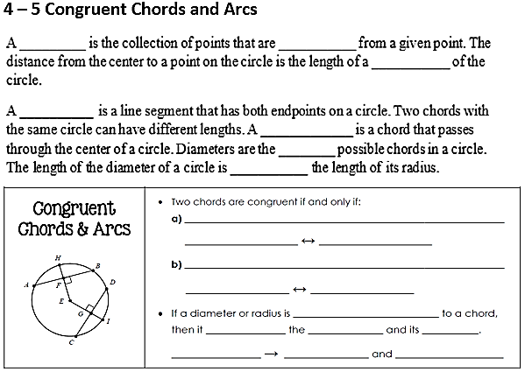
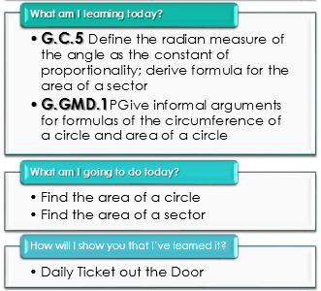
Daily Agenda
circle
equidistant
radius
chord
diameter
longest
twice
their corresponding arcs are $≅$
$$m\hat{AB}=m\hat{CD}$$
$$AB=CD$$
their corresponding radii parts are $≅$
$$AB=CD$$
$$EF=EG$$
perpendicular
bisects
chord
arc
$$EH⊥AB$$
$$AF=FB$$
$$m\hat{AH}=m\hat{HB}$$

Slide 3
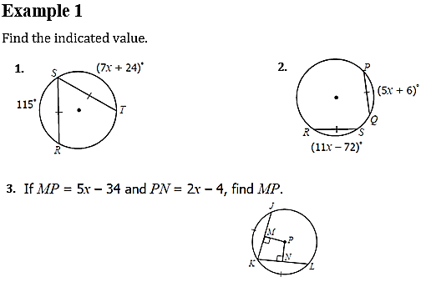
Daily Agenda
7x + 24 = 115
x = 13
5x+6 = 11x-72
x = 13
5x - 34 = 2x – 4
x = 10
MP = 16

Slide 4
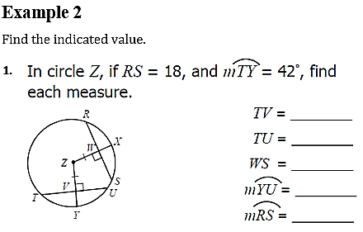
Daily Agenda
9
18
9
42˚
84˚

Slide 5
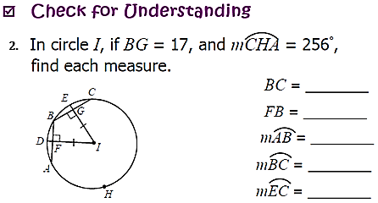
Daily Agenda
Example 2 continued
34
17
52˚
52˚
26˚

Slide 6
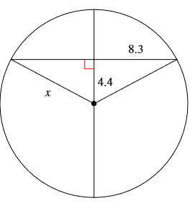
Daily Agenda
Example 3
Find x (to the nearest hundredth).
$${8.3}^{2}+{4.4}^{2}= x^{2}$$
8.3
68.89 + 19.36 = $x^{2}$
88.25 = $x^{2}$
9.38 = x

Slide 7
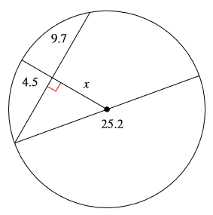
Daily Agenda
Example 4
Find x (to the nearest hundredth).
$${9.7}^{2}+x^{2}= {12.6}^{2}$$
94.09 + $x^{2}$ = 158.76
9.7
$x^{2}$= 64.67
12.6
x = 8.04

Slide 8
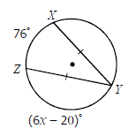
Extra Practice
Find the value of x, then tell me the measure of arcs YZ and YX.

Slide 9
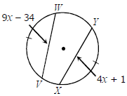
Extra Practice
Find the value of x, then tell find the measure of chords VW and XY.

Slide 10
Extra Practice

Slide 11
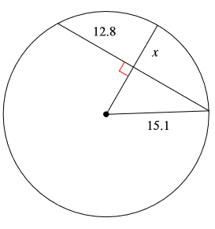
Extra Practice
Find x (to the nearest tenth).

Slide 12
Unit 4: Circles and Volume
4.6 More Chords, Secants and Tangents

Slide 13
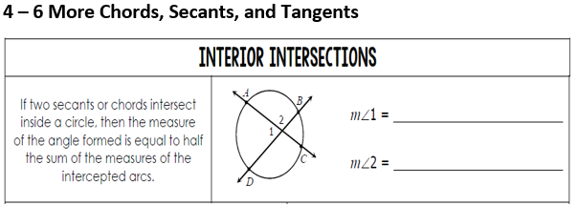
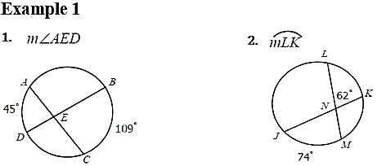
Daily Agenda
$$\frac{1}{2}\left(m\hat{AD}+m\hat{BC}\right)$$
$$\frac{1}{2}\left(m\hat{AB}+m\hat{CD}\right)$$
77˚
50˚

Slide 14
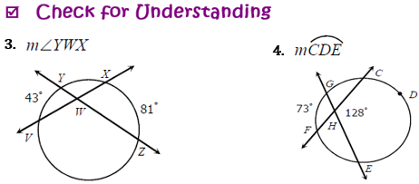
Daily Agenda
$$\frac{1}{2}\left(m\hat{AD}+m\hat{BC}\right)$$
$$\frac{1}{2}\left(m\hat{AB}+m\hat{CD}\right)$$
Example 1 continued
118˚
183˚

Slide 15
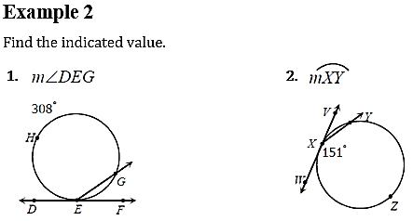
Daily Agenda
$$\frac{1}{2}\left(m\hat{AB}\right)$$
$$\frac{1}{2}\left(m\hat{ACB}\right)$$
154˚
58˚

Slide 16
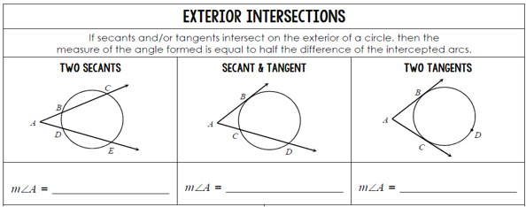
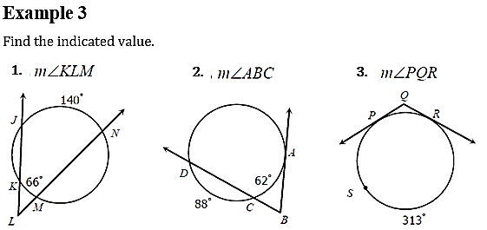
Daily Agenda
$$\frac{1}{2}\left(m\hat{CE}−m\hat{BD}\right)$$
$$\frac{1}{2}\left(m\hat{BD}−m\hat{BC}\right)$$
$$\frac{1}{2}\left(m\hat{BDC}−m\hat{BC}\right)$$
37˚
74˚
133˚

Slide 17
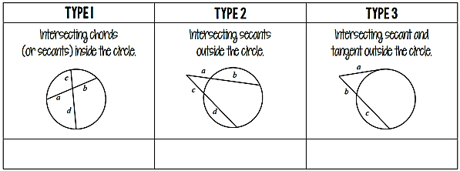
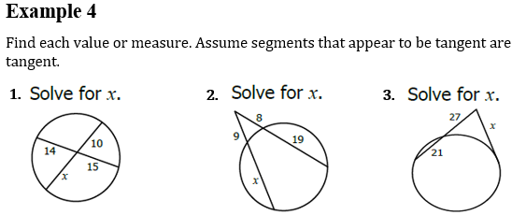
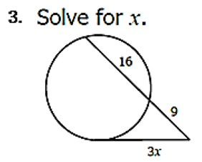
Daily Agenda
$$a∙b=c∙d$$
$$a(a+b)=c(c+d)$$
$$a^{2}=b(b+c)$$
21
15
5

Slide 18
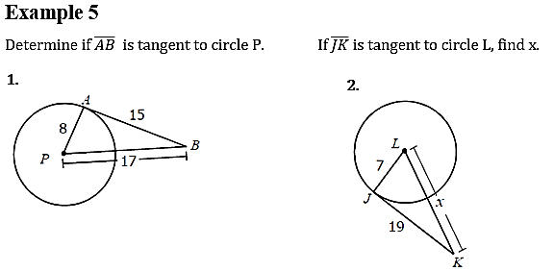
Daily Agenda
one
perpendicular
radius
yes
20.2

Slide 19
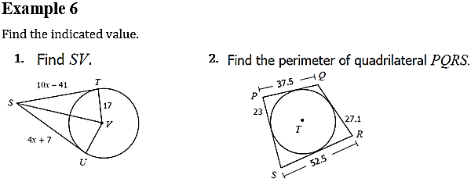
Daily Agenda
42.5
180

Slide 20
Unit 4: Circles and Volume
Vocabulary Builder

Slide 21
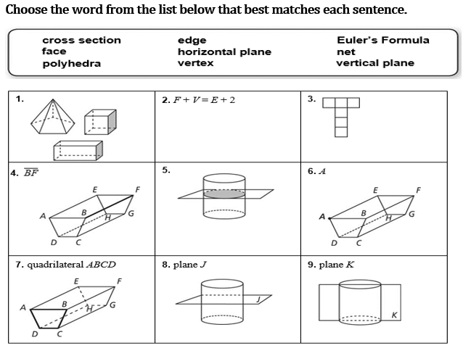
Daily Agenda
What am I learning today?
G.GMD.1 Give informal arguments for geometric formulas
G.GMD.3 Use volume formulas to solve problems
What am I going to do today?
Vocabulary Builder
Volume of Cylinders
Volume of Rectangular and Triangular Prisms
How will I show you that I’ve learned it?
Daily 5 Question Check for Understanding
Daily Ticket out the Door
Polyhedra
Euler’s Formula
net
edge
Vertex
Cross section
Face
Horizontal plane
Vertical plane

Slide 22
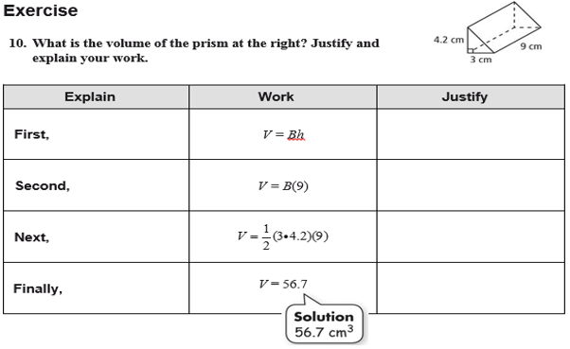
Daily Agenda
What am I learning today?
G.GMD.1 Give informal arguments for geometric formulas
G.GMD.3 Use volume formulas to solve problems
What am I going to do today?
Vocabulary Builder
Volume of Cylinders
Volume of Rectangular and Triangular Prisms
How will I show you that I’ve learned it?
Daily 5 Question Check for Understanding
Daily Ticket out the Door
Formula for volume
Substitution
h = 9
Base is a right triangle, legs 3 and 4.2
Multiply

Slide 23
Daily Agenda
What am I learning today?
G.GMD.1 Give informal arguments for geometric formulas
G.GMD.3 Use volume formulas to solve problems
What am I going to do today?
Vocabulary Builder
Volume of Cylinders
Volume of Rectangular and Triangular Prisms
How will I show you that I’ve learned it?
Daily 5 Question Check for Understanding
Daily Ticket out the Door
5
4
2
1
3
2
5
3
4
1

Slide 24
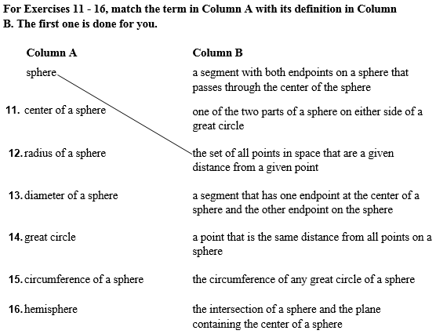
Daily Agenda
What am I learning today?
G.GMD.1 Give informal arguments for geometric formulas
G.GMD.3 Use volume formulas to solve problems
What am I going to do today?
Vocabulary Builder
Volume of Cylinders
Volume of Rectangular and Triangular Prisms
How will I show you that I’ve learned it?
Daily 5 Question Check for Understanding
Daily Ticket out the Door

Slide 25
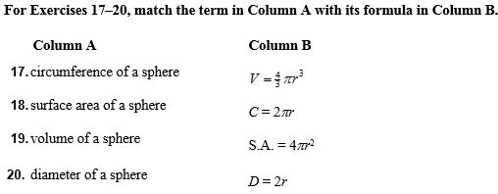
Daily Agenda
What am I learning today?
G.GMD.1 Give informal arguments for geometric formulas
G.GMD.3 Use volume formulas to solve problems
What am I going to do today?
Vocabulary Builder
Volume of Cylinders
Volume of Rectangular and Triangular Prisms
How will I show you that I’ve learned it?
Daily 5 Question Check for Understanding
Daily Ticket out the Door

Slide 26
Daily Agenda
What am I learning today?
G.GMD.1 Give informal arguments for geometric formulas
G.GMD.3 Use volume formulas to solve problems
What am I going to do today?
Vocabulary Builder
Volume of Cylinders
Volume of Rectangular and Triangular Prisms
How will I show you that I’ve learned it?
Daily 5 Question Check for Understanding
Daily Ticket out the Door
Ratio
Similar
Proportion
Scale factor

Slide 27
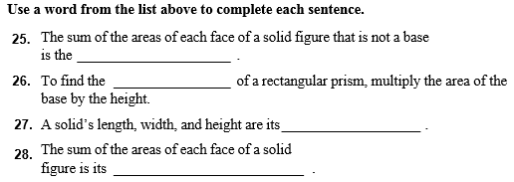
Daily Agenda
What am I learning today?
G.GMD.1 Give informal arguments for geometric formulas
G.GMD.3 Use volume formulas to solve problems
What am I going to do today?
Vocabulary Builder
Volume of Cylinders
Volume of Rectangular and Triangular Prisms
How will I show you that I’ve learned it?
Daily 5 Question Check for Understanding
Daily Ticket out the Door
Lateral area
Volume
Linear dimensions
Surface area

Slide 28
Daily Agenda
What am I learning today?
G.GMD.1 Give informal arguments for geometric formulas
G.GMD.3 Use volume formulas to solve problems
What am I going to do today?
Vocabulary Builder
Volume of Cylinders
Volume of Rectangular and Triangular Prisms
How will I show you that I’ve learned it?
Daily 5 Question Check for Understanding
Daily Ticket out the Door

Slide 29
Unit 4: Circles and Volume
4.7 Volume of Prisms, Pyramids, and Spheres

Slide 30
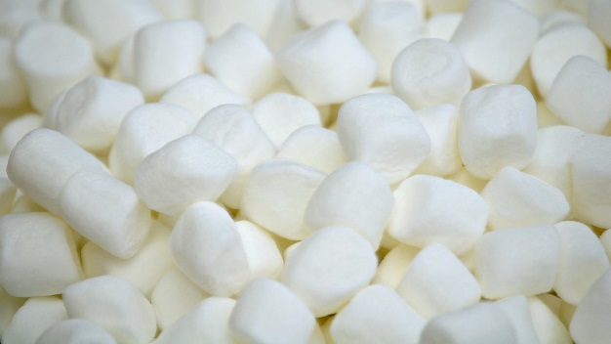
Marshmallow Demonstration
How many marshmallows does it take to fill the bottom of Container #1?
How many in the length? How many in the width?
How many rows of marshmallows does it take to fill Container #1 to the top?
How many marshmallows to fill all of Container #1?
How did you figure out how many marshmallows it took to fill up Container #1?

Slide 31
Daily Agenda
Volume
What am I learning today?
G.GMD.1 Give informal arguments for geometric formulas
G.GMD.3 Use volume formulas to solve problems
What am I going to do today?
Volume of Cylinders
Volume of Rectangular and Triangular Prisms
How will I show you that I’ve learned it?
Daily 5 Question Check for Understanding
Marshmallow Activity
cubic
congruent
right rectangular prism
bases
length
width
height

Slide 32
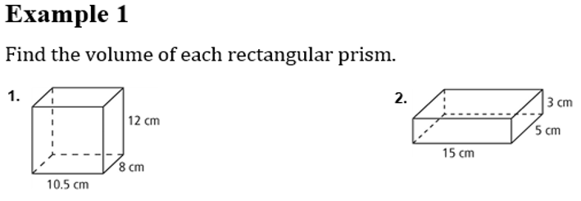
Daily Agenda
What am I learning today?
G.GMD.1 Give informal arguments for geometric formulas
G.GMD.3 Use volume formulas to solve problems
What am I going to do today?
Volume of Cylinders
Volume of Rectangular and Triangular Prisms
How will I show you that I’ve learned it?
Daily 5 Question Check for Understanding
Marshmallow Activity
$$V=lwh$$
$$V=lwh$$
$$V=10.5×8×12$$
$$V=15×5×3$$
$$V=1008{cm}^{3}$$
$$V=225{cm}^{3}$$

Slide 33
Daily Agenda
What am I learning today?
G.GMD.1 Give informal arguments for geometric formulas
G.GMD.3 Use volume formulas to solve problems
What am I going to do today?
Volume of Cylinders
Volume of Rectangular and Triangular Prisms
How will I show you that I’ve learned it?
Daily 5 Question Check for Understanding
Marshmallow Activity
height
bases
multiply
base
height

Slide 34
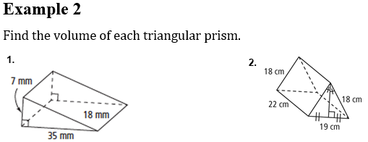
Daily Agenda
What am I learning today?
G.GMD.1 Give informal arguments for geometric formulas
G.GMD.3 Use volume formulas to solve problems
What am I going to do today?
Volume of Cylinders
Volume of Rectangular and Triangular Prisms
How will I show you that I’ve learned it?
Daily 5 Question Check for Understanding
Marshmallow Activity
Must find the height!
$$x^{2}+{9.5}^{2}={18}^{2}$$
$$x^{2}=233.75$$
$$x=15.3$$
$$V=\frac{7×18×35}{2}$$
$$V=\frac{22×15.3×19}{2}$$
$$V=2205mm^{3}$$
$$V=3197.7cm^{3}$$

Slide 35
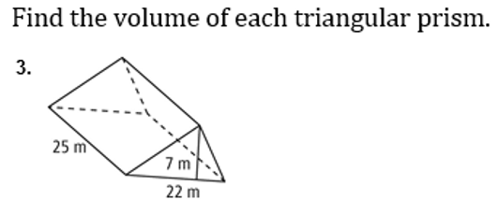
Daily Agenda
What am I learning today?
G.GMD.1 Give informal arguments for geometric formulas
G.GMD.3 Use volume formulas to solve problems
What am I going to do today?
Volume of Cylinders
Volume of Rectangular and Triangular Prisms
How will I show you that I’ve learned it?
Daily 5 Question Check for Understanding
Marshmallow Activity
Example 2 continued
$$V=1925m^{3}$$

Slide 36
Daily Agenda
What am I learning today?
G.GMD.1 Give informal arguments for geometric formulas
G.GMD.3 Use volume formulas to solve problems
What am I going to do today?
Volume of Cylinders
Volume of Rectangular and Triangular Prisms
How will I show you that I’ve learned it?
Daily 5 Question Check for Understanding
Marshmallow Activity
capacity
area
height

Slide 37
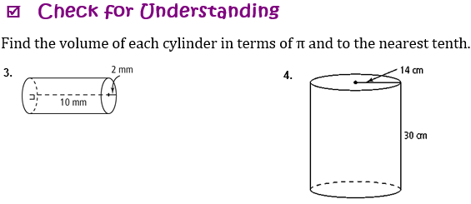
Daily Agenda
What am I learning today?
G.GMD.1 Give informal arguments for geometric formulas
G.GMD.3 Use volume formulas to solve problems
What am I going to do today?
Volume of Cylinders
Volume of Rectangular and Triangular Prisms
How will I show you that I’ve learned it?
Daily 5 Question Check for Understanding
Marshmallow Activity
Example 3
$$V=πr^{2}h$$
$$V=πr^{2}h$$
$$V=π{(8.5)}^{2}(7)$$
$$V=π{\left(4.5\right)}^{2}(8.5)$$
$$V=505.8π$$
$$V=172.1π$$
$$V=1588.2 m^{3}$$
$$V=540.1 {cm}^{3}$$
$$V=18463.2 {cm}^{3}$$
$$V=125.6 mm^{3}$$

Slide 38
Marshmallow Activity
You may work alone or in pairs.
You (and your partner) will create 2 prisms of marshmallows on one piece of construction paper using marshmallows.
You must also show how to find the volume of your prisms.
The prisms can only be a rectangular, right or cylinder (all types we learned today).
Be careful (but creative) with your prisms.
DUE AT THE END OF THE PERIOD!!!!

Slide 39
What is the volume? – Small Group Game
Once you are in your groups, please take out a sheet of paper.
Designate one person in your group to be the recorder on the whiteboard (you are still responsible for showing your work on your paper to hand in!)
Each group will be solving the same problem (5 total).
Everyone must solve the problem on their own sheet of paper (this will be turned in!).
Once everyone is done, decide, as a whole group, the final answer, and have your recorder write it on the whiteboard.
Your team will receive one point for each correct answer.

Slide 40
Group Practice Problem #1
Find the volume of this prism in terms of $π$.
$$V=3380π{ in.}^{3}$$

Slide 41
Group Practice Problem #2
Find the volume of this prism.
$$V=1000 {ft}^{3}$$

Slide 42
Group Practice Problem #3
Find the volume of this prism.
$$V=30 {in.}^{3}$$

Slide 43
Group Practice Problem #4
Find the volume of this prism.
$$V=216 {in.}^{3}$$

Slide 44
Group Practice Problem #5
Find the volume of this prism.
$$V=160 {in.}^{3}$$

Slide 45
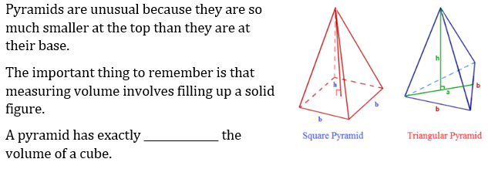
Daily Agenda
4-7 Volume of Prisms, Pyramids, and Spheres
What am I learning today?
G.GMD.1 Give informal arguments for geometric formulas
G.GMD.3 Use volume formulas to solve problems
What am I going to do today?
Volume of Sphere
Volume of Cones
Volume of Rectangular and Triangular Pyramid
How will I show you that I’ve learned it?
Daily 5 Question Check for Understanding
Daily Ticket out the Door
one-third

Slide 46
Daily Agenda
4-7 Volume of Prisms, Pyramids, and Spheres
What am I learning today?
G.GMD.1 Give informal arguments for geometric formulas
G.GMD.3 Use volume formulas to solve problems
What am I going to do today?
Volume of Sphere
Volume of Cones
Volume of Rectangular and Triangular Pyramid
How will I show you that I’ve learned it?
Daily 5 Question Check for Understanding
Daily Ticket out the Door
Example 4
$$V=\frac{8×8×10}{3}$$
$$V=\frac{400×36}{3}$$
$$V=213.3{in}^{3}$$
$$V=4800{yd}^{3}$$
$$V=15{cm}^{3}$$
$$V=48{cm}^{3}$$

Slide 47
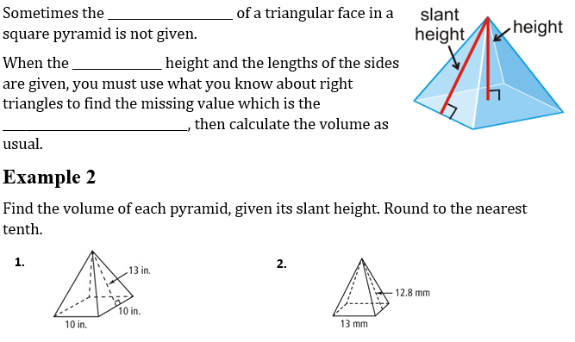
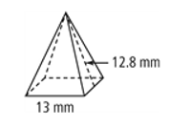
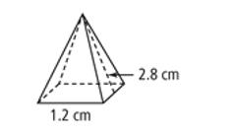
4-7 Volume of Prisms, Pyramids, and Spheres
Daily Agenda
What am I learning today?
G.GMD.1 Give informal arguments for geometric formulas
G.GMD.3 Use volume formulas to solve problems
What am I going to do today?
Volume of Sphere
Volume of Cones
Volume of Rectangular and Triangular Pyramid
How will I show you that I’ve learned it?
Daily 5 Question Check for Understanding
Daily Ticket out the Door
height
slant
Pythagorean Theorem
$$x^{2}+{0.6}^{2}={2.8}^{2}$$
$$x^{2}+{6.5}^{2}={12.8}^{2}$$
$$x=11$$
$$x=2.73$$
$$V=\frac{1.2×1.2×2.73}{3}$$
$$V=\frac{13×13×11}{3}$$
$$V=619.7{mm}^{3}$$
$$V=1.3{cm}^{3}$$

Slide 48
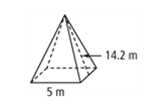
4-7 Volume of Prisms, Pyramids, and Spheres
Daily Agenda
What am I learning today?
G.GMD.1 Give informal arguments for geometric formulas
G.GMD.3 Use volume formulas to solve problems
What am I going to do today?
Volume of Sphere
Volume of Cones
Volume of Rectangular and Triangular Pyramid
How will I show you that I’ve learned it?
Daily 5 Question Check for Understanding
Daily Ticket out the Door
Example 5 continued
$$x^{2}+{2.5}^{2}={14.2}^{2}$$
$$x=14$$
$$V=\frac{5×5×14}{3}$$
$$V=116.7m^{3}$$

Slide 49
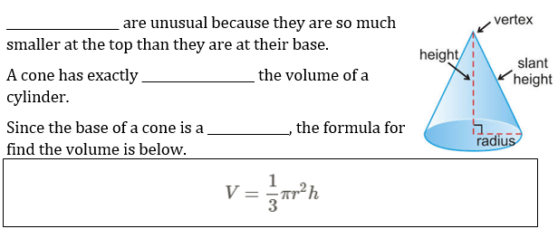
4-7 Volume of Prisms, Pyramids, and Spheres
Daily Agenda
Cones
What am I learning today?
G.GMD.1 Give informal arguments for geometric formulas
G.GMD.3 Use volume formulas to solve problems
What am I going to do today?
Volume of Sphere
Volume of Cones
Volume of Rectangular and Triangular Pyramid
How will I show you that I’ve learned it?
Daily 5 Question Check for Understanding
Daily Ticket out the Door
one-third
circle
Example 6
$$V=\frac{π{(7)}^{2}(24)}{3}$$
$$V=\frac{π{(4)}^{2}(12)}{3}$$
$V=392π$ ${ft}^{3}$
$$V=64πm^{3}$$

Slide 50
4-7 Volume of Prisms, Pyramids, and Spheres
Daily Agenda
What am I learning today?
G.GMD.1 Give informal arguments for geometric formulas
G.GMD.3 Use volume formulas to solve problems
What am I going to do today?
Volume of Sphere
Volume of Cones
Volume of Rectangular and Triangular Pyramid
How will I show you that I’ve learned it?
Daily 5 Question Check for Understanding
Daily Ticket out the Door
Example 6 continued
$$V=31.25π {in}^{3}$$
$$V=1633.3π m^{3}$$

Slide 51
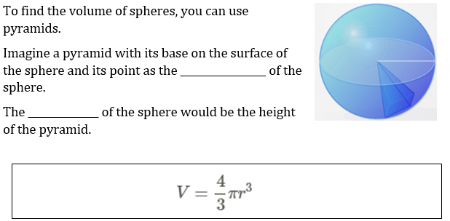
4-7 Volume of Prisms, Pyramids, and Spheres
Daily Agenda
What am I learning today?
G.GMD.1 Give informal arguments for geometric formulas
G.GMD.3 Use volume formulas to solve problems
What am I going to do today?
Volume of Sphere
Volume of Cones
Volume of Rectangular and Triangular Pyramid
How will I show you that I’ve learned it?
Daily 5 Question Check for Understanding
Daily Ticket out the Door
center
radius

Slide 52
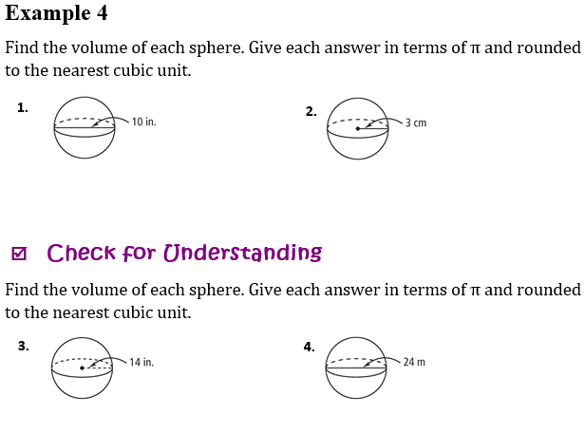
4-7 Volume of Prisms, Pyramids, and Spheres
Daily Agenda
What am I learning today?
G.GMD.1 Give informal arguments for geometric formulas
G.GMD.3 Use volume formulas to solve problems
What am I going to do today?
Volume of Sphere
Volume of Cones
Volume of Rectangular and Triangular Pyramid
How will I show you that I’ve learned it?
Daily 5 Question Check for Understanding
Daily Ticket out the Door
Example 7
$$V=\frac{4π{(5)}^{3}}{3}$$
$$V=\frac{4π{(3)}^{3}}{3}$$
$$V=166.7π$$
$$V=36π$$
$$V=523.6{in}^{3}$$
$$V=113.1{cm}^{3}$$
$$V=11494{in}^{3}$$
$$V=7238.2m^{3}$$

Slide 53
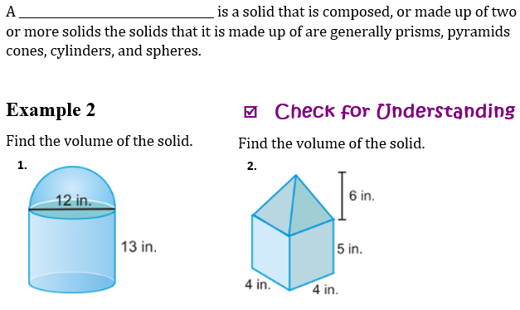
4-7 Volume of Prisms, Pyramids, and Spheres
Daily Agenda
composite solid
What am I learning today?
G.GMD.1 Give informal arguments for geometric formulas
G.GMD.3 Use volume formulas to solve problems
What am I going to do today?
Volume of Sphere
Volume of Cones
Volume of Rectangular and Triangular Pyramid
How will I show you that I’ve learned it?
Daily 5 Question Check for Understanding
Daily Ticket out the Door
Example 8
Composite Solid = Volume 1 + Volume 2
$$V=\frac{1}{2}∙\frac{4π{(6)}^{3}}{3}$$
$$+ π{\left(6\right)}^{2}(13)$$
$$V=144π+468π$$
$$V=612π$$
$$V=1922.7{in}^{3}$$

Slide 54
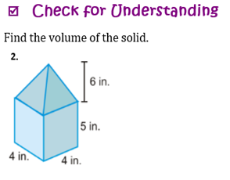
4-7 Volume of Prisms, Pyramids, and Spheres
Daily Agenda
composite solid
What am I learning today?
G.GMD.1 Give informal arguments for geometric formulas
G.GMD.3 Use volume formulas to solve problems
What am I going to do today?
Volume of Sphere
Volume of Cones
Volume of Rectangular and Triangular Pyramid
How will I show you that I’ve learned it?
Daily 5 Question Check for Understanding
Daily Ticket out the Door
Example 8 continued
Composite Solid = Volume 1 + Volume 2
$$V=\frac{(4)(4)(6) }{3}$$
$$+ (4)(4)(5)$$
$$V=112{in}^{3}$$

Slide 55
4-7 Volume of Prisms, Pyramids, and Spheres
Daily Agenda
What am I learning today?
G.GMD.1 Give informal arguments for geometric formulas
G.GMD.3 Use volume formulas to solve problems
What am I going to do today?
Volume of Sphere
Volume of Cones
Volume of Rectangular and Triangular Pyramid
How will I show you that I’ve learned it?
Daily 5 Question Check for Understanding
Daily Ticket out the Door

Slide 56
Unit 4: Circles and Volume
4.8 3-Dimensional Figures

Slide 57
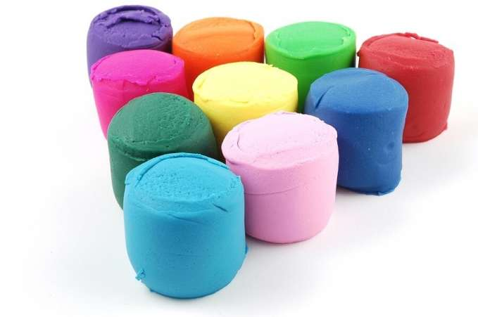
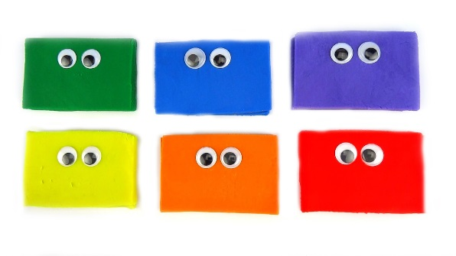
Playdoh Activity
In groups of 3-4, create a cylinder, rectangular prism, and right rectangular prism using playdoh.
Using dental floss, your group will make cuts into cross sections and answer questions regarding your findings.
You will have 30 minutes to complete this activity.
Work together!

Slide 58
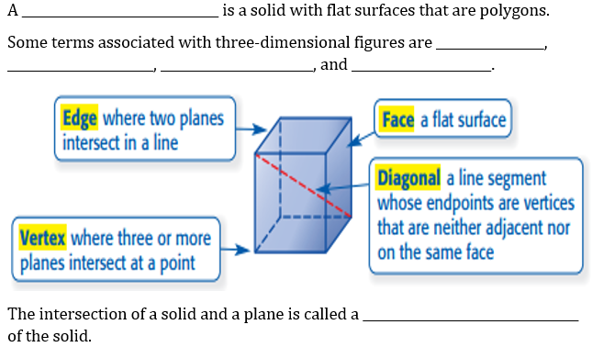
Daily Agenda
4-8 3-Dimensional Figures
What am I learning today?
G.GMD.4 Identify the shapes of two-dimensional cross-sections of three-dimensional objects and rotations
What am I going to do today?
Cross Sections
3-Dimensional Figures
How will I show you that I’ve learned it?
Daily 5 Question Check for Understanding
Daily Ticket out the Door
polyhedron
edge
face
vertex
diagonal
cross section

Slide 59
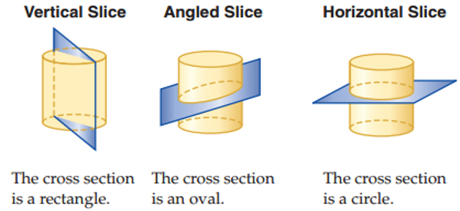
Daily Agenda
4-8 3-Dimensional Figures
What am I learning today?
G.GMD.4 Identify the shapes of two-dimensional cross-sections of three-dimensional objects and rotations
What am I going to do today?
Cross Sections
3-Dimensional Figures
How will I show you that I’ve learned it?
Daily 5 Question Check for Understanding
Daily Ticket out the Door

Slide 60
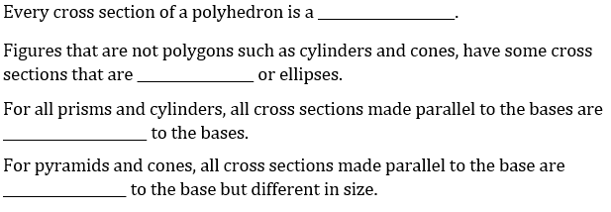
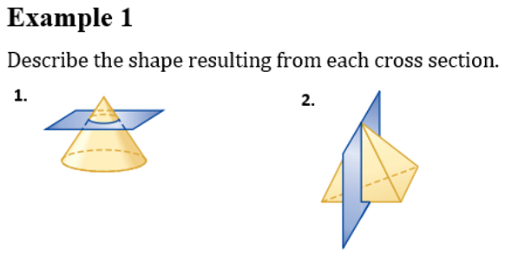
Daily Agenda
4-8 3-Dimensional Figures
polygon
What am I learning today?
G.GMD.4 Identify the shapes of two-dimensional cross-sections of three-dimensional objects and rotations
What am I going to do today?
Cross Sections
3-Dimensional Figures
How will I show you that I’ve learned it?
Daily 5 Question Check for Understanding
Daily Ticket out the Door
circles
congruent
similar
circle
triangle

Slide 61
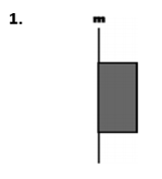
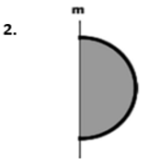
Daily Agenda
4-8 3-Dimensional Figures
What am I learning today?
G.GMD.4 Identify the shapes of two-dimensional cross-sections of three-dimensional objects and rotations
What am I going to do today?
Cross Sections
3-Dimensional Figures
How will I show you that I’ve learned it?
Daily 5 Question Check for Understanding
Daily Ticket out the Door
axis

Slide 62
4-8 3-Dimensional Figures
Daily Agenda
What am I learning today?
G.GMD.2 Give an informal argument using Cavalieri’s Principle for the formulas for the volume of a sphere and other solids
What am I going to do today?
Cavalieri’s Principle
Density
How will I show you that I’ve learned it?
Daily 5 Question Check for Understanding
Daily Ticket out the Door
Example 3
$$V=πr^{2}h$$
Cylinder A:
Cylinder B:
$$V=π{(5)}^{2}(12)$$
$$V=π{(5)}^{2}(12)$$
$$V=300π$$
$$V=300π$$
$$V=942.5m^{3}$$
$$V=942.5m^{3}$$

Slide 63
4-8 3-Dimensional Figures
Daily Agenda
What am I learning today?
G.GMD.2 Give an informal argument using Cavalieri’s Principle for the formulas for the volume of a sphere and other solids
What am I going to do today?
Cavalieri’s Principle
Density
How will I show you that I’ve learned it?
Daily 5 Question Check for Understanding
Daily Ticket out the Door
Example 4

