Slide 1
Unit 4: Circles and Volume
Circle Vocabulary

Slide 2
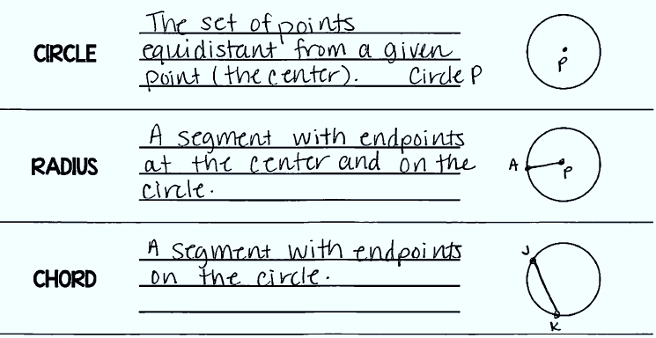
Daily Agenda

Slide 3
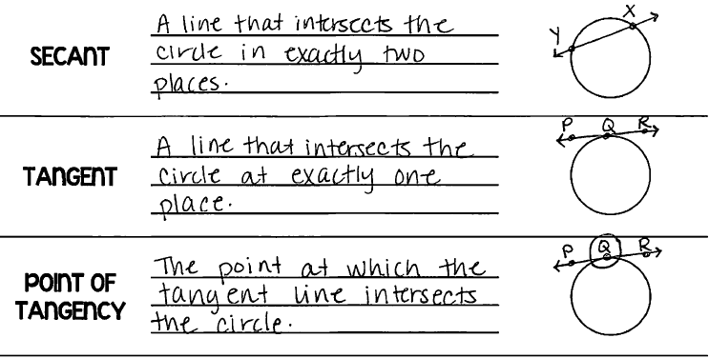
Daily Agenda

Slide 4
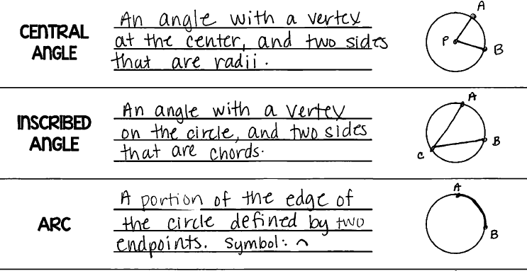
Daily Agenda

Slide 5
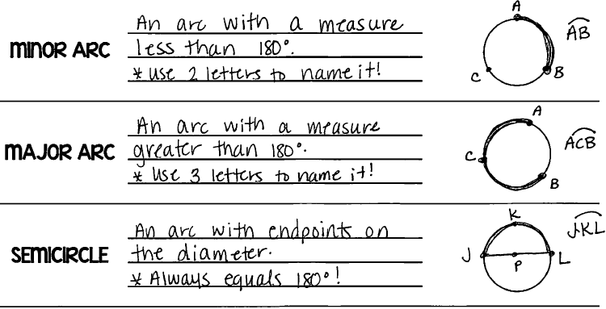
Daily Agenda

Slide 6
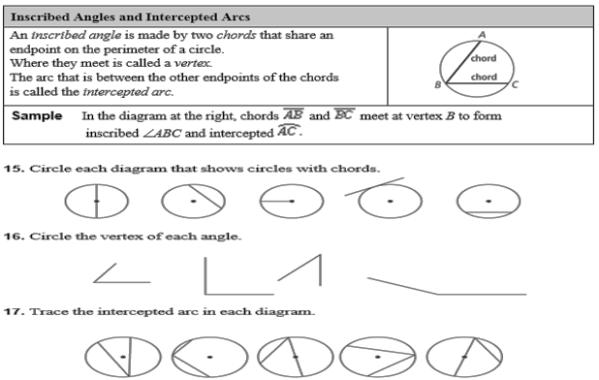
Daily Agenda

Slide 7
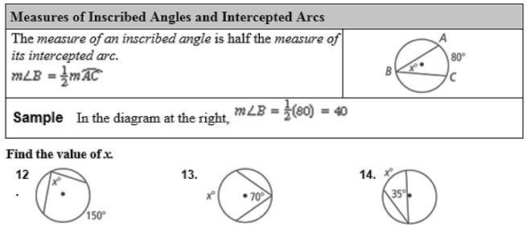
Daily Agenda
$$\frac{1}{2}\left(150\right)=$$
$$\left(70\right)×2=$$
$$\left(35\right)×2=$$

Slide 8
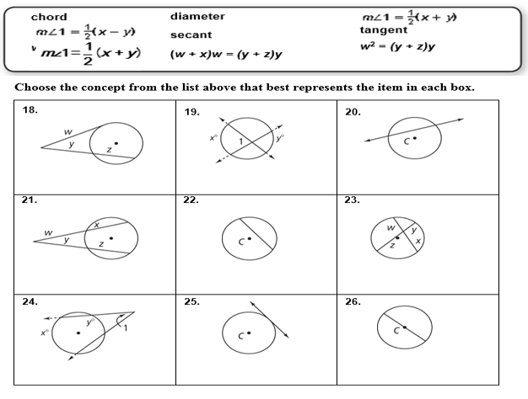
Daily Agenda

Slide 9
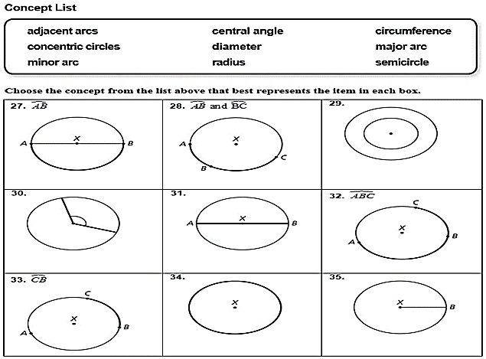
Daily Agenda
Adjacent arcs
Semicircle
Concentric circles
Central angle
diameter
Major arc
Minor arc
circumference
radius

Slide 10
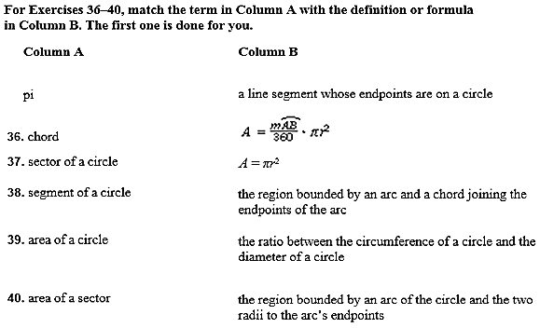
Daily Agenda

Slide 11
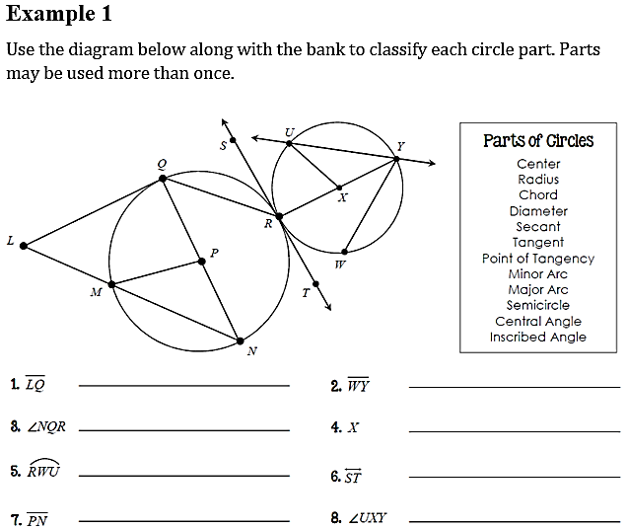
Daily Agenda
Tangent
Chord
Inscribed Angle
Center
Major Arc
Tangent
Radius
Central Angle

Slide 12
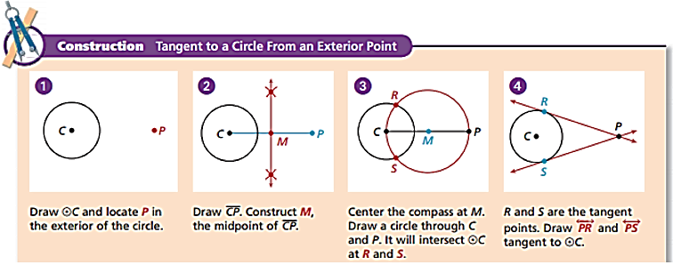
Daily Agenda
http://Construction: Tangent to a Circle

Slide 13
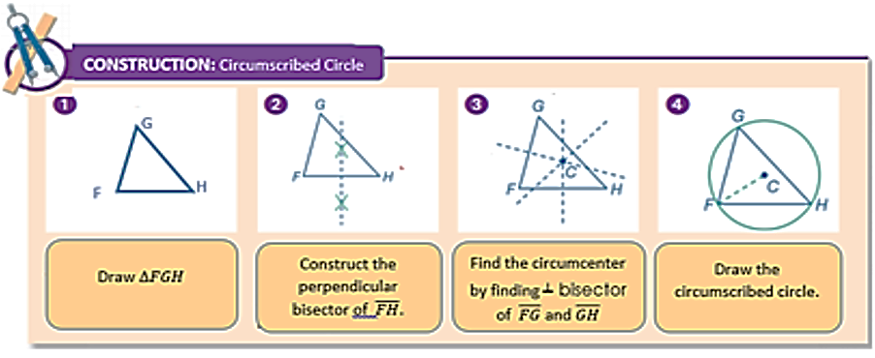
Daily Agenda
http://Construction: Circumscribed Circle

Slide 14
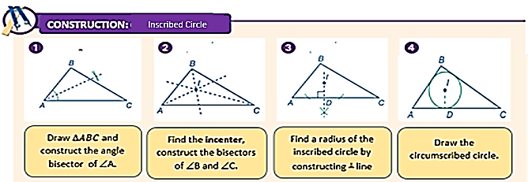
Daily Agenda
Construction: Inscribed Circle

Slide 15
Unit 4: Circles and Volume
4.1 Similar Circles and Proportions

Slide 16
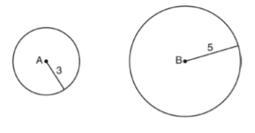
4 – 1 Similar Circles and Proportions
similar
sequence
of
All circles are __________________ if there exists a ____________________ ___ ______________________ that maps circle A onto circle B.
In the diagram to the above, Circle A can be mapped onto circle B by first ______________ circle A onto circle B, and then _______________ circle A, centered at A, by a scale factor of $\frac{5}{3}$ .
Since there exists a sequence of transformations that maps circle A onto circle B, circle A is ____________ to circle B.
Performing a translation and dilation can transform a circle into any other circle. In other words, all circles are similar.
transformations
rotating
dilating
similar

Slide 17
Circle #1
C = $2π\left(5\right)$
C = 10$π$
Ratio
$\frac{10π}{5}$ = 2$π$
Circle #2
C = $2π\left(10\right)$
C = 20$π$
Ratio
$\frac{20π}{10}$ = 2$π$
These circles are similar because the ratios of the circumference to the radius for both circles is 2$π$.

Slide 18
proportional
radius
concentric
circles

Slide 19
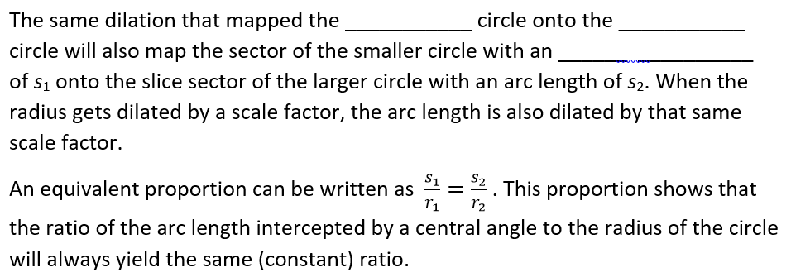
smaller
larger
arc
length

Slide 20
To find x:
$\frac{25}{5}$ = $\frac{50}{\overline{PA}}$
Smaller Circle
$\frac{s_{1}}{r_{1}}$ = $\frac{25}{5}$ = 5
Larger Circle
$\frac{s_{2}}{r_{2}}$ = $\frac{50}{\overline{PA}}$
25y = 250
y = 10
x = 10 – 5 = 5

Slide 21
Unit 4: Circles and Volume
4.2 Circumference and Arc Length of a Circle

Slide 22
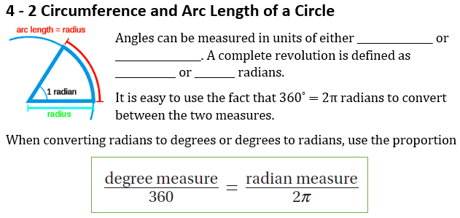
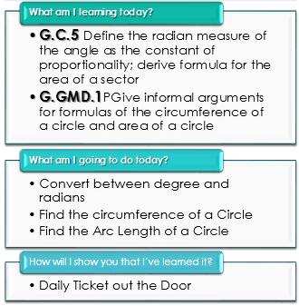
Daily Agenda
degrees
radians
360˚
2π

Slide 23
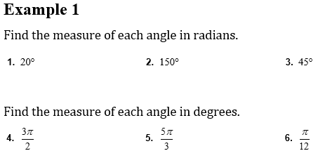
Daily Agenda
Converting between Degrees and Radians
$$20×\frac{π}{180}=$$
$$\frac{π}{9}$$
$$150×\frac{π}{180}=$$
$$\frac{5π}{6}$$
$$45×\frac{π}{180}=$$
$$\frac{π}{4}$$
$$\frac{3π}{2}×\frac{180}{π}=$$
$$\frac{5π}{3}×\frac{180}{π}=$$
$$270°$$
$$300°$$
$$\frac{π}{12}×\frac{180}{π}=$$
$$15°$$

Slide 24
Daily Agenda
perimeter
circumference
diameter
radius
double
ratio
π
$$\frac{22}{7}$$
3.14

Slide 25
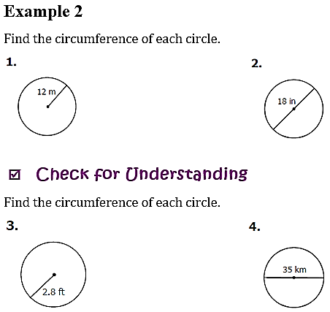
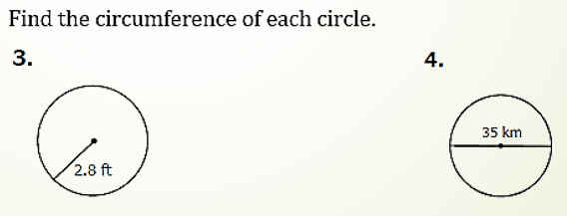
Daily Agenda
$$2π\left(12\right)=$$
$$24π$$
$$2π\left(9\right)=$$
$$18π$$
$$2π\left(17.5\right)=$$
$$35π$$
$$2π\left(2.8\right)=$$
5.6$π$

Slide 26
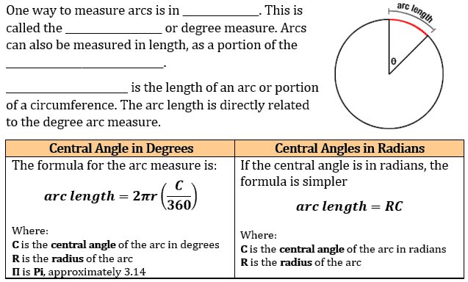
Daily Agenda
degrees
angle measure
circumference
Arc length

Slide 27
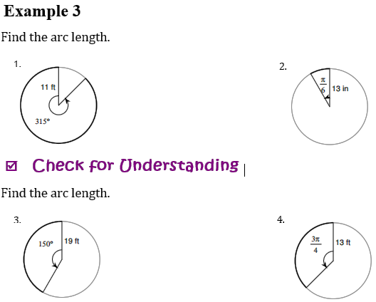
Daily Agenda
$$2π(11)×\frac{315}{360}=$$
$$13×\frac{π}{6}=$$
$$\frac{77π}{4}$$
$$\frac{13π}{6}$$
$$2π(19)×\frac{150}{360}=$$
$$\frac{95π}{6}$$
$$13×\frac{3π}{4}=$$
$$\frac{39π}{4}$$

Slide 28
Daily Agenda
Example 4
Find the missing variable. Round to nearest hundredth if necessary.
Arc Length = 66 2. Arc Length = 135
Central angle = $\frac{π}{2}$ Central Angle = 55$°$
Radius = Radius =
3. Arc Length = 300$π$ 4. Arc Length = 28
Central Angle = (in radians) Central Angle = (in degrees)
Radius = 6$π$ Radius = 7
$$66=R(\frac{π}{2})$$
$$135=2πr(\frac{55}{360})$$
R = 42.02
$$\frac{9720}{11}=2πr$$
R = $\frac{4860π}{11}$
28 $=2π(7)(\frac{C}{360})$
$$300π=6πC$$
C = 50$°$
C = 229.18$°$
28 $=14π(\frac{C}{360})$
$$\frac{2}{π}= \frac{C}{360}$$

Slide 29
Unit 4: Circles and Volume
4.3 Area and Area of a Sector

Slide 30
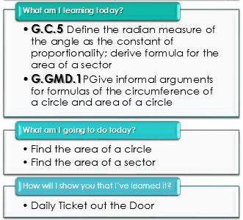
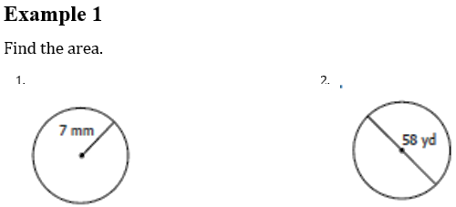
Daily Agenda
area
radius
$$π{(7)}^{2}=$$
$$49π$$
$$π{(29)}^{2}=$$
$$841π$$

Slide 31
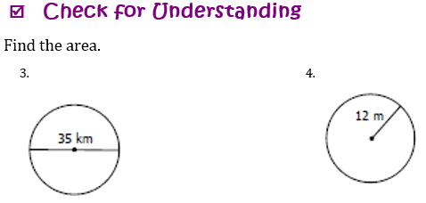
Daily Agenda
$$π{(17.5)}^{2}=$$
$$306.25π$$
$$π{(12)}^{2}=$$
$$144π$$

Slide 32
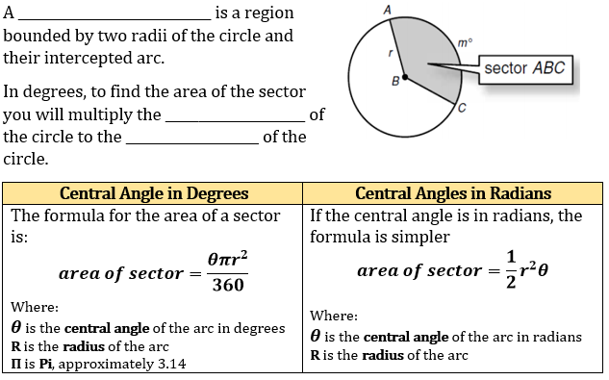
Daily Agenda
area of a sector
area
angle ratio

Slide 33
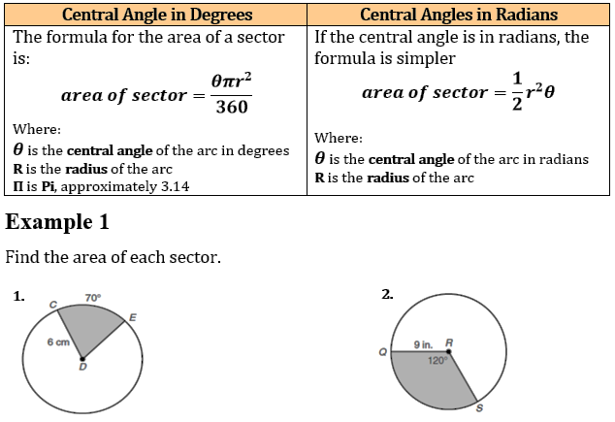
Daily Agenda
2
$$\frac{(120)π{(9)}^{2}}{360}=$$
$$\frac{(70)π{(6)}^{2}}{360}=$$
$$7π$$
$$27π$$

Slide 34
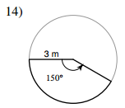
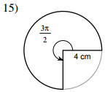
Daily Agenda
2
3.
4.
$$\frac{(150)π{(3)}^{2}}{360}=$$
$$\frac{15π}{4}$$
$$\frac{1}{2}(4^{2})\frac{3π}{2}=$$
$$12π$$

Slide 35
Daily Agenda
Example 3
Find the missing variable.
1. Area of Sector = 72 2. Area of Sector = 125
Radius = 4 Radius =
Central Angle = (in degrees) Central Angle = 10$°$
72 $= \frac{θπ(4^{2})}{360}$
125 $=$ $\frac{1}{2}r^{2}(10)$
125 $=5r^{2}$
25920 $=16πθ$
25 $=r^{2}$
$$θ=\frac{1620}{π}$$
r = 5

Slide 36
Area of a Segment of a Circle
The segment of a circle is the region bounded by a chord and the arc subtended by the chord. The segment is the small partially curved figure left when the triangular portion of the sector is removed.
To find the area of the segment:

Slide 37
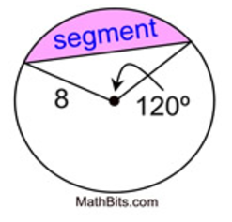
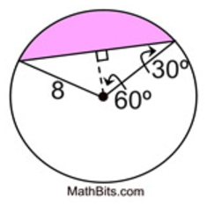
Example 4: Find the area of a segment of a circle with a central angle of 120 degrees and a radius of 8 cm. Express answer to the nearest integer.
Step 1: Find the area of the sector
Step 2: Draw the line that represents the height (altitude) of the triangle.

Slide 38
Step 3: Use the appropriate Trig ratio to find the missing sides
x = height of the triangle y = base of the triangle
Sin 60°= $\frac{y}{8}$ Cos 60°= $\frac{x}{8}$
8 ·sin 60 = y 8 ·cos 60 = x
6.93 = y 4 = x

Slide 39
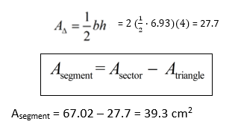
Step 4: Find the area of the triangle.

Slide 40
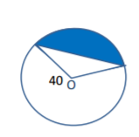
Example 5: Find the area of a segment of a circle if the central angle of the segment is 165º and the radius is 40.

Slide 41
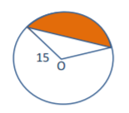
Example 6: Find the area of a segment of a circle if the central angle of the segment is 50º and the radius is 15.

Slide 42
Unit 4: Circles and Volume
4.4 Central and Inscribed Angles

Slide 43
Daily Agenda
arc
arc-like
length
measure
central
80˚
central
80˚
vertex
intercepted arc

Slide 44
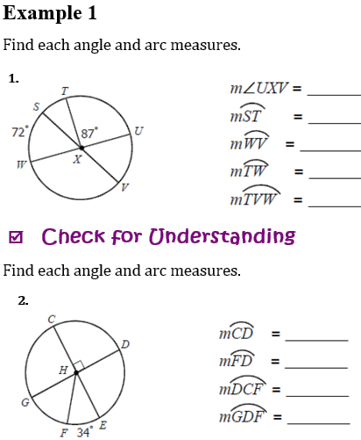
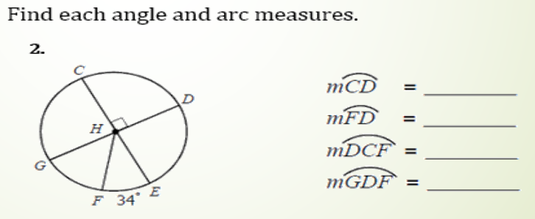
Daily Agenda
72˚
21˚
108˚
93˚
267˚
90˚
124˚
236˚
304˚

Slide 45
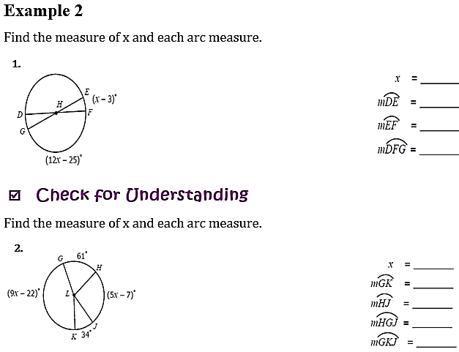
Daily Agenda
16
167˚
13˚
347˚
21
167˚
98˚
262˚
201˚

Slide 46
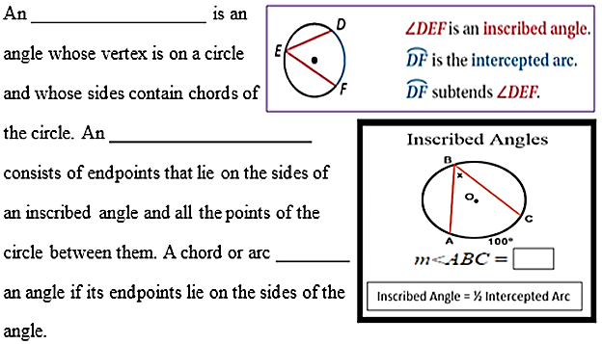
Daily Agenda
inscribed angle
intercepted arc
subtends
50$°$

Slide 47
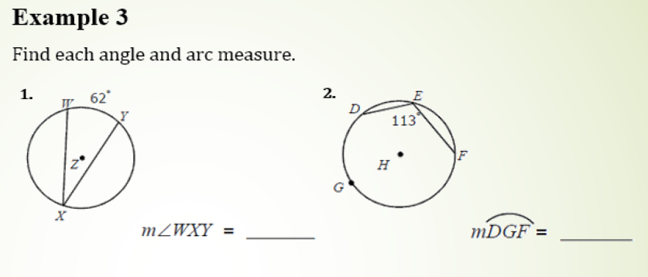
Daily Agenda
31˚
226˚

Slide 48
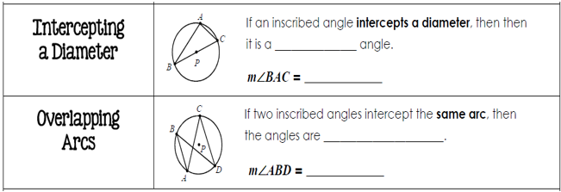
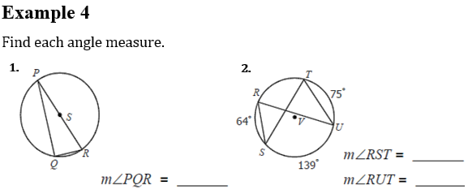
Daily Agenda
right
90˚
congruent
m∠ACD
41˚
90˚
41˚

Slide 49
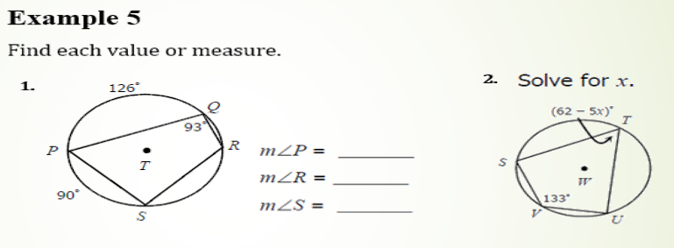
Daily Agenda
supplementary
$$m∠A+m∠C=180$$
$$m∠B+m∠D=180$$
72˚
108˚
87˚
x = 3

