Slide 1
Unit 3: Right Triangle Trigonometry
Vocabulary Builder

Slide 2
Daily Agenda
Hypotenuse
Similar Triangles
Square Root
Simplest radical
form
leg
Variable
Pythagorean Theorem
45-45-90 Triangle
30-60-90 Triangle

Slide 3
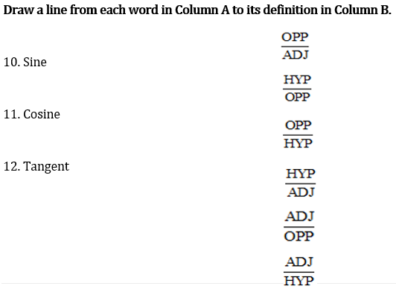
Daily Agenda

Slide 4
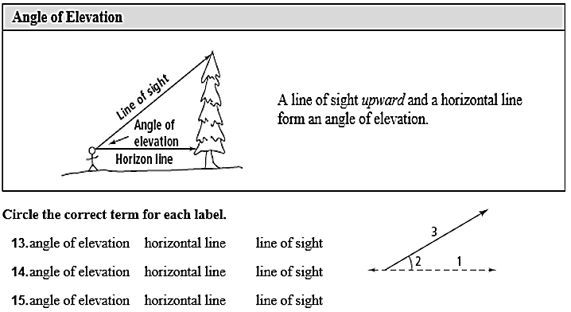
Daily Agenda

Slide 5
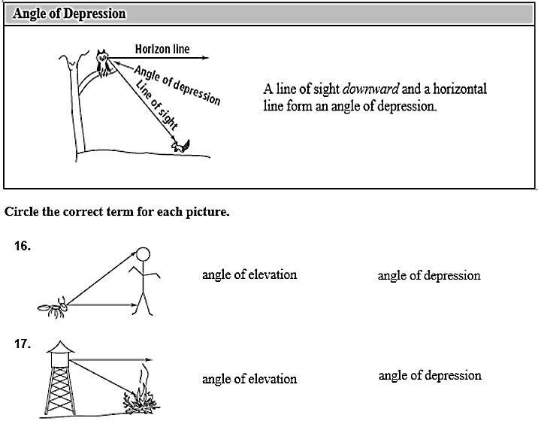
Daily Agenda

Slide 6
Unit 3: Right Triangle Trigonometry
3.1 Trigonometric Ratios

Slide 7
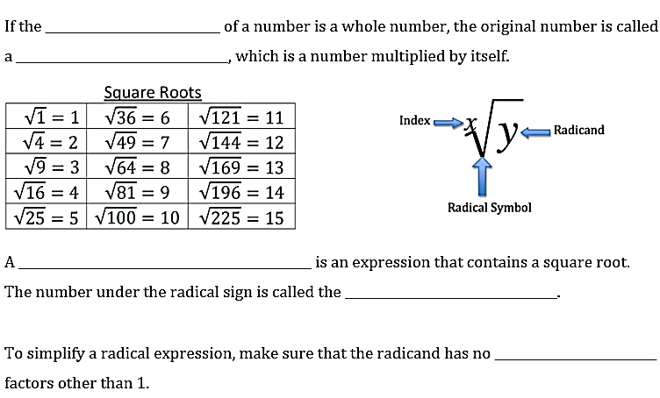
3.1 Trigonometric Ratios
Daily Agenda
square root
perfect square
radical expression
radicand
perfect square

Slide 8
3.1 Trigonometric Ratios
Daily Agenda
5
8
14
30
18
23
Example 2
$$6\sqrt{2}$$
2$\sqrt{6}$
3$\sqrt{11}$
10$\sqrt{3}$
3$\sqrt{10}$
$$5\sqrt{3}$$

Slide 9
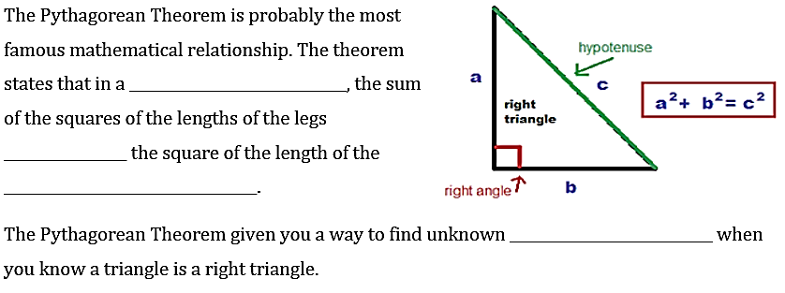
3.1 Trigonometric Ratios
Daily Agenda
right triangle
equals
hypotenuse
side lengths

Slide 10
3.1 Trigonometric Ratios
Daily Agenda
Example 3
13)
14)
15)
$$4^{2}+8^{2}=x^{2}$$
$$6^{2}+3^{2}=x^{2}$$
$$x^{2}+{3.9}^{2}={11}^{2}$$
$$16+64=x^{2}$$
$$36+9=x^{2}$$
$$x^{2}+15.21=121$$
$$80=x^{2}$$
$$45=x^{2}$$
$$x^{2}=105.79$$
$$4\sqrt{5}=x$$
$$3\sqrt{5}=x$$
$$x=10.29$$

Slide 11
3.1 Trigonometric Ratios
Daily Agenda
We can use the Pythagorean Theorem to determine if 3 given numbers represent the sides of a right triangle.
Example 4
1. 5, 5, 10
2. 9, 12, 15
$5^{2}$+ $5^{2}$= ${10}^{2}$
$9^{2}$+ ${12}^{2}$= ${15}^{2}$
25 + 25 = 100
81 + 144 = 225
50 $≠$100 NO
225 = 225 YES
3. 6, 8, 10
4. 4, 6, $\sqrt{40}$

Slide 12
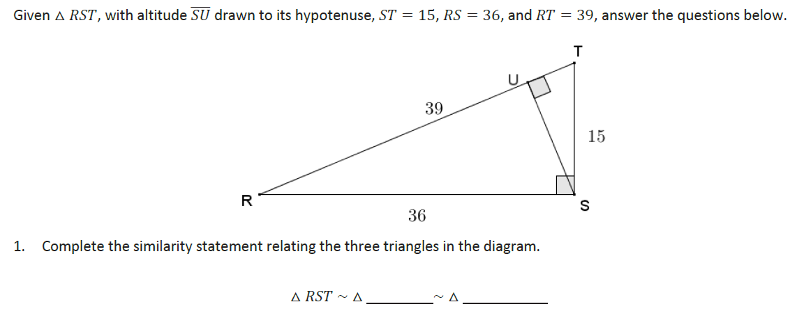
3.1 Trigonometric Ratios
Daily Agenda
Dividing into 2 Similar Sub-Triangles
Example 5
$$RUS$$
$$SUT$$

Slide 13
3.1 Trigonometric Ratios
Daily Agenda
Dividing into 2 Similar Sub-Triangles
Example 5 con’t
15:39
36:39
15:36
$\overline{SU}$:36
$\overline{RU}$:36
$\overline{SU}$:$\overline{RU}$
$\overline{TU}$:15
$\overline{SU}$:15
$\overline{SU}$:$\overline{TU}$

Slide 14
3.1 Trigonometric Ratios
Daily Agenda
Dividing into 2 Similar Sub-Triangles
Example 5 con’t
3. Use the values of the ratios you calculated to find the length of $\overline{SU}, \overline{RU},$ and $\overline{TU}.$

Slide 15
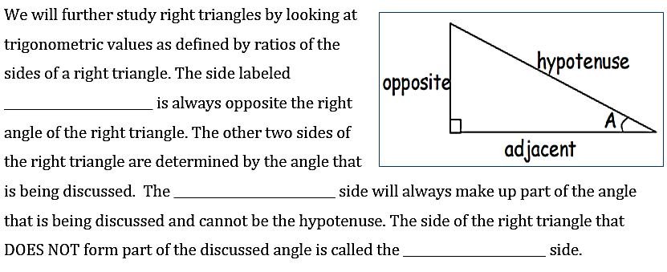
3.1 Trigonometric Ratios
Daily Agenda
hypotenuse
adjacent
opposite

Slide 16
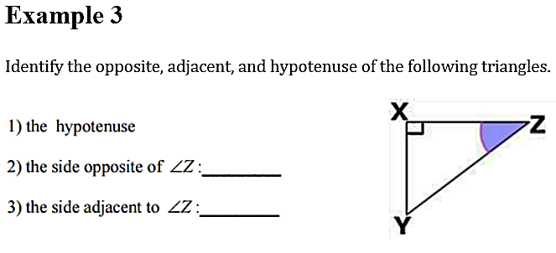
3.1 Trigonometric Ratios
Daily Agenda
Example 6
$$\overline{YZ}$$
$$\overline{XY}$$
$$\overline{XZ}$$

Slide 17
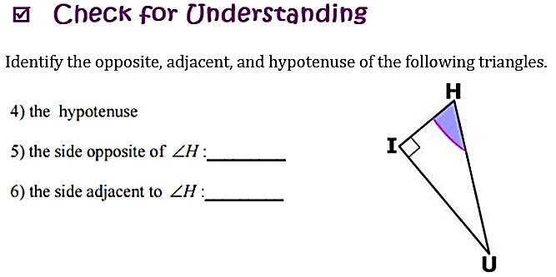
3.1 Trigonometric Ratios
Daily Agenda
Example 7
$$\overline{HU}$$
$$\overline{UI}$$
$$\overline{HI}$$

Slide 18
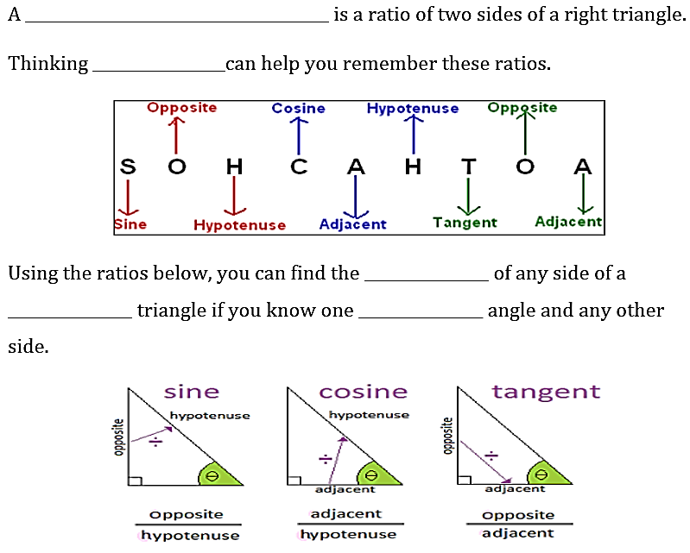
3.1 Trigonometric Ratios
Daily Agenda
trigonometric ratio
SOH CAH TOA
length
right
acute

Slide 19
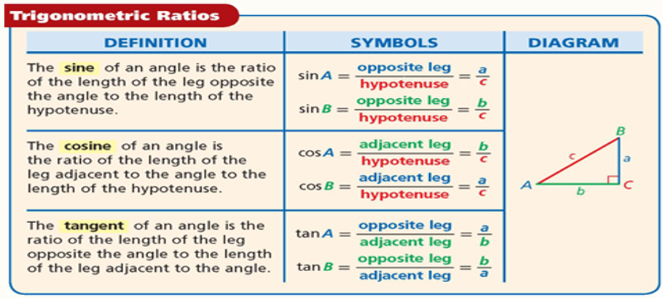
3.1 Trigonometric Ratios
Daily Agenda

Slide 20
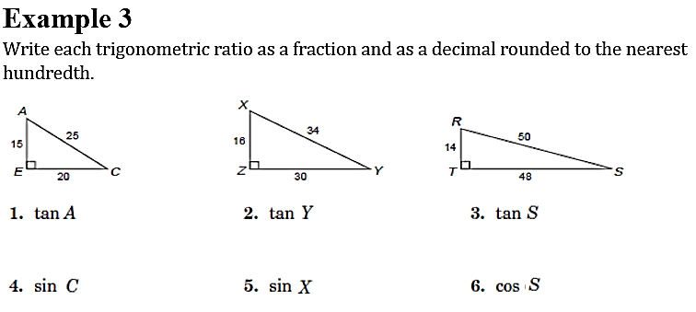
3.1 Trigonometric Ratios
Daily Agenda
Example 8
SOH CAH TOA
$$\frac{OPP}{ADJ}$$
$$=\frac{20}{15}$$
$$=\frac{4}{3}$$
$$\frac{OPP}{ADJ}$$
$$=\frac{16}{30}$$
$$=\frac{8}{15}$$
$$\frac{OPP}{ADJ}$$
$$=\frac{14}{48}$$
$$=\frac{7}{24}$$
$$\frac{OPP}{HYP}$$
$$=\frac{15}{25}$$
$$=\frac{3}{5}$$
$$\frac{OPP}{HYP}$$
$$=\frac{30}{34}$$
$$=\frac{15}{17}$$
$$\frac{ADJ}{HYP}$$
$$=\frac{48}{50}$$
$$=\frac{24}{25}$$

Slide 21
3.1 Trigonometric Ratios
Daily Agenda
Example 9
$$=\frac{11}{29}$$
$$=\frac{11}{29}$$
$$=\frac{25}{29}$$
$$=\frac{25}{11}$$
$$=\frac{18}{7}$$
$$=1$$

Slide 22
Simplify each radical
$√72$ 4. $√300$
$√24$ 5. $√90$
3. $√99$ 6. $√75$

Slide 23
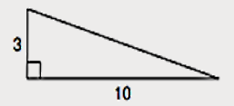
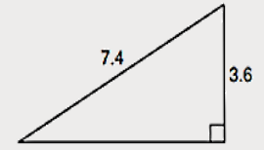
Use Pythagorean Theorem to solve for missing sides.
8.
9.

Slide 24
Write the requested trig ratio
sin B = sin G = sin D =
cos B = cos G = cos D =
tan B = tan G = tan D =
sin C = sin H = sin F =
cos C = cos H = cos F =
tan C = tan H = tan F =

Slide 25
Unit 3: Right Triangle Trigonometry
3.2 Finding Sides and Angles of Right Triangles

Slide 26
Daily Agenda
3.2 Missing Sides and Angles
functions
angle
input
output

Slide 27
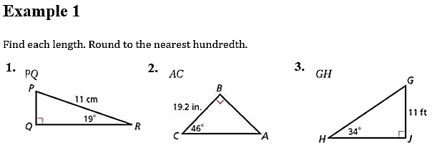
Daily Agenda
3.2 Missing Sides and Angles
x
x
x
$$\sin{R}=\frac{OPP}{HYP}$$
$$\cos{C}=\frac{ADJ}{HYP}$$
$$\sin{H}=\frac{OPP}{HYP}$$
$$\sin{19°}=\frac{x}{11}$$
$$\cos{46°}=\frac{19.2}{x}$$
$$\sin{34°}=\frac{11}{x}$$
$$11∙\sin{19°}=x$$
$$x=\frac{19.2}{\cos{46°}}$$
$$x=\frac{11}{\sin{34°}}$$
$$3.58=x$$
$$x=27.64$$
$$x=19.67$$

Slide 28
Daily Agenda
3.2 Missing Sides and Angles
Example 2
x
$$\tan{26°}=\frac{OPP}{ADJ}$$
$$\tan{50°}=\frac{OPP}{ADJ}$$
$$\tan{20°}=\frac{OPP}{ADJ}$$
$$14.63=x$$
$$x=15.49$$
$$x=6.92$$

Slide 29
Daily Agenda
3.2 Missing Sides and Angles
sin⁻¹
cos⁻¹
tan⁻¹
Example 3
$$\tan{x}=\frac{5}{5}$$
$$\tan{x}=\frac{5}{12}$$
$$\cos{x}=\frac{40}{42}$$
$$\tan{x}=1$$
$$\tan^{−1}\left(\frac{5}{12}\right)=x$$
$$\cos^{−1}\left(\frac{40}{42}\right)=x$$
$$\tan^{−1}\left(1\right)=x$$
$$45°=x$$
$$22.6°=x$$
$$17.8°=x$$

Slide 30
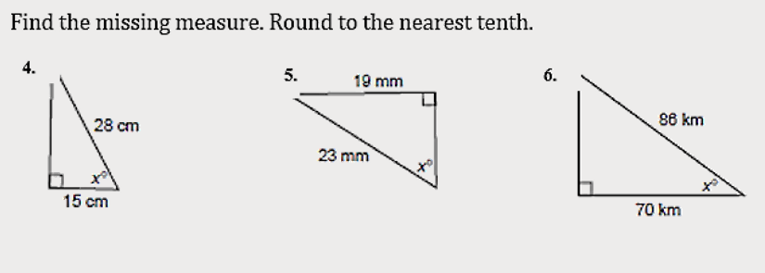
Daily Agenda
3.2 Missing Sides and Angles
Example 4
$$\cos^{−1}\left(\frac{15}{28}\right)=x$$
$$\sin^{−1}\left(\frac{19}{23}\right)=x$$
$$\cos^{−1}\left(\frac{70}{86}\right)=x$$
$$57.6°=x$$
$$55.7°=x$$
$$35.5°=x$$

Slide 31
Unit 3: Right Triangle Trigonometry
3.3 Sine and Cosine of Complementary Angles

Slide 32
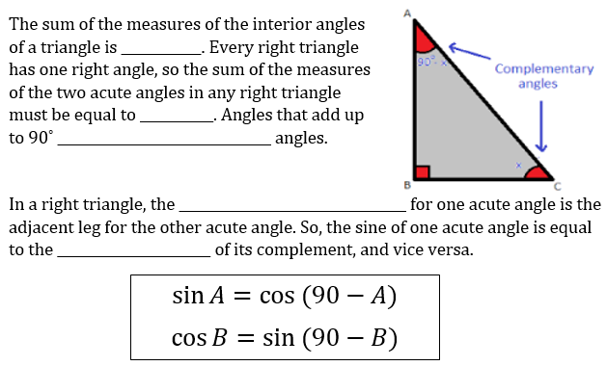
Daily Agenda
3.3 Sine and Cosine of Complementary Angles
What am I learning today?
What am I going to do today?
How will I show you that I’ve learned it?
G.SRT.7 Explain and use the relationship between the sine and cosine of complementary angles
Find the complement of sine and cosine
5 Question Daily Assessment
Daily Ticket out the Door
180˚
90˚ - x
90˚
complementary
x
opposite angle
cosine

Slide 33
Daily Agenda
3.3 Sine and Cosine of Complementary Angles
What am I learning today?
What am I going to do today?
How will I show you that I’ve learned it?
G.SRT.7 Explain and use the relationship between the sine and cosine of complementary angles
Find the complement of sine and cosine
5 Question Daily Assessment
Daily Ticket out the Door
$$=cos{26°}$$
$$=sin{6°}$$
$$=sin{52°}$$
$$=cos{66°}$$
$$=sin{18°}$$
$$=cos{45°}$$
Example 2
$$=cos{68°}$$
$$=sin{25°}$$
$$=sin{46°}$$
$$=cos{58°}$$
$$=sin{65°}$$
$$=cos{75°}$$

Slide 34
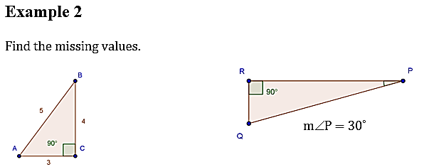
Daily Agenda
3.3 Sine and Cosine of Complementary Angles
What am I learning today?
What am I going to do today?
How will I show you that I’ve learned it?
G.SRT.7 Explain and use the relationship between the sine and cosine of complementary angles
Find the complement of sine and cosine
5 Question Daily Assessment
Daily Ticket out the Door
Example 3
$$\frac{4}{5}$$
$$\frac{3}{5}$$
$$\frac{3}{5}$$
$$\frac{4}{5}$$

Slide 35
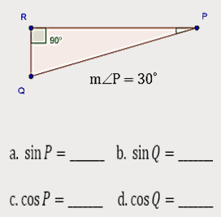
Daily Agenda
3.3 Sine and Cosine of Complementary Angles
What am I learning today?
What am I going to do today?
How will I show you that I’ve learned it?
G.SRT.7 Explain and use the relationship between the sine and cosine of complementary angles
Find the complement of sine and cosine
5 Question Daily Assessment
Daily Ticket out the Door
Example 3 continued
Then m∠Q = 60˚
$$0.5$$
$$0.866$$
$$0.866$$
$$0.5$$
Sin A and Cos B are the same which means the complement of sine and cosine are equal.

Slide 36
Daily Agenda
3.3 Sine and Cosine of Complementary Angles
What am I learning today?
What am I going to do today?
How will I show you that I’ve learned it?
G.SRT.7 Explain and use the relationship between the sine and cosine of complementary angles
Find the complement of sine and cosine
5 Question Daily Assessment
Daily Ticket out the Door
Example 4
$$\cos{52°}$$
$$≈0.616$$
$$\sin{30°}$$
$$≈0.5$$

Slide 37
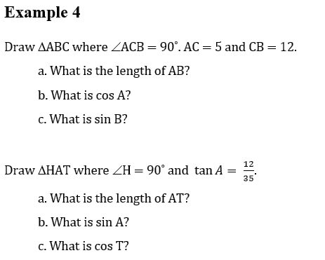
Daily Agenda
3.3 Sine and Cosine of Complementary Angles
What am I learning today?
What am I going to do today?
How will I show you that I’ve learned it?
G.SRT.7 Explain and use the relationship between the sine and cosine of complementary angles
Find the complement of sine and cosine
5 Question Daily Assessment
Daily Ticket out the Door
Example 5
13
A
$$\frac{5}{13}$$
$$5^{2}+{12}^{2}=x^{2}$$
13
$$25+144=x^{2}$$
5
$$\frac{5}{13}$$
$$169=x^{2}$$
$$13=x$$
C
12
B
A
37
$$\frac{12}{37}$$
37
$${12}^{2}+{35}^{2}=x^{2}$$
35
$$\frac{12}{37}$$
$$144+1225=x^{2}$$
$$1369=x^{2}$$
H
T
$$37=x$$
12

Slide 38
Daily Agenda
3.3 Sine and Cosine of Complementary Angles
What am I learning today?
What am I going to do today?
How will I show you that I’ve learned it?
G.SRT.7 Explain and use the relationship between the sine and cosine of complementary angles
Find the complement of sine and cosine
5 Question Daily Assessment
Daily Ticket out the Door
Example 5 continued
10
$$\frac{4}{5}$$
$$\frac{4}{5}$$
$$8^{2}+6^{2}=x^{2}$$
$$64+36=x^{2}$$
$$100=x^{2}$$
$$10=x$$

Slide 39
Unit 3: Right Triangle Trigonometry
3.4 Solve Right Triangles

Slide 40
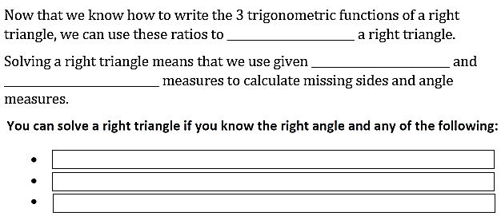
3.4 Solve Right Triangles using
Trigonometric Ratios
Daily Agenda
What am I learning today?
What am I going to do today?
How will I show you that I’ve learned it?
G.SRT.8 Use trigonometric ratios and the Pythagorean Theorem to solve triangles in applied problems
Use the Pythagorean Theorem to Solve Right Triangles
5 Question Daily Assessment
Daily Ticket out the Door
Use Trigonometric Ratios to Solve Right Triangles
solve
side lengths
angle
The length of two sides
The length of 1 side and 1 acute angle
The length of 1 side and 1 trigonometric ratio

Slide 41
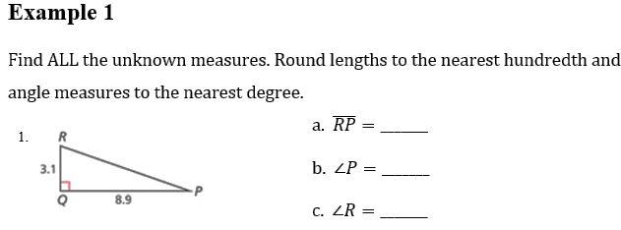
3.4 Solve Right Triangles using
Trigonometric Ratios
Daily Agenda
What am I learning today?
What am I going to do today?
How will I show you that I’ve learned it?
G.SRT.8 Use trigonometric ratios and the Pythagorean Theorem to solve triangles in applied problems
Use the Pythagorean Theorem to Solve Right Triangles
5 Question Daily Assessment
Daily Ticket out the Door
Use Trigonometric Ratios to Solve Right Triangles
$${3.1}^{2}+{8.9}^{2}=x^{2}$$
$$9.61+79.21=x^{2}$$
9.42
$$88.82=x^{2}$$
$$9.42=x$$
9.4
$$\tan^{−1}\left(\frac{3.1}{8.9}\right)=∠P$$
19˚
$$19.2°=∠P$$
71˚
∠R = 90 – 19.2 = 70.8˚

Slide 42
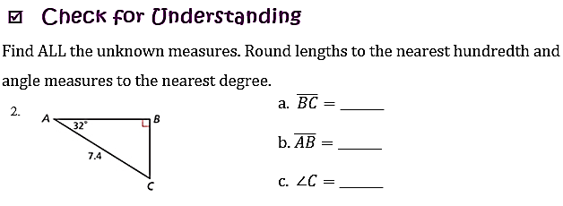
3.4 Solve Right Triangles using
Trigonometric Ratios
Daily Agenda
What am I learning today?
What am I going to do today?
How will I show you that I’ve learned it?
G.SRT.8 Use trigonometric ratios and the Pythagorean Theorem to solve triangles in applied problems
Use the Pythagorean Theorem to Solve Right Triangles
5 Question Daily Assessment
Daily Ticket out the Door
Use Trigonometric Ratios to Solve Right Triangles
Example 2
$$\sin{32°}=\frac{BC}{7.4}$$
$$3.92=BC$$
3.92
6.27
$$x^{2}+{3.9}^{2}={7.4}^{2}$$
6.27
$$x^{2}+15.21=54.76$$
3.92
$$x^{2}=39.55$$
$$x=6.27$$
58˚
∠C = 90 – 32 = 58˚

Slide 43
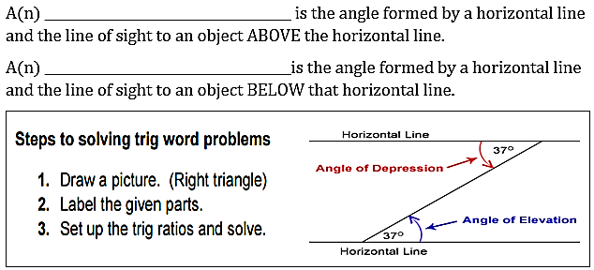
3.4 Solve Right Triangles using
Trigonometric Ratios
Daily Agenda
What am I learning today?
What am I going to do today?
How will I show you that I’ve learned it?
G.SRT.8 Use trigonometric ratios and the Pythagorean Theorem to solve triangles in applied problems
Use the Pythagorean Theorem to Solve Right Triangles
5 Question Daily Assessment
Daily Ticket out the Door
Use Trigonometric Ratios to Solve Right Triangles
angle of elevation
angle of depression

Slide 44
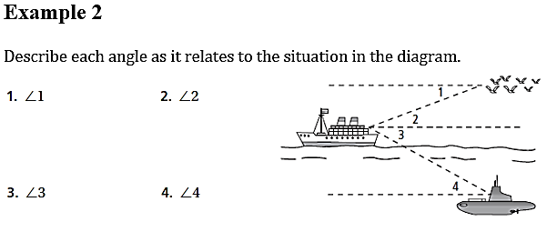
3.4 Solve Right Triangles using
Trigonometric Ratios
Daily Agenda
What am I learning today?
What am I going to do today?
How will I show you that I’ve learned it?
G.SRT.8 Use trigonometric ratios and the Pythagorean Theorem to solve triangles in applied problems
Use the Pythagorean Theorem to Solve Right Triangles
5 Question Daily Assessment
Daily Ticket out the Door
Use Trigonometric Ratios to Solve Right Triangles
Example 3

Slide 45
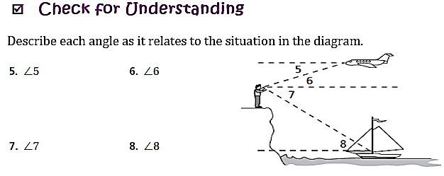
3.4 Solve Right Triangles using
Trigonometric Ratios
Daily Agenda
What am I learning today?
What am I going to do today?
How will I show you that I’ve learned it?
G.SRT.8 Use trigonometric ratios and the Pythagorean Theorem to solve triangles in applied problems
Use the Pythagorean Theorem to Solve Right Triangles
5 Question Daily Assessment
Daily Ticket out the Door
Use Trigonometric Ratios to Solve Right Triangles
Example 4

Slide 46
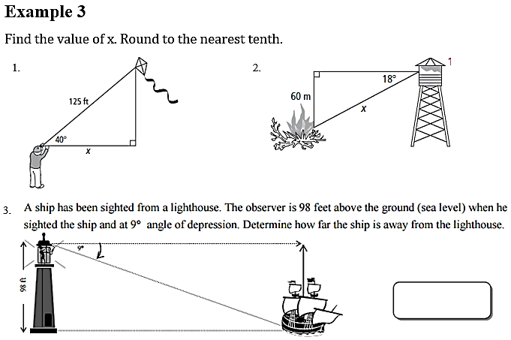
3.4 Solve Right Triangles using
Trigonometric Ratios
Daily Agenda
What am I learning today?
What am I going to do today?
How will I show you that I’ve learned it?
G.SRT.8 Use trigonometric ratios and the Pythagorean Theorem to solve triangles in applied problems
Use the Pythagorean Theorem to Solve Right Triangles
5 Question Daily Assessment
Daily Ticket out the Door
Use Trigonometric Ratios to Solve Right Triangles
Example 5
618.75 ft

Slide 47
3.4 Solve Right Triangles using
Trigonometric Ratios
Daily Agenda
What am I learning today?
What am I going to do today?
How will I show you that I’ve learned it?
G.SRT.8 Use trigonometric ratios and the Pythagorean Theorem to solve triangles in applied problems
Use the Pythagorean Theorem to Solve Right Triangles
5 Question Daily Assessment
Daily Ticket out the Door
Use Trigonometric Ratios to Solve Right Triangles
Example 6
991.86 ft

