Slide 1
Unit 2: Congruence, Similarity, and Dilations
Vocabulary Builder

Slide 2
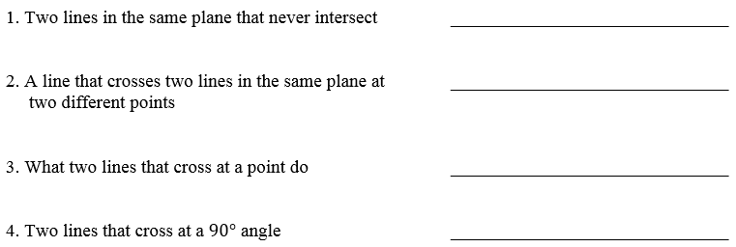
What am I learning today?
What am I going to do today?
How will I show you that I’ve learned it?
G.CO.1 Experiment with transformations in the plane
Use definitions of angles, circles, perpendicular lines, parallel lines, and line segments based on the undefined terms
Daily Ticket out the Door
Vocabulary Builder
Daily Agenda
Parallel
Transversal
Intersect
Perpendicular

Slide 3
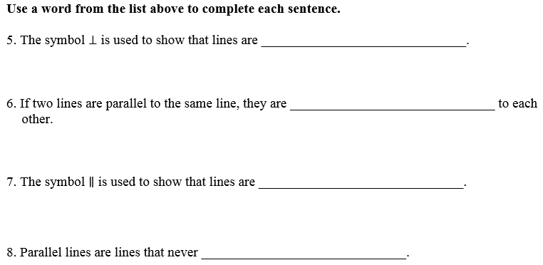
What am I learning today?
What am I going to do today?
How will I show you that I’ve learned it?
G.CO.1 Experiment with transformations in the plane
Use definitions of angles, circles, perpendicular lines, parallel lines, and line segments based on the undefined terms
Daily Ticket out the Door
Vocabulary Builder
Daily Agenda
Perpendicular
Parallel
Parallel
Intersect

Slide 4
What am I learning today?
What am I going to do today?
How will I show you that I’ve learned it?
G.CO.1 Experiment with transformations in the plane
Use definitions of angles, circles, perpendicular lines, parallel lines, and line segments based on the undefined terms
Daily Ticket out the Door
Vocabulary Builder
Daily Agenda
9. | 10. | 11.
12. | 13. | 14.
15. | 16. | 17.
Perpendicular lines
Is perpendicular to
Congruent segments
Perpendicular bisector
Parallel lines
Midpoint
Is greater than
Angle bisector
arc

Slide 5
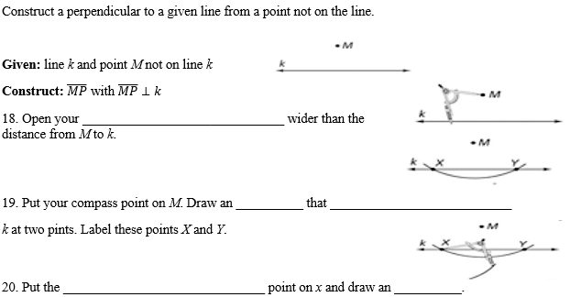
What am I learning today?
What am I going to do today?
How will I show you that I’ve learned it?
G.CO.1 Experiment with transformations in the plane
Use definitions of angles, circles, perpendicular lines, parallel lines, and line segments based on the undefined terms
Daily Ticket out the Door
Vocabulary Builder
Daily Agenda
compass
arc
intersects
compass
arc

Slide 6
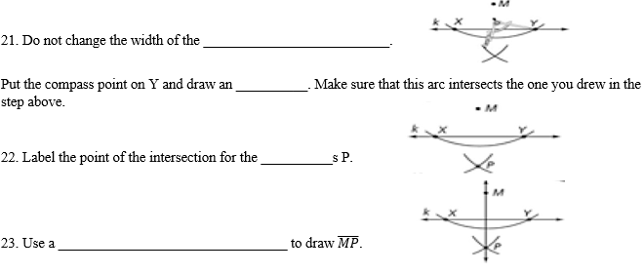
What am I learning today?
What am I going to do today?
How will I show you that I’ve learned it?
G.CO.1 Experiment with transformations in the plane
Use definitions of angles, circles, perpendicular lines, parallel lines, and line segments based on the undefined terms
Daily Ticket out the Door
Vocabulary Builder
Daily Agenda
compass
arc
arc
straightedge

Slide 7
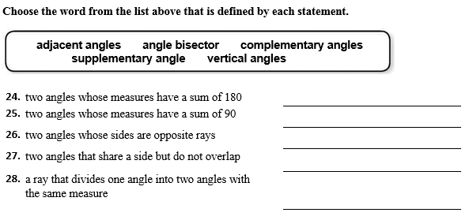
What am I learning today?
What am I going to do today?
How will I show you that I’ve learned it?
G.CO.1 Experiment with transformations in the plane
Use definitions of angles, circles, perpendicular lines, parallel lines, and line segments based on the undefined terms
Daily Ticket out the Door
Vocabulary Builder
Daily Agenda
Supplementary angles
Complementary angles
Vertical angles
Adjacent angles
Angle bisector

Slide 8
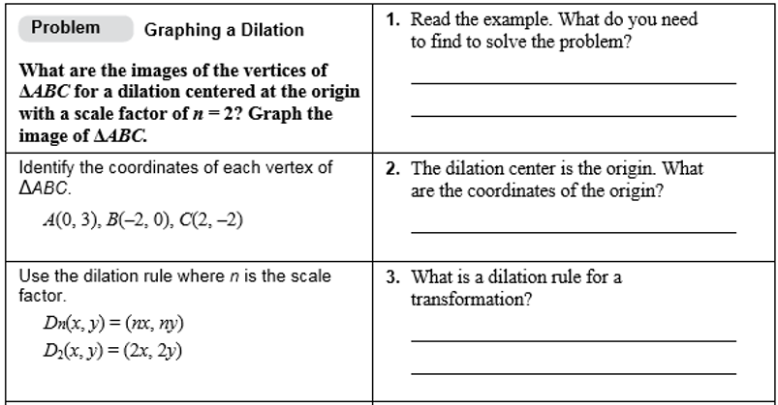
What am I learning today?
What am I going to do today?
How will I show you that I’ve learned it?
G.CO.1 Experiment with transformations in the plane
Use definitions of angles, circles, perpendicular lines, parallel lines, and line segments based on the undefined terms
Daily Ticket out the Door
Vocabulary Builder
Daily Agenda

Slide 9
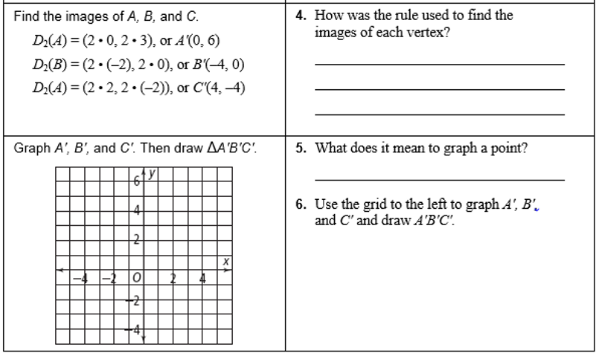
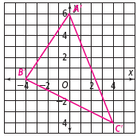
What am I learning today?
What am I going to do today?
How will I show you that I’ve learned it?
G.CO.1 Experiment with transformations in the plane
Use definitions of angles, circles, perpendicular lines, parallel lines, and line segments based on the undefined terms
Daily Ticket out the Door
Vocabulary Builder
Daily Agenda

Slide 10
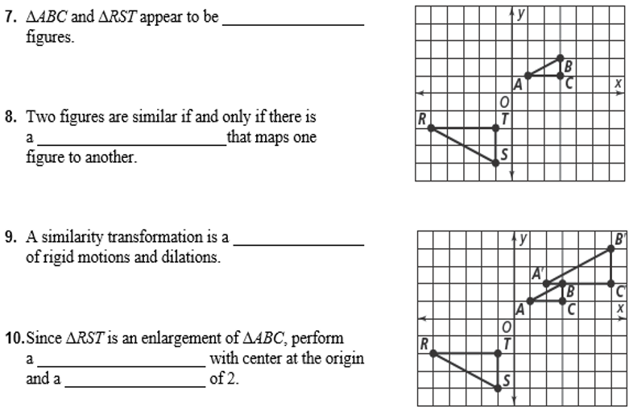
What am I learning today?
What am I going to do today?
How will I show you that I’ve learned it?
G.CO.1 Experiment with transformations in the plane
Use definitions of angles, circles, perpendicular lines, parallel lines, and line segments based on the undefined terms
Daily Ticket out the Door
Vocabulary Builder
Daily Agenda
similar
similarity transformation
composition
dilation
Scale factor

Slide 11
What am I learning today?
What am I going to do today?
How will I show you that I’ve learned it?
G.CO.1 Experiment with transformations in the plane
Use definitions of angles, circles, perpendicular lines, parallel lines, and line segments based on the undefined terms
Daily Ticket out the Door
Vocabulary Builder
Daily Agenda
reflection
line of reflection
translation

Slide 12
Unit 2: Congruence, Similarity, and Proofs
2.1 Constructions of Lines and Angles

Slide 13
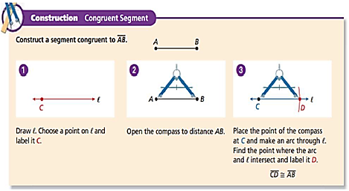
2.1 Constructions of Lines and Angles
Daily Agenda
construction
What am I learning today?
What am I going to do today?
How will I show you that I’ve learned it?
G.CO.12 Make geometric constructions
Make formal geometric constructions with a variety of tools and methods
Daily Ticket out the Door
Copy a Segment, Construct a Segment Bisector
5 Question Daily Assessment
Copy an Angle, Construct an Angle Bisector
Construct Parallel Lines and Perpendicular Bisector
compass
straightedge

Slide 14
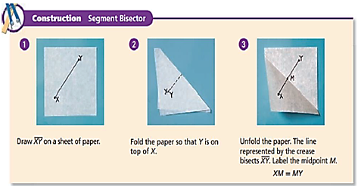
2.1 Constructions of Lines and Angles
2.5 Constructions of Lines and Angles
Daily Agenda
What am I learning today?
What am I going to do today?
How will I show you that I’ve learned it?
G.CO.12 Make geometric constructions
Make formal geometric constructions with a variety of tools and methods
Daily Ticket out the Door
Copy a Segment, Construct a Segment Bisector
5 Question Daily Assessment
Copy an Angle, Construct an Angle Bisector
Construct Parallel Lines and Perpendicular Bisector
segment bisector

Slide 15
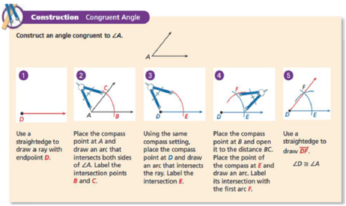
2.2 Constructions of Lines and Angles
Daily Agenda
Congruent segments
What am I learning today?
What am I going to do today?
How will I show you that I’ve learned it?
G.CO.12 Make geometric constructions
Make formal geometric constructions with a variety of tools and methods
Daily Ticket out the Door
Copy a Segment, Construct a Segment Bisector
5 Question Daily Assessment
Copy an Angle, Construct an Angle Bisector
Construct Parallel Lines and Perpendicular Bisector
Tick marks
Congruent angles
Arc marks

Slide 16
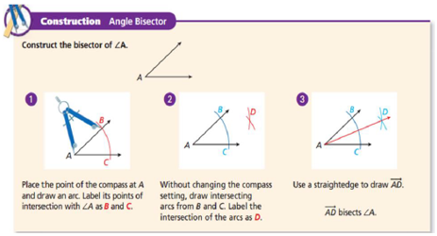
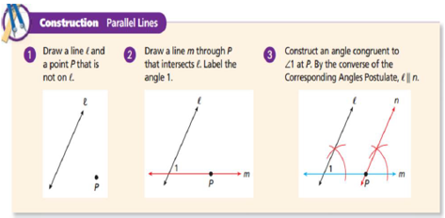
2.1 Constructions of Lines and Angles
Daily Agenda
What am I learning today?
What am I going to do today?
How will I show you that I’ve learned it?
G.CO.12 Make geometric constructions
Make formal geometric constructions with a variety of tools and methods
Daily Ticket out the Door
Copy a Segment, Construct a Segment Bisector
5 Question Daily Assessment
Copy an Angle, Construct an Angle Bisector
Construct Parallel Lines and Perpendicular Bisector

Slide 17
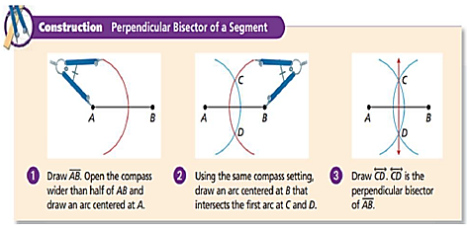
2.1 Constructions of Lines and Angles
Daily Agenda
What am I learning today?
What am I going to do today?
How will I show you that I’ve learned it?
G.CO.12 Make geometric constructions
Make formal geometric constructions with a variety of tools and methods
Daily Ticket out the Door
Copy a Segment, Construct a Segment Bisector
5 Question Daily Assessment
Copy an Angle, Construct an Angle Bisector
Construct Parallel Lines and Perpendicular Bisector
perpendicular bisector
perpendicular
distance from a point on a line

Slide 18
2.1 Constructions of Lines and Angles
Daily Agenda
What am I learning today?
What am I going to do today?
How will I show you that I’ve learned it?
G.CO.12 Make geometric constructions
Make formal geometric constructions with a variety of tools and methods
Daily Ticket out the Door
Copy a Segment, Construct a Segment Bisector
5 Question Daily Assessment
Copy an Angle, Construct an Angle Bisector
Construct Parallel Lines and Perpendicular Bisector
Construction: Congruent Segment
Construction: Segment Bisector (using patty paper)
Construction: Congruent Angle
Construction: Angle Bisector
Construction: Parallel Lines
Construction: Perpendicular Bisector

Slide 19
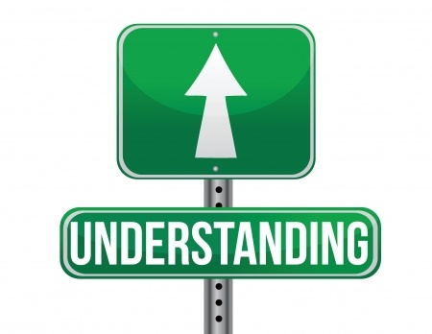
Checking for Understanding
Lesson 1: Constructions of Lines and Angles

Slide 20
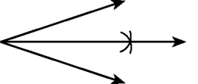
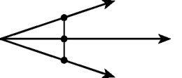
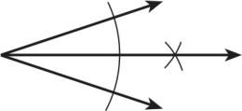
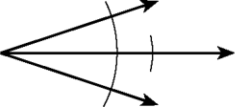
Checking for Understanding
1
Copyright© 2015 EducAide Software Inc. All rights reserved.
Notes:
D

Slide 21
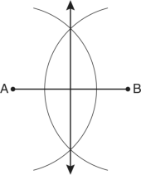
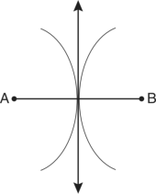
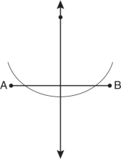
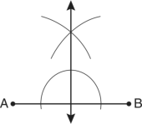
Checking for Understanding
2
Which diagram shows the construction of the perpendicular bisector of $\overline{AB}?$
Copyright© 2015 EducAide Software Inc. All rights reserved.
Notes:
A

Slide 22
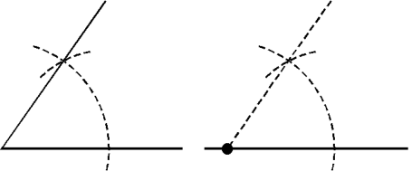
Checking for Understanding
3
Copyright© 2015 EducAide Software Inc. All rights reserved.
Notes:
C

Slide 23
Checking for Understanding
4
Copyright© 2015 EducAide Software Inc. All rights reserved.
Notes:
A

Slide 24
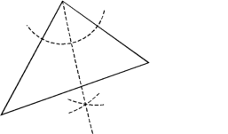
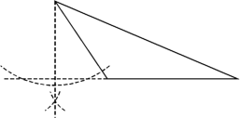
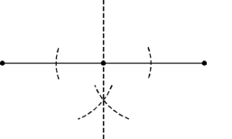
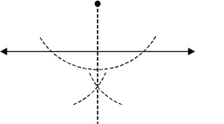
Checking for Understanding
5
Copyright© 2015 EducAide Software Inc. All rights reserved.
Notes:
D

Slide 25
Unit 2: Congruence, Similarity, and Proofs
2.2 Constructions of Polygons

Slide 26
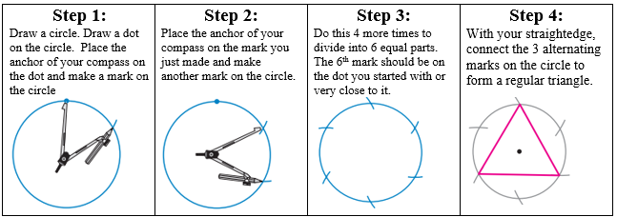
2.2 Construction of Polygons
Daily Agenda
What am I learning today?
What am I going to do today?
How will I show you that I’ve learned it?
G.CO.13 Make geometric constructions
Construct an equilateral triangle, a square, and a regular hexagon, each inscribed in a circle
Daily Ticket out the Door
Construct a Square, Hexagon, and an Equilateral Triangle Inscribed in a Circle
5 Question Daily Assessment
regular polygon
equiangular
equilateral
angles
sides
equilateral
triangle
congruent

Slide 27
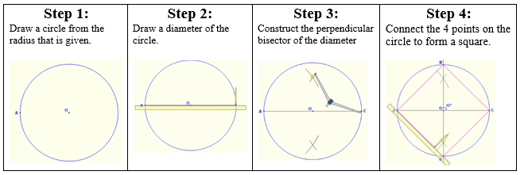
2.2 Construction of Polygons
Daily Agenda
What am I learning today?
What am I going to do today?
How will I show you that I’ve learned it?
G.CO.13 Make geometric constructions
Construct an equilateral triangle, a square, and a regular hexagon, each inscribed in a circle
Daily Ticket out the Door
Construct a Square, Hexagon, and an Equilateral Triangle Inscribed in a Circle
5 Question Daily Assessment
Squares
90˚

Slide 28
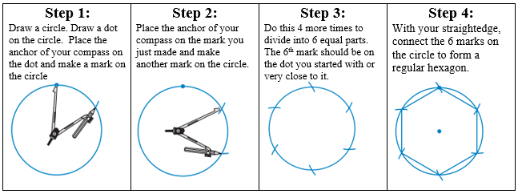
2.2 Construction of Polygons
Daily Agenda
What am I learning today?
What am I going to do today?
How will I show you that I’ve learned it?
G.CO.13 Make geometric constructions
Construct an equilateral triangle, a square, and a regular hexagon, each inscribed in a circle
Daily Ticket out the Door
Construct a Square, Hexagon, and an Equilateral Triangle Inscribed in a Circle
5 Question Daily Assessment
hexagon
inscribed
vertex

Slide 29
2.2 Construction of Polygons
Daily Agenda
What am I learning today?
What am I going to do today?
How will I show you that I’ve learned it?
G.CO.13 Make geometric constructions
Construct an equilateral triangle, a square, and a regular hexagon, each inscribed in a circle
Daily Ticket out the Door
Construct a Square, Hexagon, and an Equilateral Triangle Inscribed in a Circle
5 Question Daily Assessment
Construction 1: Regular Hexagon
Construction 2: Equilateral Triangle (same as hexagon)
Construction 3: Square
Construction 4: Incircle

Slide 30
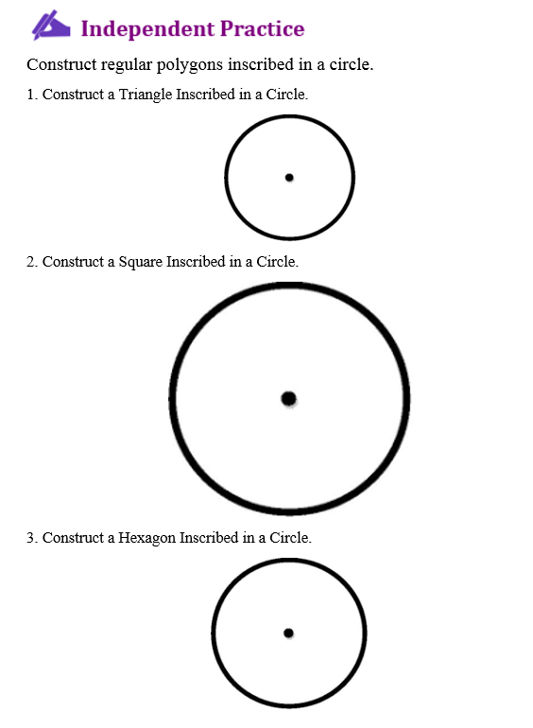
2.2 Construction of Polygons
Daily Agenda
What am I going to do today?
How will I show you that I’ve learned it?
G.CO.13 Make geometric constructions
Construct an equilateral triangle, a square, and a regular hexagon, each inscribed in a circle
Daily Ticket out the Door
Construct a Square, Hexagon, and an Equilateral Triangle Inscribed in a Circle
5 Question Daily Assessment
What am I learning today?

Slide 31
Checking for Understanding
Lesson 2: Constructions of Polygons

Slide 32
Checking for Understanding
1
Which of the following is NOT a tool used in constructions?
Compass
Pen
Straightedge
Ruler
Copyright© 2015 EducAide Software Inc. All rights reserved.
Notes:
B

Slide 33
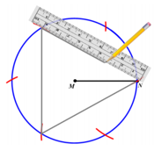
Checking for Understanding
2
Which of the following constructions represent the picture below.
Constructing a Square Inscribed in a Circle
Constructing a Triangle Inscribed in a Circle
Constructing a Circle Inscribed in a Triangle
Constructing a Hexagon Inscribed in a Circle
Copyright© 2015 EducAide Software Inc. All rights reserved.
Notes:
B

Slide 34
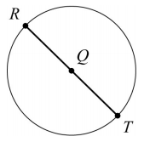
Checking for Understanding
3
Consider the beginning of a construction of a square inscribed in circle Q.
Step 1: Label point R on circle Q
Step 2: Draw a diameter through R and Q
Step 3: Label the intersection on the Circle point T
What is the next step in this construction?
Draw radius $\overline{SQ.}$
Label point S on circle Q.
Construct a line segment parallel to $\overline{RT}$
Construct the perpendicular bisector of $\overline{RT}$
Copyright© 2015 EducAide Software Inc. All rights reserved.
Notes:
B or D

Slide 35
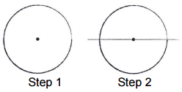
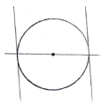
Checking for Understanding
Use the diagram to answer the question.
Daja is drawing a square inscribed in a circle using a compass and a straightedge two steps are shown.
Which is the best step for Daja to do next?
4
Copyright© 2015 EducAide Software Inc. All rights reserved.
Notes:
D

Slide 36
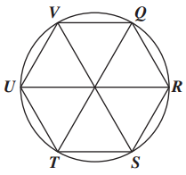
Checking for Understanding
5
In the design, a hexagon is inscribed in a circle.
Which point shows the location of Point Q after a 240˚ clockwise rotation around the center?
S
T
U
V
Copyright© 2015 EducAide Software Inc. All rights reserved.
Notes:
C

Slide 37
Unit 2: Congruence, Similarity, and Proofs
2.1 Parallel Lines and Transversals

Slide 38
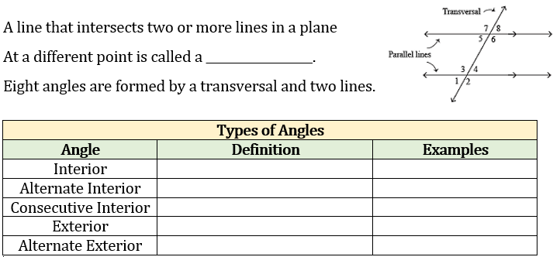
2.1 Parallel Lines and Transversals
Daily Agenda
transversal
Lie between the two lines
∠3, ∠4, ∠5, ∠6
On opposite sides of the transversal
∠3 and ∠6, ∠4 and ∠5
On same side of the transversal
∠3 and ∠5, ∠4 and ∠6
Lie outside the two lines
∠1, ∠2, ∠7, ∠8
On opposite sides of the transversal
∠1 and ∠8, ∠2 and ∠7

Slide 39
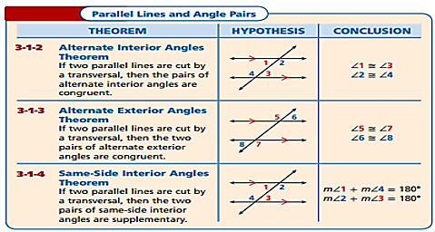
2.1 Parallel Lines and Transversals
Daily Agenda

Slide 40
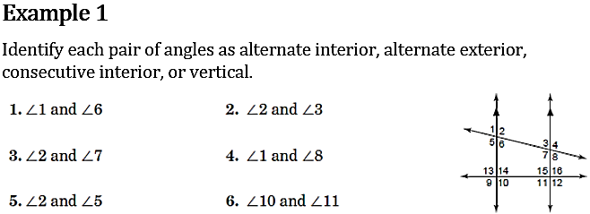
Daily Agenda
Consecutive Interior
Vertical
Alternate Interior
Alternate Exterior
Vertical
Consecutive
Interior

Slide 41
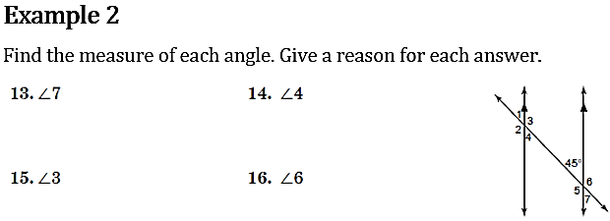
Daily Agenda
45º
45º
7.
8.
Vertical angles are congruent
Alternate interior angles are congruent
9.
135º
10.
135º
Consecutive interior angles are supplementary
Linear pairs are supplementary

Slide 42
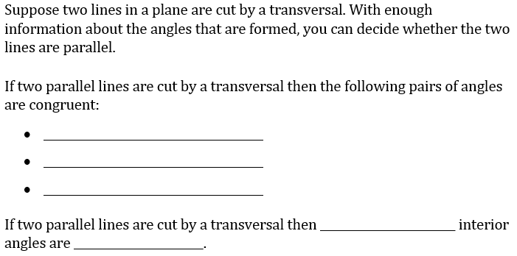
2.1 Parallel Lines and Transversals
Daily Agenda
corresponding angles
alternate interior angles
alternate exterior angles
consecutive
supplementary

Slide 43
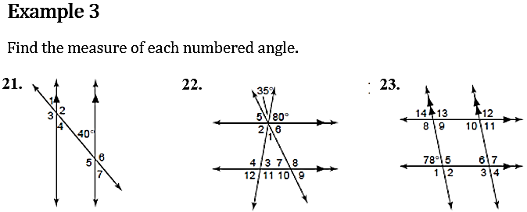
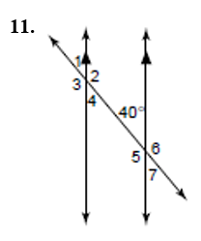
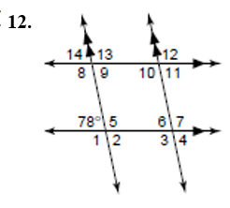
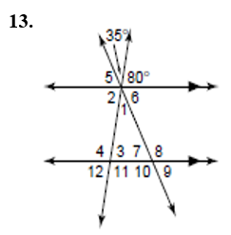
$m∠1=$ ______
$$m∠2=________$$
$m∠3=______$_
$$m∠4=________$$
$$m∠5=________$$
$m∠6=______$__
$m∠7=______$__
102
78
102
78
102
102
78
40
$m∠1=$ ______
$$m∠2=________$$
$m∠3=______$_
$$m∠4=________$$
$$m∠5=________$$
$m∠6=______$__
$m∠7=______$__
102
$m∠8=$ ______
$$m∠9=________$$
$m∠10=______$_
$$m∠11=________$$
$$m∠12=________$$
$m∠13=______$__
$m∠14=______$__
35 65
80 115
80 65
100 115
65 100
65 80
$m∠1=$ ______
$$m∠2=________$$
$m∠3=______$_
$$m∠4=________$$
$$m∠5=________$$
$m∠6=______$__
$m∠7=$ ______
$$m∠8=________$$
$m∠9=______$_
$$m∠10=________$$
$$m∠11=________$$
$m∠12=______$__
140
78
140
102
40
78
140
102
140
78
40
102

Slide 44
Example 4
2.1 Parallel Lines and Transversals
Daily Agenda

Slide 45
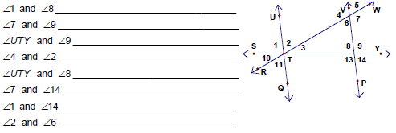
Classify each pair of angles as alternate interior, alternate exterior,
same-side (consecutive) interior, or corresponding angles.

Slide 46
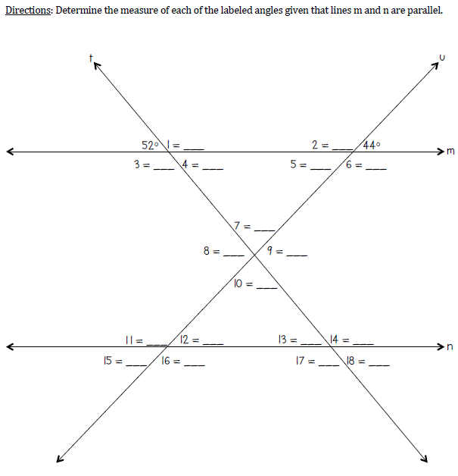

Slide 47
Find the value of the missing variable.

Slide 48
Find the value of the missing variable.
7.

Slide 49
Unit 2: Congruence, Similarity, and Proofs
2.2 Congruent Triangles

Slide 50
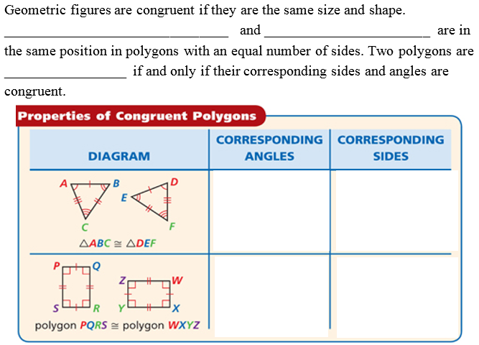
2.2 Congruent Triangles
Daily Agenda
What am I learning today?
What am I going to do today?
How will I show you that I’ve learned it?
G.CO.9 Prove geometric theorems
Daily Ticket out the Door
Copy a Segment, Construct a Segment Bisector
5 Question Daily Assessment
Copy an Angle, Construct an Angle Bisector
Construct Parallel Lines and Perpendicular Bisector
Prove theorems about lines and angles (Vertical angles, Relationships with Transversals
Corresponding angles
corresponding sides
congruent

Slide 51
2.2 Congruent Triangles
Daily Agenda
What am I learning today?
What am I going to do today?
How will I show you that I’ve learned it?
G.CO.9 Prove geometric theorems
Daily Ticket out the Door
Copy a Segment, Construct a Segment Bisector
5 Question Daily Assessment
Copy an Angle, Construct an Angle Bisector
Construct Parallel Lines and Perpendicular Bisector
Prove theorems about lines and angles (Vertical angles, Relationships with Transversals
∠T
$$\overline{BC}$$
∠A
$$\overline{AB}$$
$$\overline{RT}$$
∠S

Slide 52
2.2 Congruent Triangles
Daily Agenda
What am I learning today?
What am I going to do today?
How will I show you that I’ve learned it?
G.CO.9 Prove geometric theorems
Daily Ticket out the Door
Copy a Segment, Construct a Segment Bisector
5 Question Daily Assessment
Copy an Angle, Construct an Angle Bisector
Construct Parallel Lines and Perpendicular Bisector
Prove theorems about lines and angles (Vertical angles, Relationships with Transversals
$$\overline{AB}≅\overline{JK}$$
$$\overline{AC}≅\overline{BD}$$
$$\overline{JM}≅\overline{KL}$$
$$\overline{BC}≅\overline{KL}$$
$$\overline{AB}≅\overline{CD}$$
$$\overline{KJ}≅\overline{LM}$$
$$\overline{AC}≅\overline{JL}$$
$$\overline{BC}≅\overline{BC}$$
$$\overline{KM}≅\overline{KM}$$
$$∠A≅∠J$$
$$∠A≅∠D$$
$$∠J≅∠L$$
$$∠B≅∠K$$
$$∠ABC≅∠DCB$$
$$∠ABC≅∠DCB$$
$$∠C≅∠L$$
$$∠ACB≅∠DBC$$
$$∠ACB≅∠DBC$$
$$∆ABC ≅ ∆JKL$$
$$∆ABC ≅ ∆DCB$$
$$∆JKM ≅ ∆LMK$$

Slide 53
2.1 Corresponding Parts
Daily Agenda
What am I learning today?
What am I going to do today?
How will I show you that I’ve learned it?
G.CO.9 Prove geometric theorems
Daily Ticket out the Door
Copy a Segment, Construct a Segment Bisector
5 Question Daily Assessment
Copy an Angle, Construct an Angle Bisector
Construct Parallel Lines and Perpendicular Bisector
Prove theorems about lines and angles (Vertical angles, Relationships with Transversals
$$\overline{EG}≅\overline{LJ}$$
$$\overline{AC}≅\overline{BD}$$
$$\overline{RS}≅\overline{ST}$$
$$\overline{FG}≅\overline{LK}$$
$$\overline{AB}≅\overline{CD}$$
$$\overline{RU}≅\overline{TU}$$
$$\overline{FE}≅\overline{KJ}$$
$$\overline{BC}≅\overline{BC}$$
$$\overline{SU}≅\overline{SU}$$
$$∠F≅∠K$$
$$∠A≅∠D$$
$$∠R≅∠D$$
$$∠E≅∠J$$
$$∠ABC≅∠DCB$$
$$∠RUS≅∠TUS$$
$$∠G≅∠L$$
$$∠ACB≅∠DBC$$
$$∠SUR≅∠SUT$$

Slide 54
2.2 Congruent Triangles
Daily Agenda
What am I learning today?
What am I going to do today?
How will I show you that I’ve learned it?
G.CO.9 Prove geometric theorems
Daily Ticket out the Door
Copy a Segment, Construct a Segment Bisector
5 Question Daily Assessment
Copy an Angle, Construct an Angle Bisector
Construct Parallel Lines and Perpendicular Bisector
Prove theorems about lines and angles (Vertical angles, Relationships with Transversals
Rigid motion
Isometry
angle measure
lengths
image
pre-image
congruent
transformation

Slide 55
2.2 Congruent Triangles
Daily Agenda
What am I learning today?
What am I going to do today?
How will I show you that I’ve learned it?
G.CO.9 Prove geometric theorems
Daily Ticket out the Door
Copy a Segment, Construct a Segment Bisector
5 Question Daily Assessment
Copy an Angle, Construct an Angle Bisector
Construct Parallel Lines and Perpendicular Bisector
Prove theorems about lines and angles (Vertical angles, Relationships with Transversals
yes
Translation
T(x, y) = (x – 5, y + 1)
no
Dilation
D(x, y) = (1.5x, 1.5y)

Slide 56
2.2 Congruent Triangles
Daily Agenda
What am I learning today?
What am I going to do today?
How will I show you that I’ve learned it?
G.CO.9 Prove geometric theorems
Daily Ticket out the Door
Copy a Segment, Construct a Segment Bisector
5 Question Daily Assessment
Copy an Angle, Construct an Angle Bisector
Construct Parallel Lines and Perpendicular Bisector
Prove theorems about lines and angles (Vertical angles, Relationships with Transversals

Slide 57
2.2 Congruent Triangles
Paired Whiteboard Practice Problems

Slide 58
Identify which sides and angles are corresponding based on the given congruency statement.
5.
6.

Slide 59
Write the congruency statement for each set of triangles.
7.
8.
9.

Slide 60
Solve for the missing variables.
10.

Slide 61
Solve for the missing variables.
11.

Slide 62
Checking for Understanding
Lesson 2: Congruent Triangles

Slide 63
Checking for Understanding
1
Copyright© 2015 EducAide Software Inc. All rights reserved.
Notes:
A

Slide 64
Checking for Understanding
2
Copyright© 2015 EducAide Software Inc. All rights reserved.
Notes:
C

Slide 65
Checking for Understanding
3
Copyright© 2015 EducAide Software Inc. All rights reserved.
Notes:
A

Slide 66
Checking for Understanding
4
Copyright© 2015 EducAide Software Inc. All rights reserved.
Notes:
A

Slide 67
Checking for Understanding
5
Copyright© 2015 EducAide Software Inc. All rights reserved.
Notes:
B

Slide 68
Unit 2: Congruence, Similarity, and Proofs
2.2 Congruent Triangles

Slide 69
2.2 Congruent Triangles
Daily Agenda
What am I learning today?
What am I going to do today?
How will I show you that I’ve learned it?
G.CO.9 Prove geometric theorems
Daily Ticket out the Door
Copy a Segment, Construct a Segment Bisector
5 Question Daily Assessment
Copy an Angle, Construct an Angle Bisector
Construct Parallel Lines and Perpendicular Bisector
Prove theorems about lines and angles (Vertical angles, Relationships with Transversals
congruent
angles
sides
congruent

Slide 70
2.2 Congruent Triangles
Daily Agenda
What am I learning today?
What am I going to do today?
How will I show you that I’ve learned it?
G.CO8 Understand congruence in terms of rigid motions
Daily Ticket out the Door
Congruent Triangles
5 Question Daily Assessment
Explain how the criteria for triangle congruence follow from the definition of congruence from the definition of congruence in terms of rigid motions
Example 4
SAS
no
$$∆PRS≅∆PQS$$
SSS
SAS
$$∆PQR≅∆STU$$
$$∆ABE≅∆CBD$$
SAS
$$∆MLN≅∆ONL$$
SSS
$$∆WXV≅∆YXZ$$

Slide 71
2.2 Congruent Triangles
Daily Agenda
What am I learning today?
What am I going to do today?
How will I show you that I’ve learned it?
G.CO8 Understand congruence in terms of rigid motions
Daily Ticket out the Door
Congruent Triangles
5 Question Daily Assessment
Explain how the criteria for triangle congruence follow from the definition of congruence from the definition of congruence in terms of rigid motions
SAS
SSS
$$∆ABD≅∆CBD$$
$$∆AER≅∆WDG$$
SAS
SAS
$$∆HIJ≅∆HGE$$
$$∆PRS≅∆PQS$$
SSS
SAS
$$∆PRS≅∆PQS$$
$$∆PRS≅∆PQS$$

Slide 72
2.2 Congruent Triangles
Daily Agenda
What am I learning today?
What am I going to do today?
How will I show you that I’ve learned it?
G.CO.8 Understand congruence in terms of rigid motions
Daily Ticket out the Door
Congruent Triangles
5 Question Daily Assessment
Explain how the criteria for triangle congruence (SSS, SAS, ASA, AAS, and HL) follow from the definition of congruence in terms of rigid motions

Slide 73
2.2 Congruent Triangles
Daily Agenda
What am I learning today?
What am I going to do today?
How will I show you that I’ve learned it?
G.CO.8 Understand congruence in terms of rigid motions
Daily Ticket out the Door
Congruent Triangles
5 Question Daily Assessment
Explain how the criteria for triangle congruence (SSS, SAS, ASA, AAS, and HL) follow from the definition of congruence in terms of rigid motions
Example 5
ASA
AAS
$$∆SVX≅∆TVR$$
NOT CONGRUENT
$$∆BTR≅∆ACR$$

Slide 74
2.2 Congruent Triangles
Daily Agenda
What am I learning today?
What am I going to do today?
How will I show you that I’ve learned it?
G.CO.8 Understand congruence in terms of rigid motions
Daily Ticket out the Door
Congruent Triangles
5 Question Daily Assessment
Explain how the criteria for triangle congruence (SSS, SAS, ASA, AAS, and HL) follow from the definition of congruence in terms of rigid motions
Example 5 continued
NOT CONGRUENT
AAS
$$∆DEF≅∆IGH$$
ASA
$$∆SRT≅∆WVX$$
AAS
$$∆DEF≅∆GIH$$

Slide 75
2.2 Congruent Triangles
Daily Agenda
What am I learning today?
What am I going to do today?
How will I show you that I’ve learned it?
G.CO.8 Understand congruence in terms of rigid motions
Daily Ticket out the Door
Congruent Triangles
5 Question Daily Assessment
Explain how the criteria for triangle congruence (SSS, SAS, ASA, AAS, and HL) follow from the definition of congruence in terms of rigid motions
Example 6
$$∠R≅∠D$$
$$∠B≅∠S$$
$$\overline{OM}≅\overline{BA}$$
$$or$$
$$\overline{ON}≅\overline{CA}$$
$$\overline{XZ}≅\overline{CB}$$

Slide 76
2.2 Congruent Triangles
Daily Agenda
What am I learning today?
What am I going to do today?
How will I show you that I’ve learned it?
G.CO.8 Understand congruence in terms of rigid motions
Daily Ticket out the Door
Congruent Triangles
5 Question Daily Assessment
Explain how the criteria for triangle congruence (SSS, SAS, ASA, AAS, and HL) follow from the definition of congruence in terms of rigid motions
Whiteboard Practice Problems

Slide 77
Determine what postulate each picture is depicting (SSS, SAS, AAS, ASA, HL, or Not Congruent)

Slide 78
Determine what postulate each picture is depicting (SSS, SAS, AAS, ASA, HL, or Not Congruent)

Slide 79
Checking for Understanding
Lesson 2: Congruent Triangles

Slide 80
Checking for Understanding
1
Copyright© 2015 EducAide Software Inc. All rights reserved.
Notes:
B

Slide 81
Checking for Understanding
2
Copyright© 2015 EducAide Software Inc. All rights reserved.
Notes:
D

Slide 82
Checking for Understanding
3
Copyright© 2015 EducAide Software Inc. All rights reserved.
Notes:
C

Slide 83
Checking for Understanding
4
Copyright© 2015 EducAide Software Inc. All rights reserved.
Notes:
C

Slide 84
Checking for Understanding
5
Copyright© 2015 EducAide Software Inc. All rights reserved.
Notes:
D

Slide 85
Unit 2: Congruence, Similarity, and Proofs
2.3 Similar Figures

Slide 86
2.3 Similar Figures
Daily Agenda
ratio
What am I learning today?
What am I going to do today?
How will I show you that I’ve learned it?
G.SRT.1 Understand similarity in terms of similarity Transformations
Daily Ticket out the Door
Similar Figures
5 Question Daily Assessment
Verify experimentally the properties of dilations given by a center and a scale factor
Similar Polygons
= 0
proportion
equal
$$ad=cb$$
$$\frac{3}{4}$$
$$\frac{1}{7}$$
$$\frac{2}{3}$$
16
4
24

Slide 87
2.5 Similar Figures
Daily Agenda
What am I learning today?
What am I going to do today?
How will I show you that I’ve learned it?
G.SRT.1 Understand similarity in terms of similarity Transformations
Daily Ticket out the Door
Similar Figures
5 Question Daily Assessment
Verify experimentally the properties of dilations given by a center and a scale factor
Similar Polygons
$$\frac{4}{5}$$
$$\frac{1}{2}$$
$$\frac{4}{5}$$
9(20) = 5x
180 = 5x
5 5
x = 36
5(70) = 35x
350 = 35x
35 35
x = 10
33

Slide 88
2.3 Similar Figures
What am I learning today?
What am I going to do today?
How will I show you that I’ve learned it?
G.SRT.1 Understand similarity in terms of similarity Transformations
Daily Ticket out the Door
Similar Figures
5 Question Daily Assessment
Verify experimentally the properties of dilations given by a center and a scale factor
Similar Polygons
Daily Agenda
similar
shape
size
congruent
proportional
$$\frac{2}{5}$$
$$yes$$
$$yes$$
$$\frac{3}{6}=\frac{4}{8}=\frac{1}{2}$$

Slide 89
2.3 Similar Figures
What am I learning today?
What am I going to do today?
How will I show you that I’ve learned it?
G.SRT.1 Understand similarity in terms of similarity Transformations
Daily Ticket out the Door
Similar Figures
5 Question Daily Assessment
Verify experimentally the properties of dilations given by a center and a scale factor
Similar Polygons
Daily Agenda
$$\frac{6}{12}=\frac{x}{16}$$
$$\frac{20}{30}=\frac{20}{x}$$
x = 30
6(16) = 12x
96 = 12x
12 12
$$\frac{20}{30}=\frac{20}{y}$$
y = 30
x = 8
$$\frac{6}{12}=\frac{y}{20}$$
y = 10

Slide 90
2.3 Similar Figures
What am I learning today?
What am I going to do today?
How will I show you that I’ve learned it?
G.SRT.1 Understand similarity in terms of similarity Transformations
Daily Ticket out the Door
Similar Figures
5 Question Daily Assessment
Verify experimentally the properties of dilations given by a center and a scale factor
Similar Polygons
Daily Agenda
similarity statement
~
similarity ratio
lengths
$$\frac{AD}{EH}=\frac{8}{6}=\frac{4}{3}$$
$\frac{4}{3}=\frac{20}{x}$ x = 15
9

Slide 91
2.3 Similar Figures
What am I learning today?
What am I going to do today?
How will I show you that I’ve learned it?
G.SRT.1 Understand similarity in terms of similarity Transformations
Daily Ticket out the Door
Similar Figures
5 Question Daily Assessment
Verify experimentally the properties of dilations given by a center and a scale factor
Similar Polygons
Daily Agenda
$$\frac{x}{9}=\frac{8}{12}$$
x = 6
$$\frac{10}{5}=\frac{4.5}{x}$$
x = 2.25
$$\frac{12}{18}=\frac{x+1}{24}$$
x = 15
$$\frac{40}{30}=\frac{x+15}{18}$$
x = 9

Slide 92
Whiteboard Pair Practice Using similarity ratios, solve for the missing variable(s).

Slide 93
2.3 Similar Figures
What am I learning today?
What am I going to do today?
How will I show you that I’ve learned it?
G.SRT.1 Understand similarity in terms of similarity Transformations
Daily Ticket out the Door
Similar Figures
5 Question Daily Assessment
Verify experimentally the properties of dilations given by a center and a scale factor
Similar Polygons
Daily Agenda

Slide 94
2.3 Similar Figures
What am I learning today?
What am I going to do today?
How will I show you that I’ve learned it?
G.SRT.1 Understand similarity in terms of similarity Transformations
Daily Ticket out the Door
Similar Figures
5 Question Daily Assessment
Verify experimentally the properties of dilations given by a center and a scale factor
Similar Polygons
Daily Agenda

Slide 95
2.3 Similar Figures
What am I learning today?
What am I going to do today?
How will I show you that I’ve learned it?
G.SRT.1 Understand similarity in terms of similarity Transformations
Daily Ticket out the Door
Similar Figures
5 Question Daily Assessment
Verify experimentally the properties of dilations given by a center and a scale factor
Similar Polygons
Daily Agenda

Slide 96
2.3 Similar Figures
What am I learning today?
What am I going to do today?
How will I show you that I’ve learned it?
G.SRT.1 Understand similarity in terms of similarity Transformations
Daily Ticket out the Door
Similar Figures
5 Question Daily Assessment
Verify experimentally the properties of dilations given by a center and a scale factor
Similar Polygons
Daily Agenda
EF = $\frac{1}{2}$BC
5 = $\frac{1}{2}$(x)
BC = 10
Perimeter = 16 + 12 +10
Perimeter = 38

Slide 97
2.3 Similar Figures
What am I learning today?
What am I going to do today?
How will I show you that I’ve learned it?
G.SRT.1 Understand similarity in terms of similarity Transformations
Daily Ticket out the Door
Similar Figures
5 Question Daily Assessment
Verify experimentally the properties of dilations given by a center and a scale factor
Similar Polygons
Daily Agenda
2x - 6 = $\frac{1}{2}(18)$
x = 7.5
ED = 11.5
x = 6

Slide 98
Whiteboard Pair Practice – Triangle Similarity
5.
6.
7.

Slide 99
Whiteboard Pair Practice – Triangle Mid-Segment Theorem
8.
9.
10. Solve for x.
11.

Slide 100
2.3 Similar Figures
What am I learning today?
What am I going to do today?
How will I show you that I’ve learned it?
G.SRT.1 Understand similarity in terms of similarity Transformations
Daily Ticket out the Door
Similar Figures
5 Question Daily Assessment
Verify experimentally the properties of dilations given by a center and a scale factor
Similar Polygons
Daily Agenda
$$\frac{AE}{EB}=\frac{AF}{FC}$$
$$\overline{EF}∥\overline{BC}$$

Slide 101
2.3 Similar Figures
What am I learning today?
What am I going to do today?
How will I show you that I’ve learned it?
G.SRT.1 Understand similarity in terms of similarity Transformations
Daily Ticket out the Door
Similar Figures
5 Question Daily Assessment
Verify experimentally the properties of dilations given by a center and a scale factor
Similar Polygons
Daily Agenda

Slide 102
2.5 Similar Figures
What am I learning today?
What am I going to do today?
How will I show you that I’ve learned it?
G.SRT.1 Understand similarity in terms of similarity Transformations
Daily Ticket out the Door
Similar Figures
5 Question Daily Assessment
Verify experimentally the properties of dilations given by a center and a scale factor
Similar Polygons
Daily Agenda

Slide 103
2.3 Similar Figures
What am I learning today?
What am I going to do today?
How will I show you that I’ve learned it?
G.SRT.1 Understand similarity in terms of similarity Transformations
Daily Ticket out the Door
Similar Figures
5 Question Daily Assessment
Verify experimentally the properties of dilations given by a center and a scale factor
Similar Polygons
Daily Agenda

Slide 104
2.3 Similar Figures
What am I learning today?
What am I going to do today?
How will I show you that I’ve learned it?
G.SRT.1 Understand similarity in terms of similarity Transformations
Daily Ticket out the Door
Similar Figures
5 Question Daily Assessment
Verify experimentally the properties of dilations given by a center and a scale factor
Similar Polygons
Daily Agenda
$$\frac{AC}{CE}=\frac{BD}{DF}$$

Slide 105
2.5 Similar Figures
What am I learning today?
What am I going to do today?
How will I show you that I’ve learned it?
G.SRT.1 Understand similarity in terms of similarity Transformations
Daily Ticket out the Door
Similar Figures
5 Question Daily Assessment
Verify experimentally the properties of dilations given by a center and a scale factor
Similar Polygons
Daily Agenda

Slide 106
Whiteboard Pair Practice – Triangle Proportionality
12.
13.
14.

Slide 107
Whiteboard Pair Practice – Two Transversal Proportionality
17.
15.
16.

Slide 108
Checking for Understanding
Lesson 3: Similar Figures

Slide 109
Checking for Understanding
1
Copyright© 2015 EducAide Software Inc. All rights reserved.
Notes:
D

Slide 110
Checking for Understanding
2
Copyright© 2015 EducAide Software Inc. All rights reserved.
Notes:
B

Slide 111
Checking for Understanding
3
Copyright© 2015 EducAide Software Inc. All rights reserved.
Notes:
A

Slide 112
Checking for Understanding
4
Copyright© 2015 EducAide Software Inc. All rights reserved.
Notes:
D

Slide 113
Checking for Understanding
5
Copyright© 2015 EducAide Software Inc. All rights reserved.
Notes:
B

Slide 114
Unit 2: Congruence, Similarity, and Proofs
2.4 Dilations and Similarity

Slide 115
2.4 Dilations and Similarity
What am I learning today?
What am I going to do today?
How will I show you that I’ve learned it?
G.SRT.1 Understand similarity in terms of similarity Transformations
Daily Ticket out the Door
Similar Figures
5 Question Daily Assessment
Verify experimentally the properties of dilations given by a center and a scale factor
Similar Polygons
Daily Agenda
dilation
center of dilation
inside
on
outside
similar
angle measure
length
proportional
multiply
scale factor
enlargement
reduction

Slide 116
2.4 Dilations and Similarity
What am I learning today?
What am I going to do today?
How will I show you that I’ve learned it?
G.SRT.1 Understand similarity in terms of similarity Transformations
Daily Ticket out the Door
Similar Figures
5 Question Daily Assessment
Verify experimentally the properties of dilations given by a center and a scale factor
Similar Polygons
Daily Agenda
B
B’
A
Scale Factor = $\frac{−2}{−4}$
A’
$$S.F. =\frac{1}{2}$$
Center of Dilation
(0,0)

Slide 117
2.4 Dilations and Similarity
What am I learning today?
What am I going to do today?
How will I show you that I’ve learned it?
G.SRT.1 Understand similarity in terms of similarity Transformations
Daily Ticket out the Door
Similar Figures
5 Question Daily Assessment
Verify experimentally the properties of dilations given by a center and a scale factor
Similar Polygons
Daily Agenda
Scale Factor = $\frac{−7.5}{−5}$
$$S.F. =\frac{3}{2}=1.5$$
A
Center of Dilation
(0,0)
A’
B
C
B’
C’

Slide 118
2.4 Dilations and Similarity
What am I learning today?
What am I going to do today?
How will I show you that I’ve learned it?
G.SRT.1 Understand similarity in terms of similarity Transformations
Daily Ticket out the Door
Similar Figures
5 Question Daily Assessment
Verify experimentally the properties of dilations given by a center and a scale factor
Similar Polygons
Daily Agenda

Slide 119
2.4 Dilations and Similarity
What am I learning today?
What am I going to do today?
How will I show you that I’ve learned it?
G.SRT.1 Understand similarity in terms of similarity Transformations
Daily Ticket out the Door
Similar Figures
5 Question Daily Assessment
Verify experimentally the properties of dilations given by a center and a scale factor
Similar Polygons
Daily Agenda

Slide 120
2.4 Dilations and Similarity
What am I learning today?
What am I going to do today?
How will I show you that I’ve learned it?
G.SRT.1 Understand similarity in terms of similarity Transformations
Daily Ticket out the Door
Similar Figures
5 Question Daily Assessment
Verify experimentally the properties of dilations given by a center and a scale factor
Similar Polygons
Daily Agenda
A vertical scaling multiplies/divides every y-coordinate by a constant while leaving the x-coordinate unchanged. A horizontal scaling multiplies/divides every x-coordinate by a constant while leaving the y-coordinate unchanged. The vertical and horizontal scaling can be combined into one question.

Slide 121
What am I learning today?
What am I going to do today?
How will I show you that I’ve learned it?
G.SRT.1 Understand similarity in terms of similarity Transformations
Daily Ticket out the Door
Similar Figures
5 Question Daily Assessment
Verify experimentally the properties of dilations given by a center and a scale factor
Similar Polygons
Example 3
Graph:
A (-2, -3)
B (-1, 2)
C (2, -5)
A’ (-5, -3)
B’ (-4, 2)
C’ (-1, -5)
A” (-6, -3)
B” (-3, 2)
C” (6, -5)

Slide 122
Checking for Understanding
Lesson 4: Dilations and Similarity

Slide 123
Checking for Understanding
1
Copyright© 2015 EducAide Software Inc. All rights reserved.
Notes:
A

Slide 124
Checking for Understanding
2
$$\frac{1}{2}$$
Copyright© 2015 EducAide Software Inc. All rights reserved.
Notes:
C

Slide 125
Checking for Understanding
3
Copyright© 2015 EducAide Software Inc. All rights reserved.
Notes:
A

Slide 126
Checking for Understanding
4
Notes:
C

Slide 127
Checking for Understanding
5
Notes:
A

