Slide 1

Transformations
Vocabulary Puzzle
In groups of 2, match the vocabulary word with its definition to create the final puzzle.
Once you have the puzzle together, individually write your answers on the answer sheet to turn in.

Slide 2
Unit 1: Transformations in the Coordinate Plane
Vocabulary Builder

Slide 3

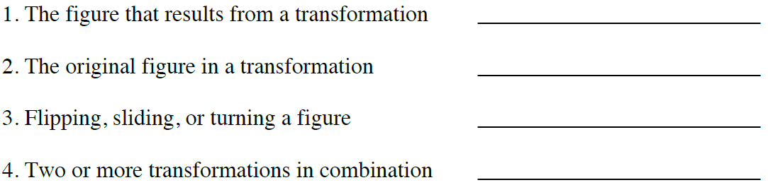
Transformations
image
pre-image
transformation
composition of transformations

Slide 4
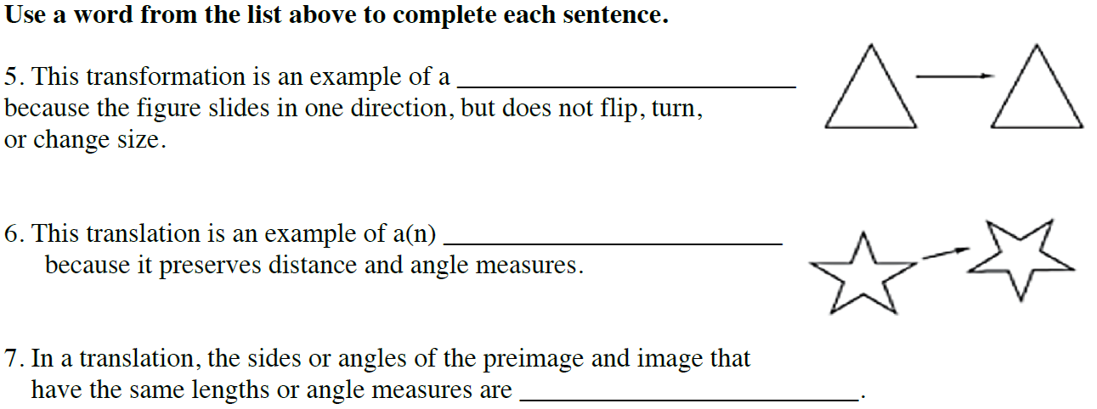
Transformations
translation
rigid motion
corresponding parts

Slide 5
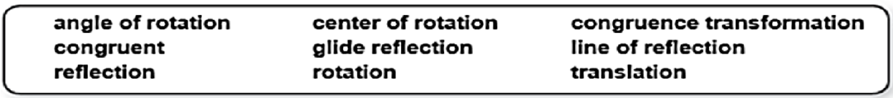
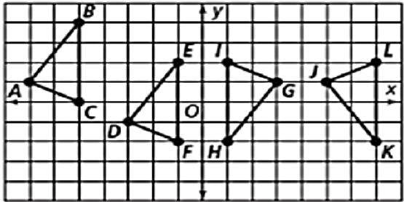
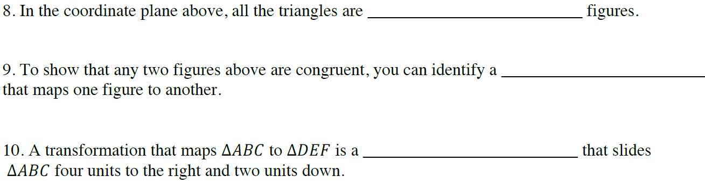
Transformations
congruent
congruence transformation
translation

Slide 6
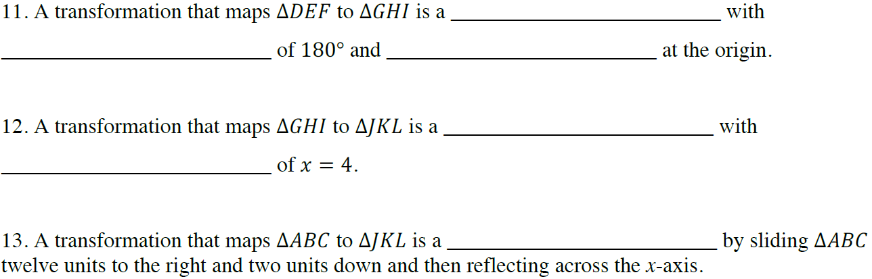
Transformations
rotation
angle of rotation
center of rotation
reflection
line of reflection
glide reflection

Slide 7

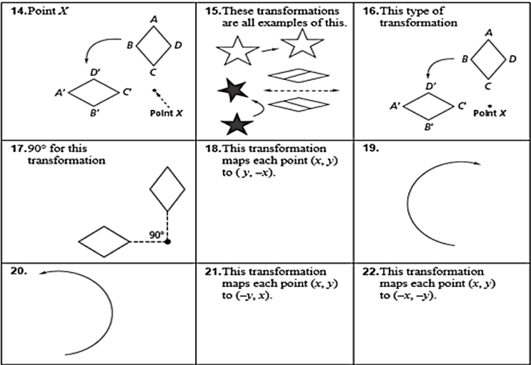
Transformations
14. center of rotation
15. rigid motion
16. rotation
17. angle of rotation
18. r_{(270,0)}
19. clockwise
20. counter-clockwise
21. r_{(90,0)}
22. r_{(180,0)}

Slide 8
Unit 1: Transformations in the Coordinate Plane
1.1 Precise Definitions

Slide 9
What am I learning today?
What am I going to do today?
How will I show you that I’ve learned it?
G.CO.1 Experiment with transformations in the plane
Use definitions of angles, circles, perpendicular lines, parallel lines, and line segments based on the undefined terms
Daily Ticket out the Door
Vocabulary Builder
1.1 Precise Definitions
Daily Agenda
Vocabulary Word | Definition | Example
Line Segment | part of a line; consists of 2 endpoints and all the points between them
Angle | 2 rays with a common endpoint
Circle | set of all points on a given plane that are equidistant from a given point (called the center)
Radius | fixed distance from the center of a circle to a point on a circle
Parallel Lines | Lines in the same plane that do not intersect
Perpendicular Lines | 2 lines that intersect to form right angles
Segment Bisector | point, line, or ray that divides a segment into 2 congruent parts
Midpoint | point that divides a segment into 2 congruent parts

Slide 10
What am I learning today?
What am I going to do today?
How will I show you that I’ve learned it?
G.CO.1 Experiment with transformations in the plane
Use definitions of angles, circles, perpendicular lines, parallel lines, and line segments based on the undefined terms
Daily Ticket out the Door
Vocabulary Builder
1.1 Precise Definitions
Daily Agenda
Vocabulary Word | Definition | Example
Angle Bisector | segment, ray, or line that divides an angle into 2 congruent angles
Adjacent Angles | 2 angles with a common side and a common vertex
Vertical Angles | 2 angles whose sides are equal and the angle measures are congruent
Complementary Angles | 2 angles whose sum is 90⁰
Supplementary Angles | 2 angles whose sum is 180⁰
Collinear | points lying in the same straight line
Vertex | Point where 2 sides meet
Ray | line that extends in a single direction from a point

Slide 11
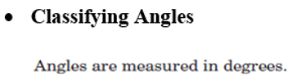
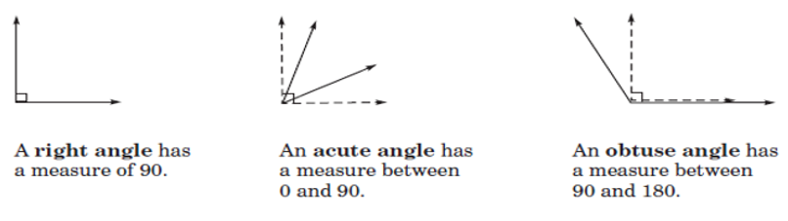
What am I learning today?
What am I going to do today?
How will I show you that I’ve learned it?
G.CO.1 Experiment with transformations in the plane
Use definitions of angles, circles, perpendicular lines, parallel lines, and line segments based on the undefined terms
Daily Ticket out the Door
Vocabulary Builder
1.1 Precise Definitions
Daily Agenda

Slide 12
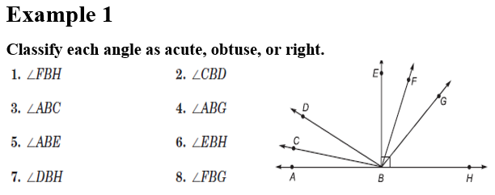
What am I learning today?
What am I going to do today?
How will I show you that I’ve learned it?
G.CO.1 Experiment with transformations in the plane
Use definitions of angles, circles, perpendicular lines, parallel lines, and line segments based on the undefined terms
Daily Ticket out the Door
Vocabulary Builder
1.1 Precise Definitions
Daily Agenda
ACUTE
ACUTE
ACUTE
OBTUSE
RIGHT
RIGHT
OBTUSE
ACUTE

Slide 13
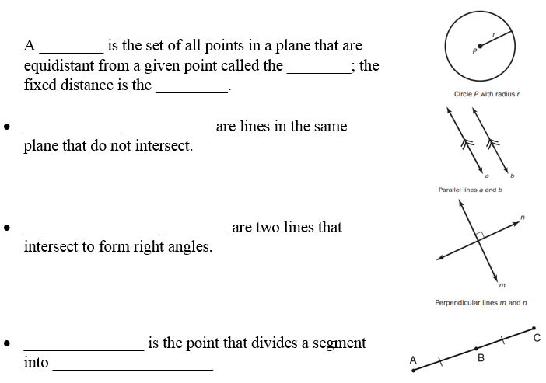
What am I learning today?
What am I going to do today?
How will I show you that I’ve learned it?
G.CO.1 Experiment with transformations in the plane
Use definitions of angles, circles, perpendicular lines, parallel lines, and line segments based on the undefined terms
Daily Ticket out the Door
Vocabulary Builder
1.1 Precise Definitions
Daily Agenda
circle
center
radius
Parallel lines
Perpendicular lines
Midpoint
two congruent parts
____ ________ .

Slide 14
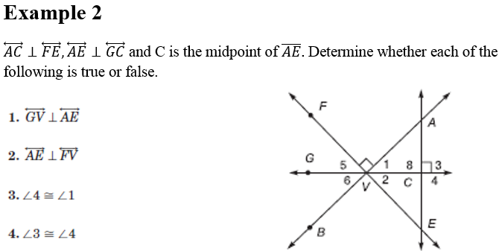
What am I learning today?
What am I going to do today?
How will I show you that I’ve learned it?
G.CO.1 Experiment with transformations in the plane
Use definitions of angles, circles, perpendicular lines, parallel lines, and line segments based on the undefined terms
Daily Ticket out the Door
Vocabulary Builder
1.1 Precise Definitions
Daily Agenda
TRUE
FALSE
FALSE
TRUE

Slide 15
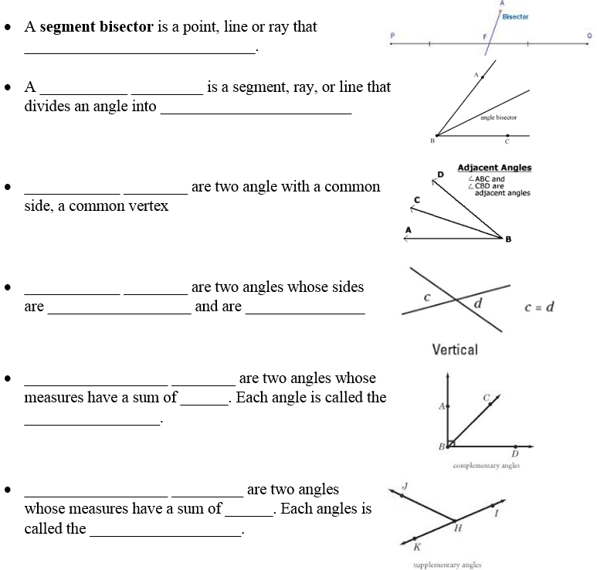
What am I learning today?
What am I going to do today?
How will I show you that I’ve learned it?
G.CO.1 Experiment with transformations in the plane
Use definitions of angles, circles, perpendicular lines, parallel lines, and line segments based on the undefined terms
Daily Ticket out the Door
Vocabulary Builder
1.1 Precise Definitions
Daily Agenda
divides into 2 equal parts
angle bisector
2 congruent angles
Adjacent angles
Vertical angles
equal
congruent
Complementary angles
90⁰
complement
Supplementary angles
180
supplement

Slide 16
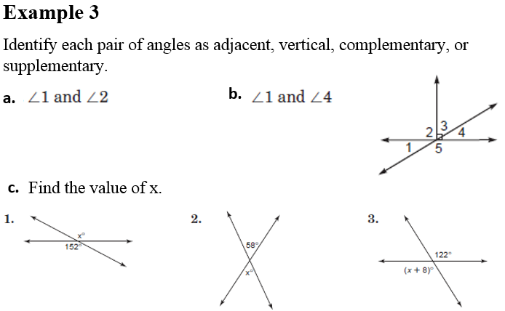
What am I going to do today?
How will I show you that I’ve learned it?
G.CO.1 Experiment with transformations in the plane
Use definitions of angles, circles, perpendicular lines, parallel lines, and line segments based on the undefined terms
Daily Ticket out the Door
Vocabulary Builder
What am I learning today?
1.1 Precise Definitions
Daily Agenda
ADJACENT
VERTICAL
c. $∠1 and ∠5$ d. $∠3 and ∠4$
SUPPLEMENTARY or
ADJACENT
COMPLEMENTARY
x = 152
x + 8 = 122
- 8 - 8
x = 114
x = 58

Slide 17
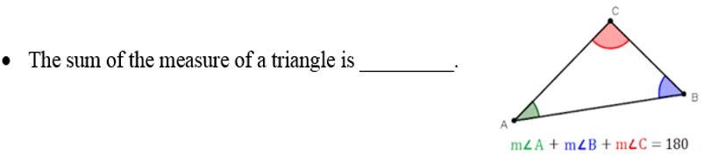
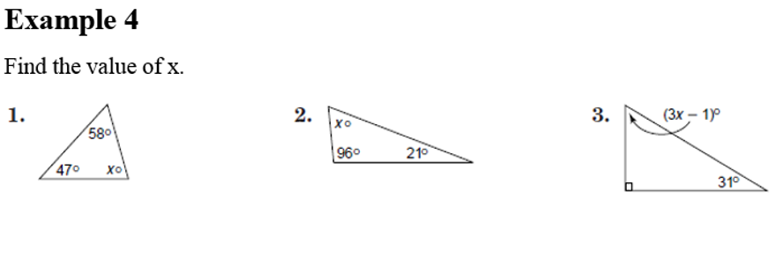
What am I going to do today?
How will I show you that I’ve learned it?
G.CO.1 Experiment with transformations in the plane
Use definitions of angles, circles, perpendicular lines, parallel lines, and line segments based on the undefined terms
Daily Ticket out the Door
Vocabulary Builder
What am I learning today?
1.1 Precise Definitions
Daily Agenda
180⁰

Slide 18
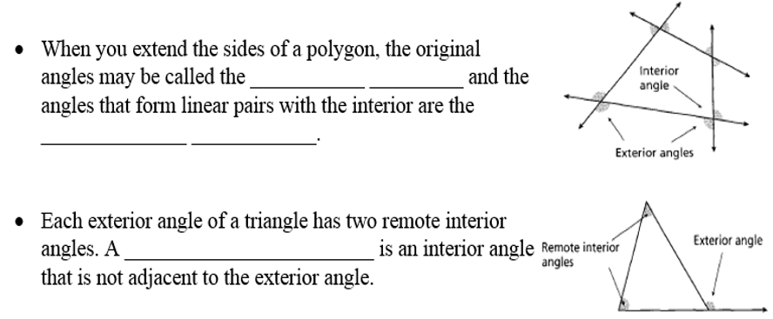
What am I learning today?
What am I going to do today?
How will I show you that I’ve learned it?
G.CO.1 Experiment with transformations in the plane
Use definitions of angles, circles, perpendicular lines, parallel lines, and line segments based on the undefined terms
Daily Ticket out the Door
Vocabulary Builder
1.1 Precise Definitions
Daily Agenda
interior angles
exterior angles
remote interior angle
*The sum of the 2 remote interior angles equal the exterior angle.

Slide 19
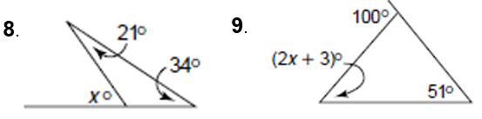
What am I learning today?
What am I going to do today?
How will I show you that I’ve learned it?
G.CO.1 Experiment with transformations in the plane
Use definitions of angles, circles, perpendicular lines, parallel lines, and line segments based on the undefined terms
Daily Ticket out the Door
Vocabulary Builder
Homework
Homework Booklet: Page 2
1.1 Precise Definitions
Daily Agenda
Example 5
Find the value of x.
1.
2.
x = 21 + 34
x = 55º

Slide 20
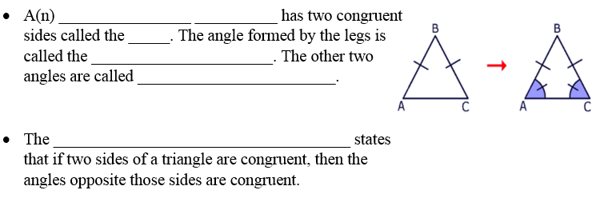
What am I learning today?
What am I going to do today?
How will I show you that I’ve learned it?
G.CO.1 Experiment with transformations in the plane
Use definitions of angles, circles, perpendicular lines, parallel lines, and line segments based on the undefined terms
Daily Ticket out the Door
Vocabulary Builder
1.1 Precise Definitions
Daily Agenda
isosceles triangle
legs
vertex angle
base angles
Isosceles Triangle Theorem

Slide 21
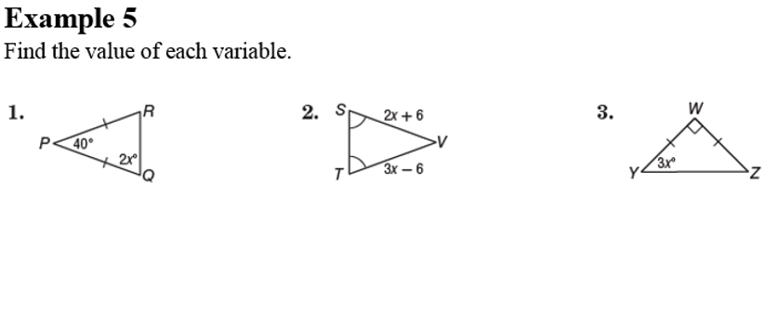
What am I learning today?
What am I going to do today?
How will I show you that I’ve learned it?
G.CO.1 Experiment with transformations in the plane
Use definitions of angles, circles, perpendicular lines, parallel lines, and line segments based on the undefined terms
Daily Ticket out the Door
Vocabulary Builder
Homework
Homework Booklet: Page 2
1.1 Precise Definitions
Daily Agenda
6
2x + 2x + 40 = 180
4x + 40 = 180
- 40 - 40
4x = 140
4 4
x = 35
2x + 6 = 3x - 6
15

Slide 22
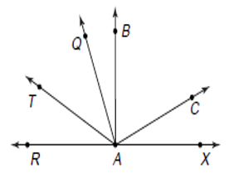
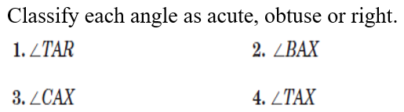
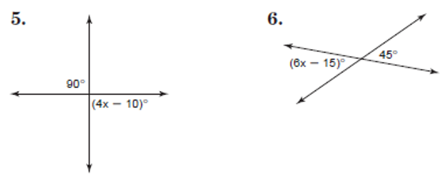
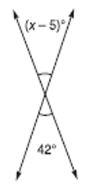

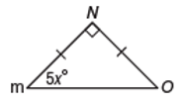
Classwork Working independently or with one other person, complete the problems and hand in before the end of class.
7.
8.

Slide 23
Unit 1: Transformations in the Coordinate Plane
1.2 Transformations

Slide 24
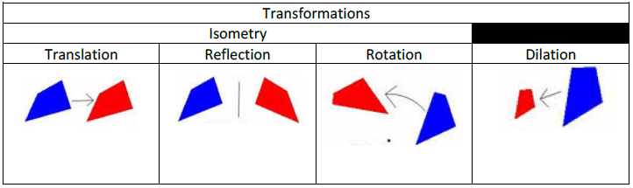
1.2 Transformations
What are we learning today?
MGSE9 – 12.G.CO.4 - Experiment with transformations in the plane
What am I going to do?
Transformations in the Coordinate Plane
How will I show you I learned it?
Daily Exit Tickets
What’s for homework?
Booklet pg. 3
Daily Agenda
Slide
Flip
Turn
Size Change

Slide 25
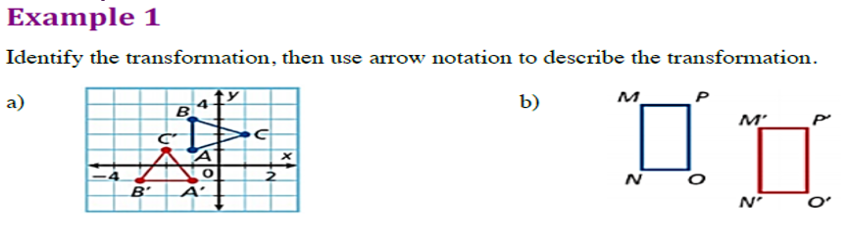


1.2 Transformations
What are we learning today?
MGSE9 – 12.G.CO.4 - Experiment with transformations in the plane
What am I going to do?
Transformations in the Coordinate Plane
How will I show you I learned it?
Daily Exit Tickets
What’s for homework?
Booklet pg. 3
Daily Agenda
rotation
translation
$$∆ABC→∆A^{′}B^{′}C′$$
$$MNOP→M′N′O′P′$$

Slide 26
1.2 Transformations
What are we learning today?
MGSE9 – 12.G.CO.4 - Experiment with transformations in the plane
What am I going to do?
Transformations in the Coordinate Plane
How will I show you I learned it?
Daily Exit Tickets
What’s for homework?
Booklet pg. 3
Daily Agenda
Work Session:
In groups of 2, you and your partner will sort the given translations into 4 categories: translation, rotation, reflection, or dilation.
When you think you have it right, have a teacher check it!
Once you have the thumbs up, you and your partner can take one iPad from the cart and pull up: http://calculationnation.nctm.org/
Click on “Guest Pass” on the right side of the screen, scroll down and click on “Challenge Yourself” under the game Flip-n-Slide.
Manipulate your triangle (or leave as is) and click “Submit Triangle.”
As you and your partner use translations to move your triangle around the coordinate plane, talk about what is happening and take some notes to share with the class!

Slide 27
Discovery
Activity
In groups of 4, assign a facilitator, recorder, and 2 “points”
The facilitator will decide which “point” is A and which is B, and place the “points” on the coordinate plane on the floor.
All 4 members of the group will then decide what horizontal and vertical steps must be taken to move from point A to point B. The recorder will record the group decision on the provided worksheet.
Members will then rotate jobs, and complete another round.
Your group is finished when each member has been the facilitator, recorder and 2 points.

Slide 28
Unit 1: Transformations in the Coordinate Plane
1.2 Translations

Slide 29
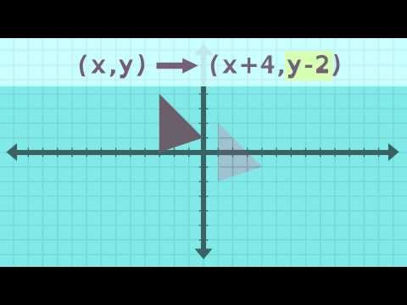
1.2 Translations

Slide 30
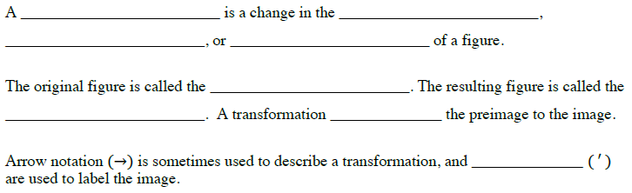
1.2 Transformations
1.2 Translations
What are we learning today?
MGSE9 – 12.G.CO.4 - Experiment with transformations in the plane
What am I going to do?
Transformations in the Coordinate Plane
How will I show you I learned it?
Daily Exit Tickets
What’s for homework?
Booklet pg.
Daily Agenda
transformation
position
shape
size
pre-image
image
maps
primes

Slide 31
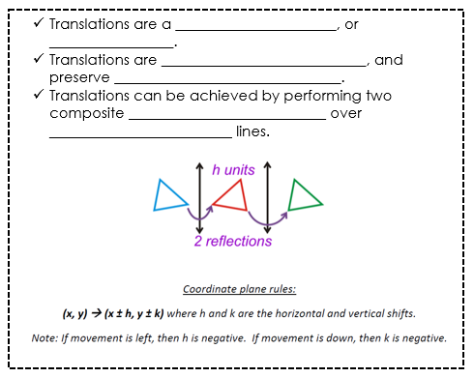
1.2 Transformations
1.2 Translations
What are we learning today?
MGSE9 – 12.G.CO.4 - Experiment with transformations in the plane
What am I going to do?
Transformations in the Coordinate Plane
How will I show you I learned it?
Daily Exit Tickets
What’s for homework?
Booklet pg.
Daily Agenda
slide
shift
isometric
orientation
reflections
parallel

Slide 32
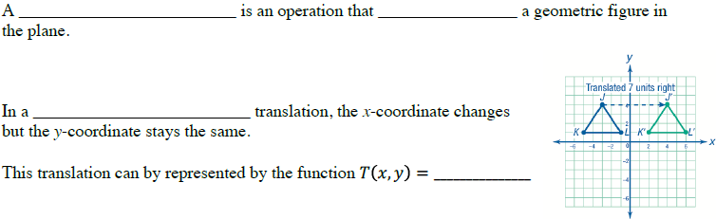
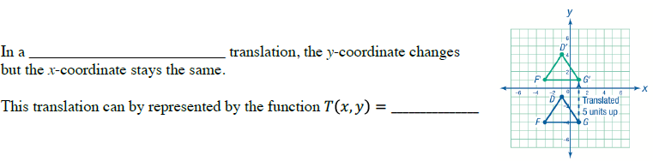


1.2 Translations
What are we learning today?
MGSE9 – 12.G.CO.4 - Experiment with transformations in the plane
What am I going to do?
Transformations in the Coordinate Plane
How will I show you I learned it?
Daily Exit Tickets
What’s for homework?
Booklet pg. 4
Daily Agenda
translation
slides
horizontal
$$(x+a, y)$$
vertical
$$(x, y + b)$$

Slide 33
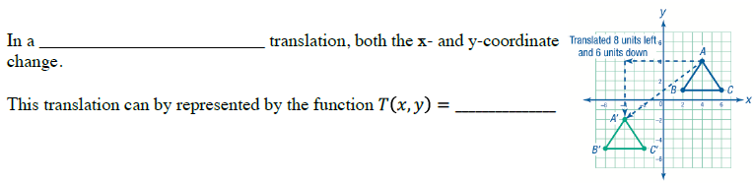

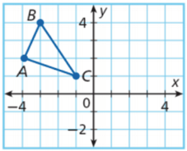





1.2 Translations
What are we learning today?
MGSE9 – 12.G.CO.4 - Experiment with transformations in the plane
What am I going to do?
Transformations in the Coordinate Plane
How will I show you I learned it?
Daily Exit Tickets
What’s for homework?
Booklet pg. 4
Daily Agenda
slant
$$(x+a, y+b)$$
$$B’$$
$$A’\left(−2, 1\right)$$
$$B’\left(−1, 3\right)$$
$$C’(1, 0)$$
$$A’$$
$$C’$$

Slide 34
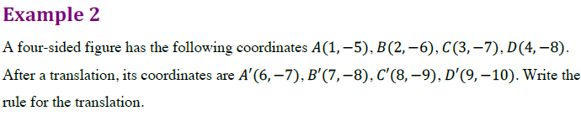

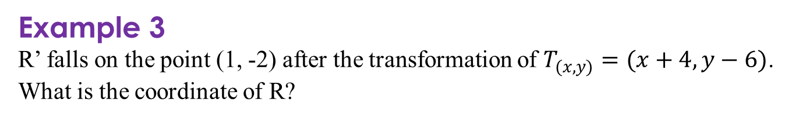
1.2 Translations
What are we learning today?
MGSE9 – 12.G.CO.4 - Experiment with transformations in the plane
What am I going to do?
Transformations in the Coordinate Plane
How will I show you I learned it?
Daily Exit Tickets
What’s for homework?
Booklet pg. 4
Daily Agenda
$$T(x, y) = (x+5, y−2)$$
Example 3
R’ falls on the point (1, -2) after the transformation of $T_{(x, y)}=(x+4, y−6)$. What is the coordinate of R?
(-3, 4)

Slide 35
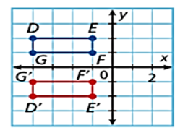
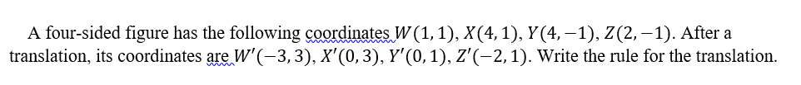
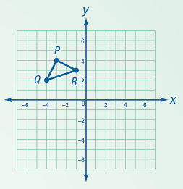
Daily Exit Ticket Working independently complete the problems and hand in before the end of class.
1.
2.
3.

Slide 36
Enrichment
Translation Worksheet
Create a polygon with at least 7 vertices on your graph paper.
Record your vertices on the worksheet.
Perform each translation using the given color on your graph paper. Record each new point on your worksheet.

Slide 37
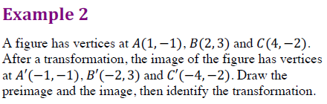
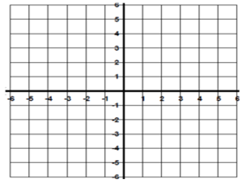




1.3 Warm-Up
What are we learning today?
MGSE9 – 12.G.CO.4 - Experiment with transformations in the plane
What am I going to do?
Transformations in the Coordinate Plane
How will I show you I learned it?
Daily Exit Tickets
What’s for homework?
Booklet pg. 3
Daily Agenda
B$′$
B
Reflection across the y-axis
$$A′$$
$$A$$
C$′$
C

Slide 38
Unit 1: Transformations in the Coordinate Plane
1.3 Reflections

Slide 39
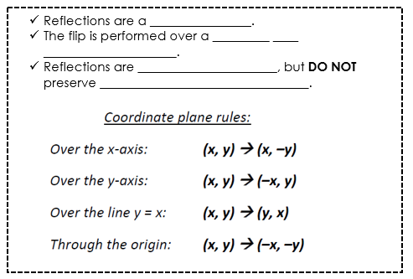
1.3 Reflections
What are we learning today?
MGSE9 – 12.G.CO.4 - Experiment with transformations in the plane
What am I going to do?
Transformations in the Coordinate Plane
How will I show you I learned it?
Daily Exit Tickets
What’s for homework?
Booklet pg. 5
Daily Agenda
A reflection is a transformation that flips a figure across a line called a ______ ____ ____________.
line of reflection
flip
line of
reflection
isometric
orientation

Slide 40
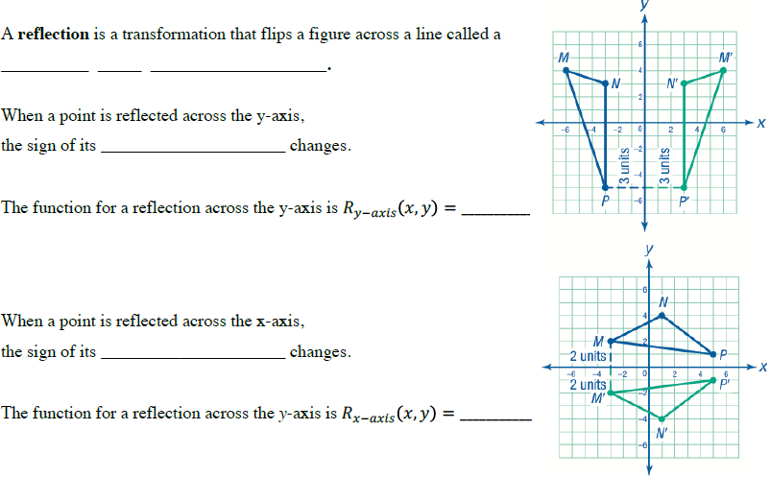


1.3 Reflections
What are we learning today?
MGSE9 – 12.G.CO.4 - Experiment with transformations in the plane
What am I going to do?
Transformations in the Coordinate Plane
How will I show you I learned it?
Daily Exit Tickets
What’s for homework?
Booklet pg. 5
Daily Agenda
x-coordinate
$$(−x, y)$$
y-coordinate
$$(x, −y)$$

Slide 41
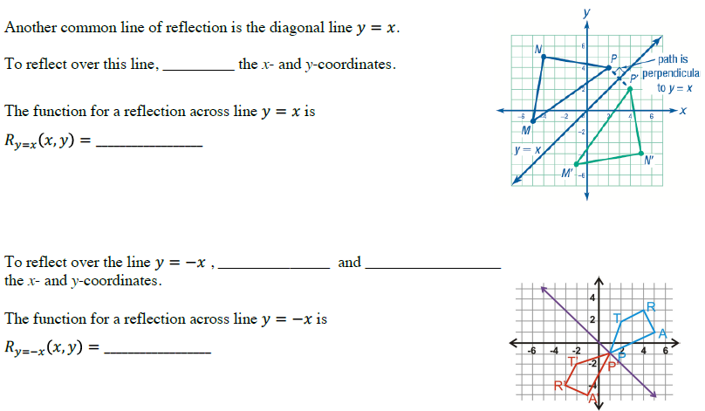


1.3 Reflections
What are we learning today?
MGSE9 – 12.G.CO.4 - Experiment with transformations in the plane
What am I going to do?
Transformations in the Coordinate Plane
How will I show you I learned it?
Daily Exit Tickets
What’s for homework?
Booklet pg. 5
Daily Agenda
swap
$$(y, x)$$
swap
opposite sign
$$(−y, −x)$$

Slide 42
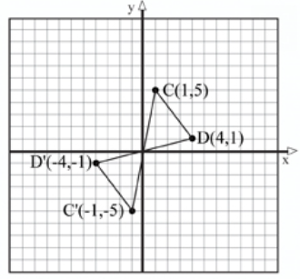

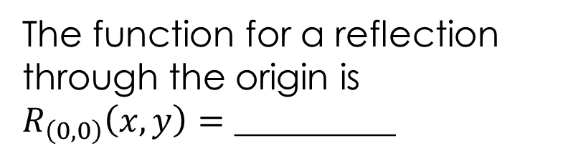
1.3 Reflections
What are we learning today?
MGSE9 – 12.G.CO.4 - Experiment with transformations in the plane
What am I going to do?
Transformations in the Coordinate Plane
How will I show you I learned it?
Daily Exit Tickets
What’s for homework?
Booklet pg. 5
Daily Agenda
To reflect through the origin, the sign of the x and y coordinates _________.
change
The function for a reflection through the origin is $R_{\left(0, 0\right)}\left(x,y\right)=$ _________
$$(−x, −y)$$

Slide 43

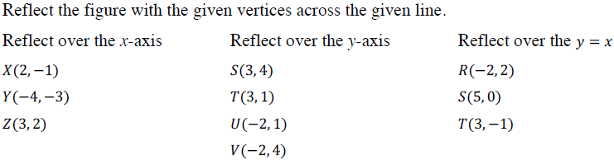
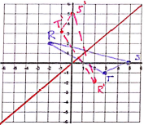
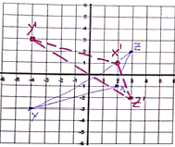
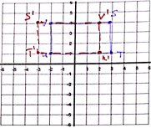



1.3 Reflections
What are we learning today?
MGSE9 – 12.G.CO.4 - Experiment with transformations in the plane
What am I going to do?
Transformations in the Coordinate Plane
How will I show you I learned it?
Daily Exit Tickets
What’s for homework?
Booklet pg. 5
Daily Agenda
$$X’\left(2,1\right)$$
$$Y^{′}\left(−4, 3\right)$$
$$Z’\left(3,−2\right)$$
$$S’\left(−3,4\right)$$
$$T^{′}\left(−3,1\right)$$
$$U’\left(2,1\right)$$
$$V’(2,4)$$
$$R’\left(2,−2\right)$$
$$S^{′}\left(0,5\right)$$
$$T’\left(−1,3\right)$$

Slide 44


1.3 Reflections
What are we learning today?
MGSE9 – 12.G.CO.4 - Experiment with transformations in the plane
What am I going to do?
Transformations in the Coordinate Plane
How will I show you I learned it?
Daily Exit Tickets
What’s for homework?
Booklet pg. 5
Daily Agenda
multiply
x
y
(2a – x, y)
x
multiply
y
(x, 2b – y)

Slide 45








1.3 Reflections
What are we learning today?
MGSE9 – 12.G.CO.4 - Experiment with transformations in the plane
What am I going to do?
Transformations in the Coordinate Plane
How will I show you I learned it?
Daily Exit Tickets
What’s for homework?
Booklet pg. 5
Daily Agenda
$$A’\left(−1,−3\right)$$
$$B^{′}\left(−5,−3\right)$$
$$C’\left(−4,−4\right)$$
$$D’(−2,−4)$$
$$P’\left(0,2\right)$$
$$Q^{′}\left(1,0\right)$$
$$R’\left(−1,−5\right)$$
$$D’\left(−1,−1\right)$$
$$E^{′}\left(−2,−3\right)$$
$$F’\left(−4,−2\right)$$

Slide 46
Classwork Working independently or with one other person, complete the problems and hand in before the end of class.
Reflect the figure with the given vertices across the given line.
1.
Reflect over the x-axis
A (1, 2)
B (3, 6)
C (5, 4)
2.
Reflect over the y-axis
D (-6, -1)
E (-2, -1)
F (-2, -4)
3.
Reflect over the y = x
G (-4, 3)
H (0, 4)
I (2, 2)
J (-1, 1)
4.
5.
Reflect over the x = 4
P (-2, -4)
Q (-1, 1)
R (2, 1)
S (-2, 4)
Reflect over the y = 3
K (-6, -1)
L (-6, 1)
M (-2, 1)
N (-2, -1)
O (-3, -3)

Slide 47
Unit 1: Transformations in the Coordinate Plane
1.4 Rotations

Slide 48


Slide 49


1.4 Rotations
What are we learning today?
MGSE9 – 12.G.CO.4 - Experiment with transformations in the plane
What am I going to do?
Transformations in the Coordinate Plane
How will I show you I learned it?
Daily Exit Tickets
What’s for homework?
Booklet pg. 6
Daily Agenda
center of rotation
Counter-clockwise
clockwise

Slide 50




1.4 Rotations
What are we learning today?
MGSE9 – 12.G.CO.4 - Experiment with transformations in the plane
What am I going to do?
Transformations in the Coordinate Plane
How will I show you I learned it?
Daily Exit Tickets
What’s for homework?
Booklet pg. 6
Daily Agenda
270˚ CW
$$(−y, x)$$
180˚ CW
$$(−x, −y)$$
90˚ CW
$$(y, −x)$$

Slide 51




1.4 Rotations
What are we learning today?
MGSE9 – 12.G.CO.4 - Experiment with transformations in the plane
What am I going to do?
Transformations in the Coordinate Plane
How will I show you I learned it?
Daily Exit Tickets
What’s for homework?
Booklet pg. 6
Daily Agenda
Example 1

Slide 52

1.4 Rotations
What are we learning today?
MGSE9 – 12.G.CO.4 - Experiment with transformations in the plane
What am I going to do?
Transformations in the Coordinate Plane
How will I show you I learned it?
Daily Exit Tickets
What’s for homework?
Booklet pg. 6
Daily Agenda
Example 2
Triangle GHJ is graphed on the coordinate plane. Draw the image of this triangle after counterclockwise rotations of $90°$, $180°$, and $270°$ about the origin.
90º CCW
180º CCW
270º CCW

Slide 53


Classwork Working independently or with one other person, complete the problems and hand in before the end of class.
6.
Triangle KLM is graphed on the coordinate plane. Draw the image of this triangle after counterclockwise rotations of $90°$, $180°$, and $270°$ about the origin.

Slide 54
Unit 1: Transformations in the Coordinate Plane
1.5 Symmetry

Slide 55



1.5 Symmetry
What are we learning today?
MGSE9 – 12.G.CO.3 - Experiment with transformations in the plane
What am I going to do?
Transformations in the Coordinate Plane
How will I show you I learned it?
Daily Exit Tickets
What’s for homework?
Booklet pg. 7
Daily Agenda
regular polygon
lines of symmetry
congruent
pre-image
line symmetry
reflection
symmetry

Slide 56

1.5 Symmetry
What are we learning today?
MGSE9 – 12.G.CO.3 - Experiment with transformations in the plane
What am I going to do?
Transformations in the Coordinate Plane
How will I show you I learned it?
Daily Exit Tickets
What’s for homework?
Booklet pg. 7
Daily Agenda
8
1

Slide 57

1.5 Symmetry
What are we learning today?
MGSE9 – 12.G.CO.3 - Experiment with transformations in the plane
What am I going to do?
Transformations in the Coordinate Plane
How will I show you I learned it?
Daily Exit Tickets
What’s for homework?
Booklet pg. 7
Daily Agenda
A figure that has ______________ ______________ will map onto itself more than once during a 360⁰ turn. To find the rotational symmetry, divide ______ by the number of sides.
rotational symmetry
360˚

Slide 58



1.5 Symmetry
What are we learning today?
MGSE9 – 12.G.CO.3 - Experiment with transformations in the plane
What am I going to do?
Transformations in the Coordinate Plane
How will I show you I learned it?
Daily Exit Tickets
What’s for homework?
Booklet pg. 7
Daily Agenda
$$360°÷4=90°$$
$$360°÷6=60°$$
90˚, 180˚, 270˚
60˚, 120˚, 180˚, 240˚, 300˚

Slide 59



1.5 Symmetry
What are we learning today?
MGSE9 – 12.G.CO.3 - Experiment with transformations in the plane
What am I going to do?
Transformations in the Coordinate Plane
How will I show you I learned it?
Daily Exit Tickets
What’s for homework?
Booklet pg. 7
Daily Agenda
Line Symmetry – yes, 4
$x=1, y=1$, and 2 diagonal lines through the sides
Line of Symmetry – yes, 6
$x−axis, y−axis$, 4 diagonal lines
Rotational Symmetry – yes, center of rotation @ (1,1)
90˚, 180˚, 270˚
Rotational Symmetry – yes, center of rotation @ (0,0)
60˚, 120,180˚,240˚,300˚

Slide 60




Classwork Working independently or with one other person, complete the problems and hand in before the end of class.
1.
2.
Determine whether the figure has rotational symmetry. If so, describe the rotation that maps the figure onto itself.
3.
4.

Slide 61
Unit 1: Transformations in the Coordinate Plane
1.6 Sequence of Transformations

Slide 62

1.6 Sequence of Transformations
What are we learning today?
MGSE9 – 12.G.CO.3 - Experiment with transformations in the plane
What am I going to do?
Transformations in the Coordinate Plane
How will I show you I learned it?
Daily Exit Tickets
What’s for homework?
Booklet pg. 8
Daily Agenda
image
pre-image
rotation
reflection
composition of transformations
glide
reflection

Slide 63

1.6 Sequence of Transformations
What are we learning today?
MGSE9 – 12.G.CO.3 - Experiment with transformations in the plane
What am I going to do?
Transformations in the Coordinate Plane
How will I show you I learned it?
Daily Exit Tickets
What’s for homework?
Booklet pg. 8
Daily Agenda
A ________ ____________ is the composition of a translation and a reflection across a line parallel to the vector of translation.
glide
reflection

Slide 64


1.6 Sequence of Transformations
What are we learning today?
MGSE9 – 12.G.CO.3 - Experiment with transformations in the plane
What am I going to do?
Transformations in the Coordinate Plane
How will I show you I learned it?
Daily Exit Tickets
What’s for homework?
Booklet pg. 8
Daily Agenda

Slide 65

1.6 Sequence of Transformations
What are we learning today?
MGSE9 – 12.G.CO.3 - Experiment with transformations in the plane
What am I going to do?
Transformations in the Coordinate Plane
How will I show you I learned it?
Daily Exit Tickets
What’s for homework?
Booklet pg. 8
Daily Agenda

Slide 66



1.6 Sequences of Transformations
What are we learning today?
MGSE9 – 12.G.CO.3 - Experiment with transformations in the plane
What am I going to do?
Transformations in the Coordinate Plane
How will I show you I learned it?
Daily Exit Tickets
What’s for homework?
Booklet pg. 8
Daily Agenda
Sequence 1: $T\left(x,y\right)=(x+5,y−4)$
Sequence 2: $R_{x−axis}$

Slide 67

1.6 Sequences of Transformations
What are we learning today?
MGSE9 – 12.G.CO.3 - Experiment with transformations in the plane
What am I going to do?
Transformations in the Coordinate Plane
How will I show you I learned it?
Daily Exit Tickets
What’s for homework?
Booklet pg. 8
Daily Agenda
Identify a composition of transformations that will map each pre-image onto its final image. Use correct transformation notation.

Slide 68

1.6 Sequences of Transformations
What are we learning today?
MGSE9 – 12.G.CO.3 - Experiment with transformations in the plane
What am I going to do?
Transformations in the Coordinate Plane
How will I show you I learned it?
Daily Exit Tickets
What’s for homework?
Booklet pg. 8
Daily Agenda

Slide 69

Whiteboard Practice #1
A (3, 2)
B (-4, 5)
C (-4, 2)

Slide 70

Whiteboard Practice #2
W (-2, 6)
X (-3, 6)
Y (-3, 2)
Z (-2, 2)

Slide 71

Whiteboard Practice #3
M (-2, 3)
N (-3, -3)

Slide 72
Whiteboard Practice #4
R (5, 4)
S (7, 4)
T (4, -3)
U (6, -3)
Step 1: Translate 3 units down.
Step 2: Reflect over the line y = x.

Slide 73


Whiteboard Practice #5
Step 1: Reflect over the x-axis.
Step 2: Reflect over the line $x=−3$

