Slide 1
EOC/Final Exam Review
Unit 1: Transformations in the Coordinate Plane

Slide 2
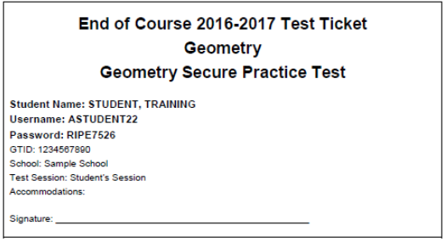
http://www.gaexperienceonline.com/

Slide 3
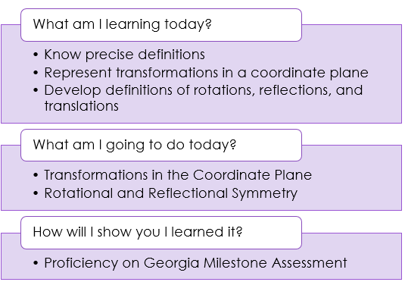
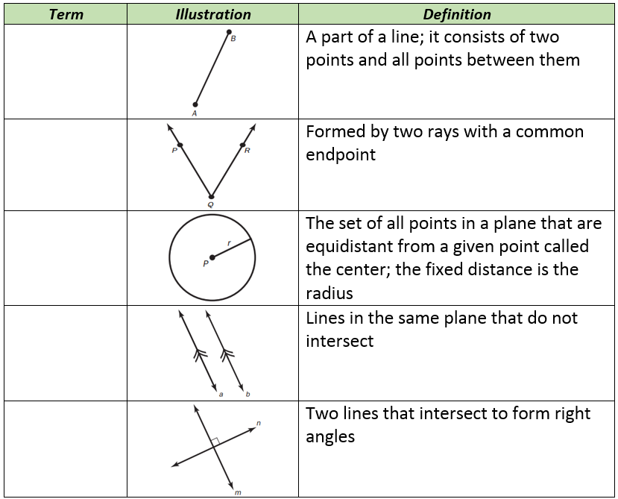
Line Segment
Angle
Circle
Parallel Lines
Perpendicular Lines

Slide 4
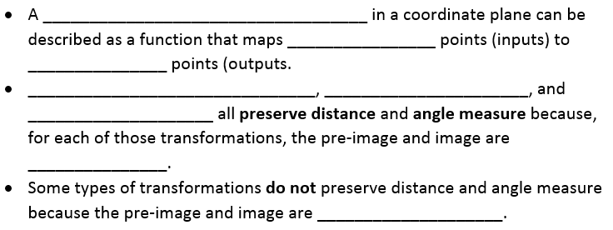
Transformation
Pre-image
image
Translations
Reflections
Rotations
congruent
Not congruent

Slide 6
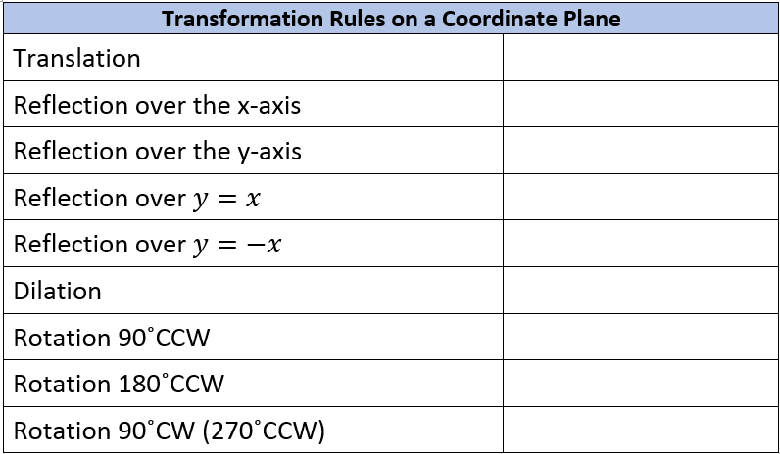
$$T=(x+a, y+b)$$
$$r_{x−axis}=(x, −y)$$
$$r_{y−axis}=(−x, y)$$
$$r_{y=x}=(y, x)$$
$$r_{y=−x}=(−y, −x)$$
$$D=(kx, ky)$$
$$R_{90CCW}=(−y, x)$$
$$R_{180}=(−x, −y)$$
$$R_{90CW}=(y, −x)$$

Slide 7
EOC/Final Exam Review
Unit 2: Similarity, Congruence, and Proofs

Slide 8
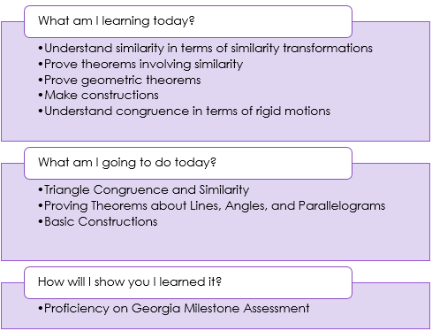
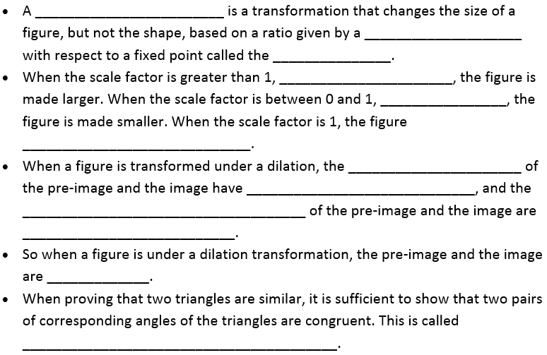
Dilation
Scale factor
center
enlargement
reduction
Does not change
Corresponding angles
Equal measures
Corresponding sides
proportional
similar
(AA) Angle-Angle Similarity

Slide 9
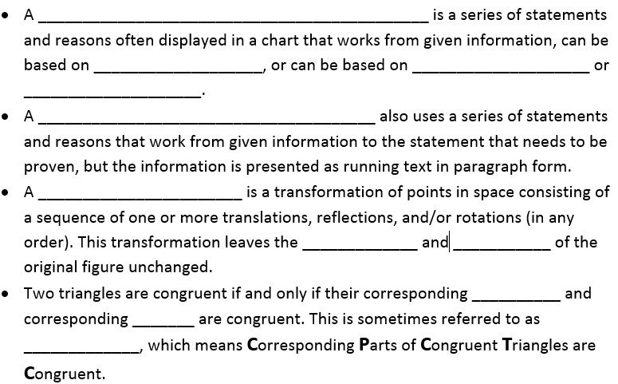
Two-column proof
definitions
postulates
theorems
Paragraph proof
Rigid Motion
shape
size
sides
angles
CPCTC

Slide 10
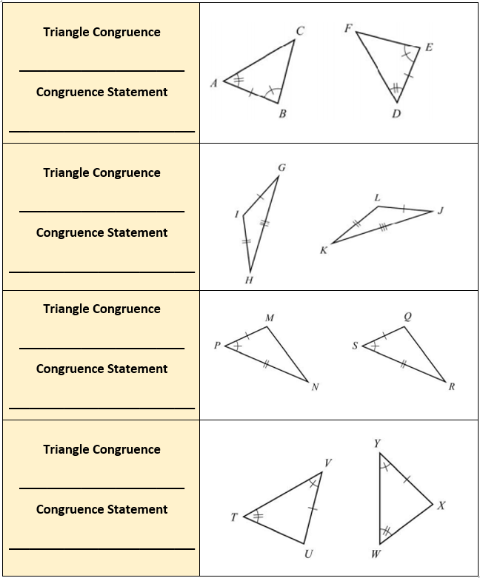
ASA (Angle-Side-Angle)
$$∆ABC≅∆DEF$$
SSS (Side-Side-Side)
$$∆GIH≅∆JLK$$
SAS (Side-Angle-Side)
$$∆MPN≅∆QSR$$
AAS (Angle-Angle-Side)
$$∆VTU≅∆YWX$$

Slide 11
Vertical Angles Theorem
Alternate Interior
Angles Theorem
Corresponding Angles
Postulate
Perpendicular
Bisector
Triangle Angle
Sum Theorem
Isosceles Triangle
Theorem
Triangle Mid-Segment
Theorem

Slide 12
Copy a Segment
Copy an Angle
Bisect an Angle

Slide 13
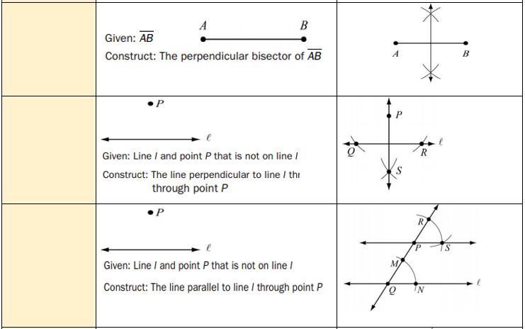
Perpendicular
Bisector
of a line Segment
Line $⊥$to a given line through a point not on a line
Line $∥$to a given line through a point not on a line

Slide 14
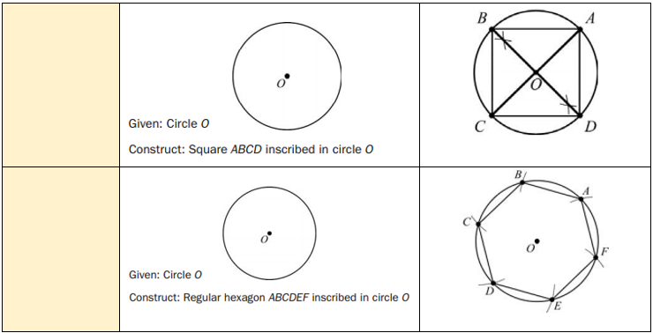
Equilateral triangle inscribed in a circle
Square inscribed in a circle
Hexagon inscribed in a circle

Slide 15
Midpoint Formula
Distance Formula
Slope Formula

Slide 16
Slope formula
Slope formula
Distance formula
Slope and distance
midpoint formula
Midpoint and distance formula
Midpoint and distance formula
Midpoint, distance, and slope

Slide 17
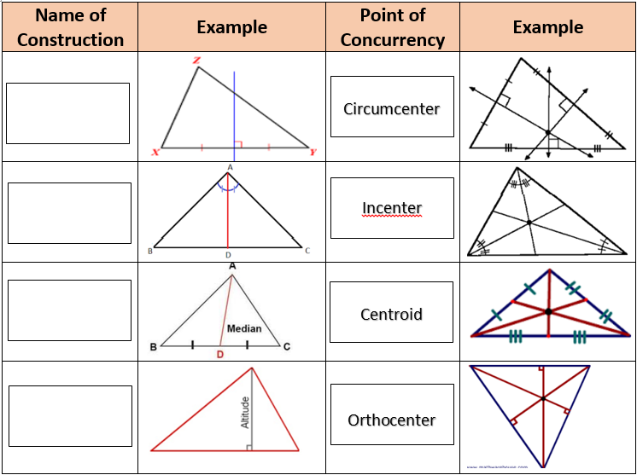
Perpendicular bisector
Angle bisector
Median
Altitude

Slide 18
EOC/Final Exam Review
Unit 3: Right Triangle Trigonometry

Slide 19
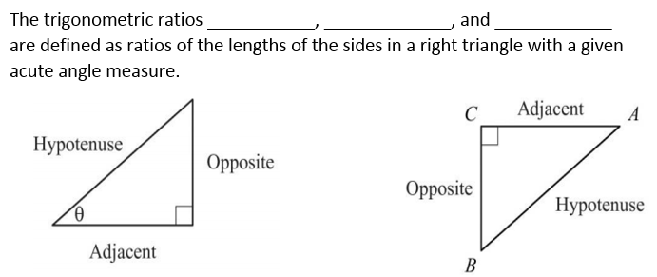
cosine
sine
tangent

Slide 20
complementary
$$\cos{Q}$$
$$\cos{P}$$
Trigonometric ratios
Pythagorean Theorem

Slide 21
EOC/Final Exam Review
Unit 4: Circles and Volume

Slide 22
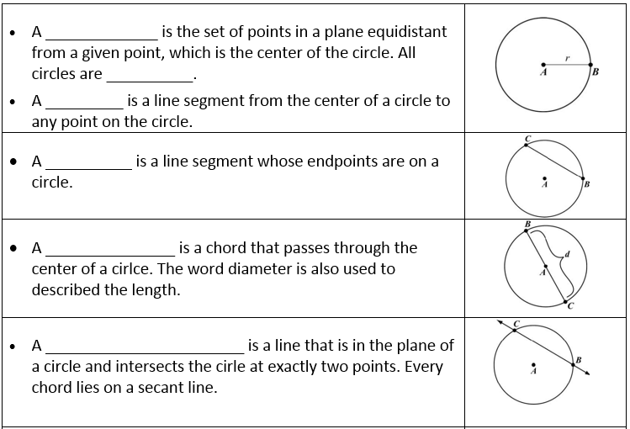
Circle
Similar
Radius
Chord
diameter
Secant Line

Slide 23
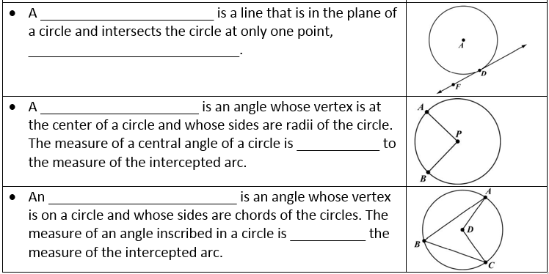
Tangent line
Point of tangency
Central angle
equal
Inscribed angle
half

Slide 24
Circumference
C=2πr
length
diameter
arc
Minor arc
Semi-circle
Major arc
perpendicular
congruent

Slide 25
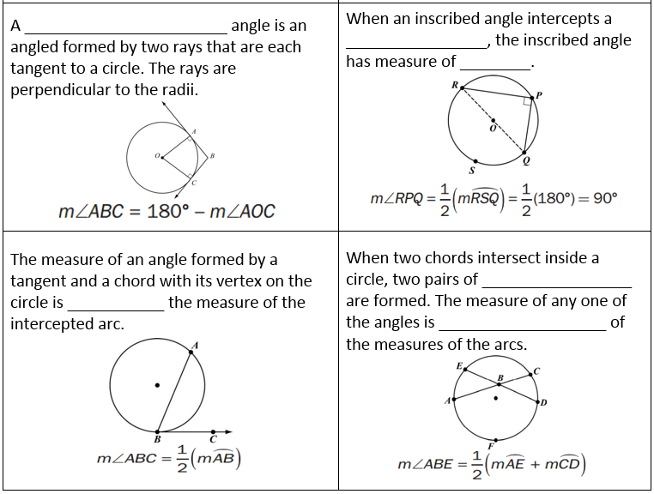
circumscribed
Semi-circle
90˚
Vertical angles
half
Half the sum

Slide 26
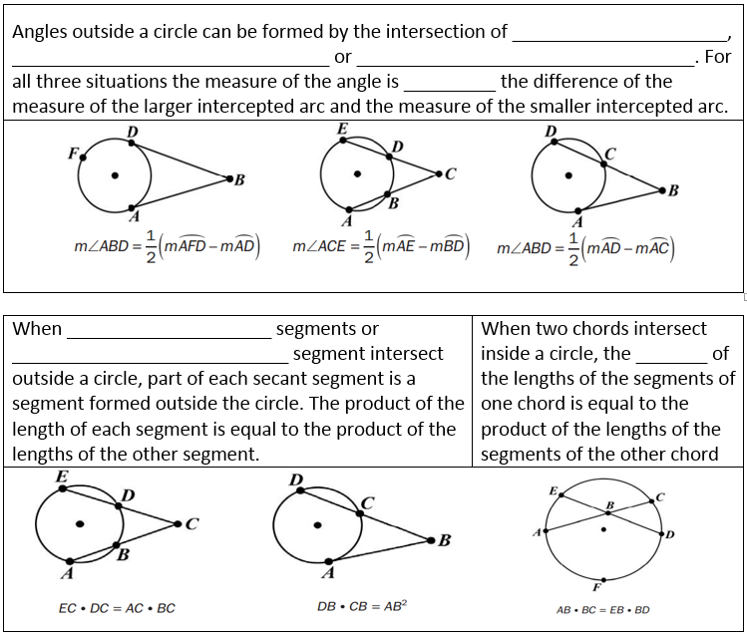
Two tangents
Two secants
Secant and a tangent
half
Two-secant
Secant-tangent
product

Slide 27
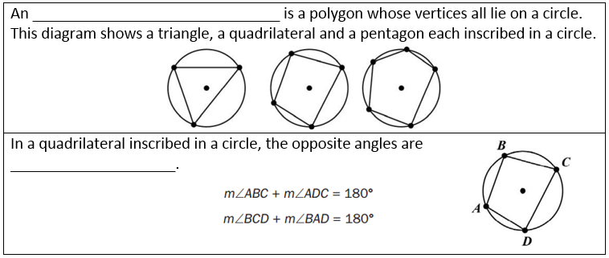
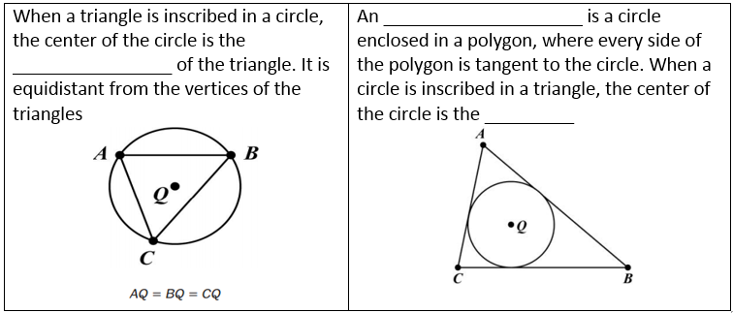
Inscribed polygon
supplementary
Inscribed circle
circumcenter
incenter

Slide 28
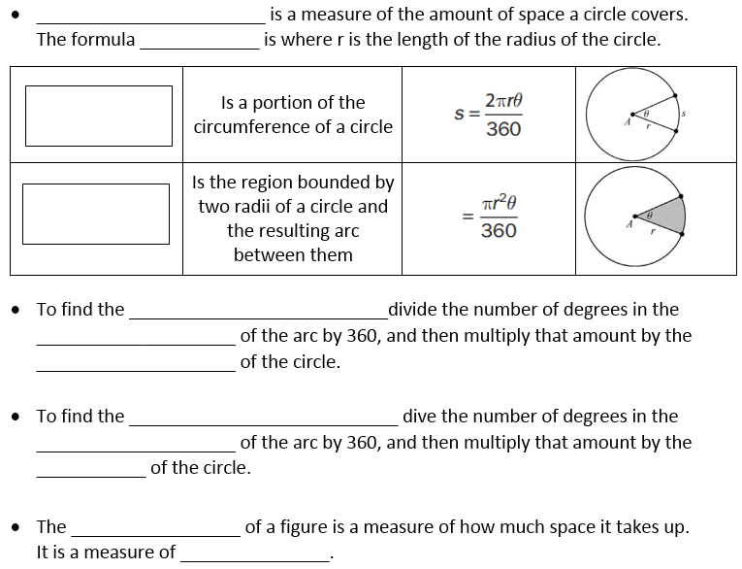
Area
A=πr²
Arc Length
Area of a Sector
Length of an arc
Central angle
circumference
Area of a sector
Central angle
area
volume
capacity

Slide 29
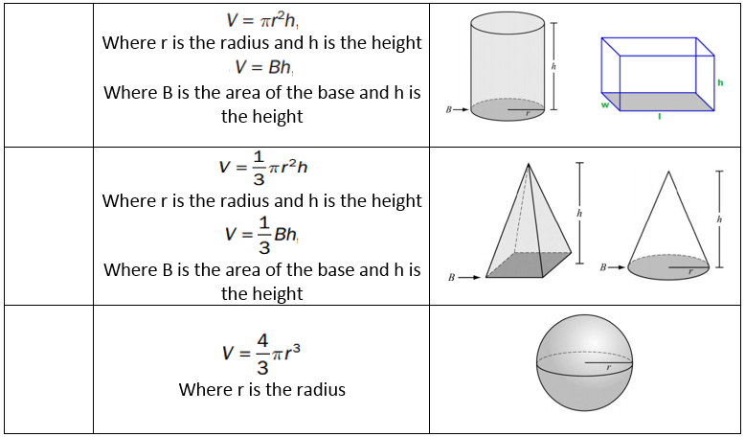
Volume of Prisms & Cylinders
Volume of Pyramid & Cones
Volume of a Sphere

Slide 30
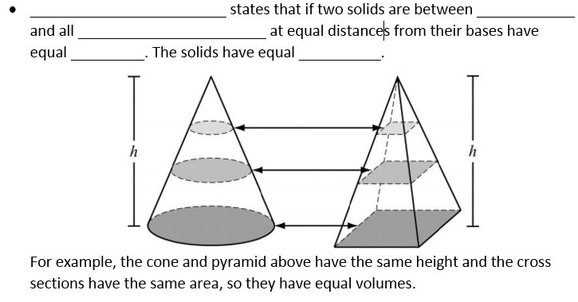
Cavalieri’s Principle
Parallel planes
Cross sections
areas
volumes

Slide 31
EOC/Final Exam Review
Unit 5: Algebraic and Geometric Connections

Slide 32
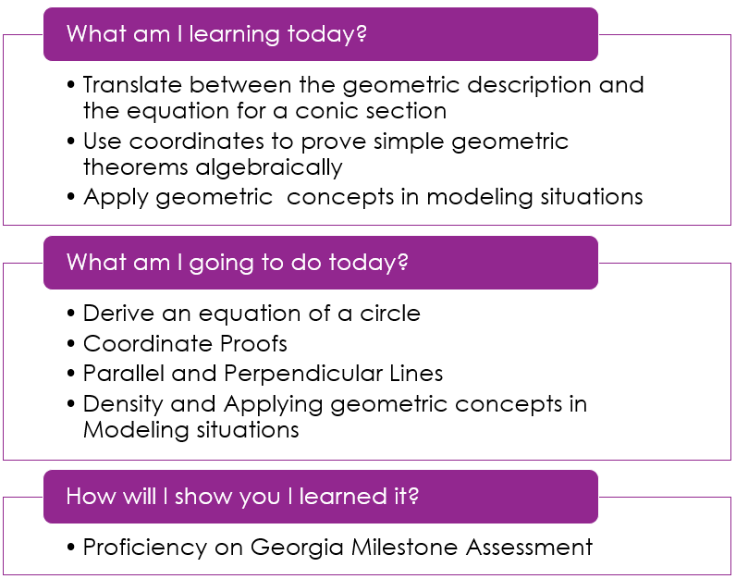
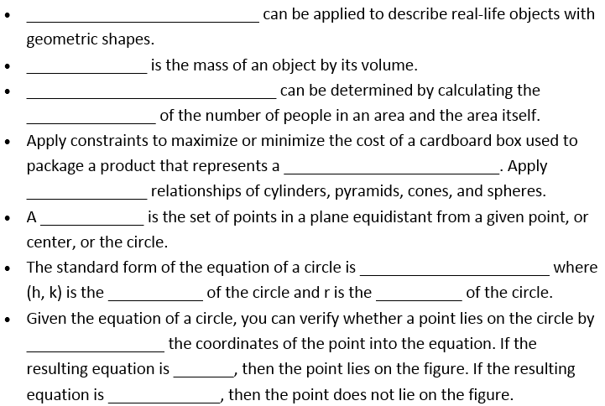
Modeling
Density
Population density
quotient
Geometric figure
volume
circle
$${(x−h)}^{2}+{(y−k)}^{2}=r^{2}$$
center
radius
substituting
true
Not true

Slide 33
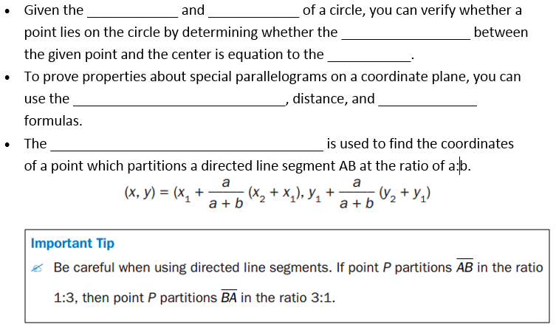
center
radius
distance
radius
Partitioning of a segment
slope
Partitioning of a segment formula

Slide 34
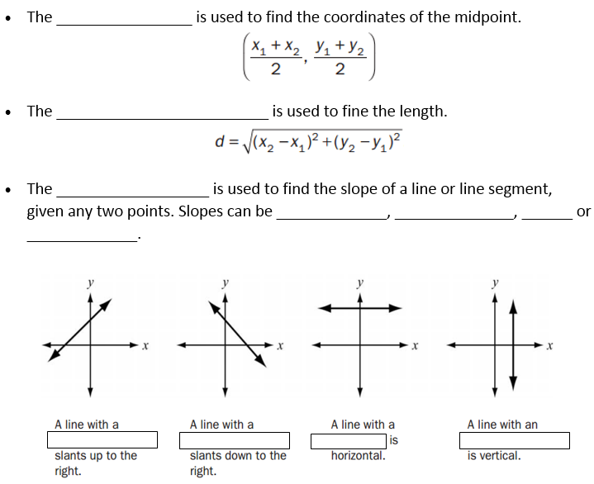
Midpoint Formula
Distance Formula
Slope Formula
positive
negative
0
undefined
positive
negative
0
undefined

Slide 35
EOC/Final Exam Review
Unit 6: Application of Probability

Slide 36
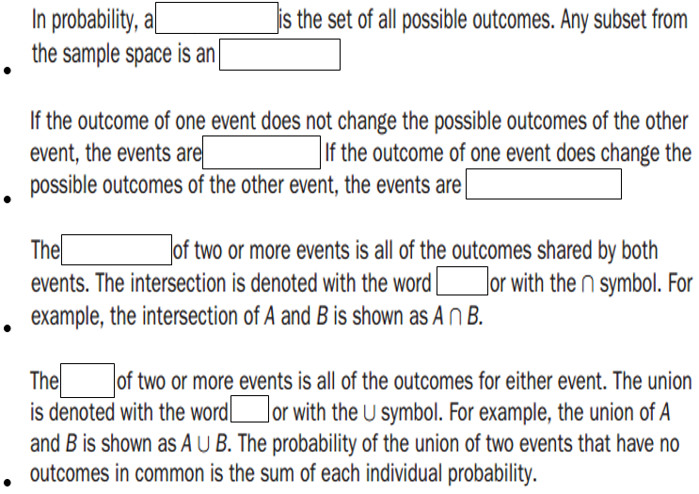
Sample space
event
independent
dependent
intersection
“and”
union
“or”

Slide 37
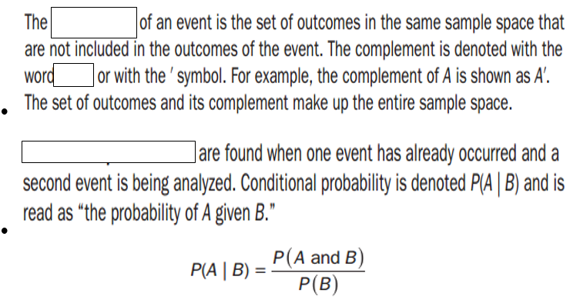
complement
“not”
Conditional Probabilities

Slide 38
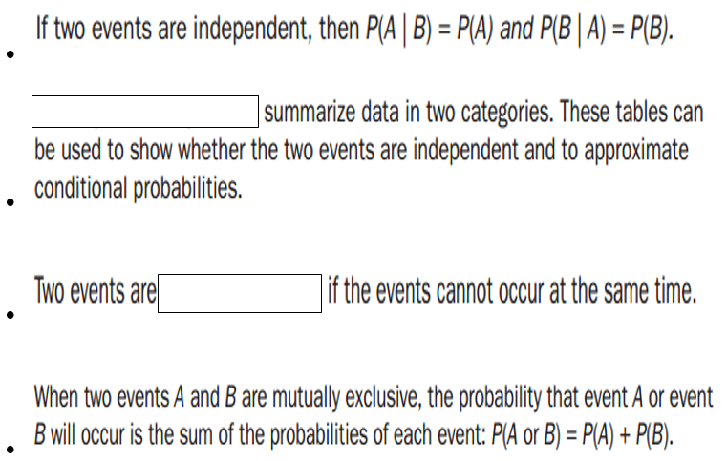
Two-Way Frequency Table
Mutually exclusive

Slide 39
